Slide 1


Slide 2

Learning Hub @ GBRI
Presents

Slide 3
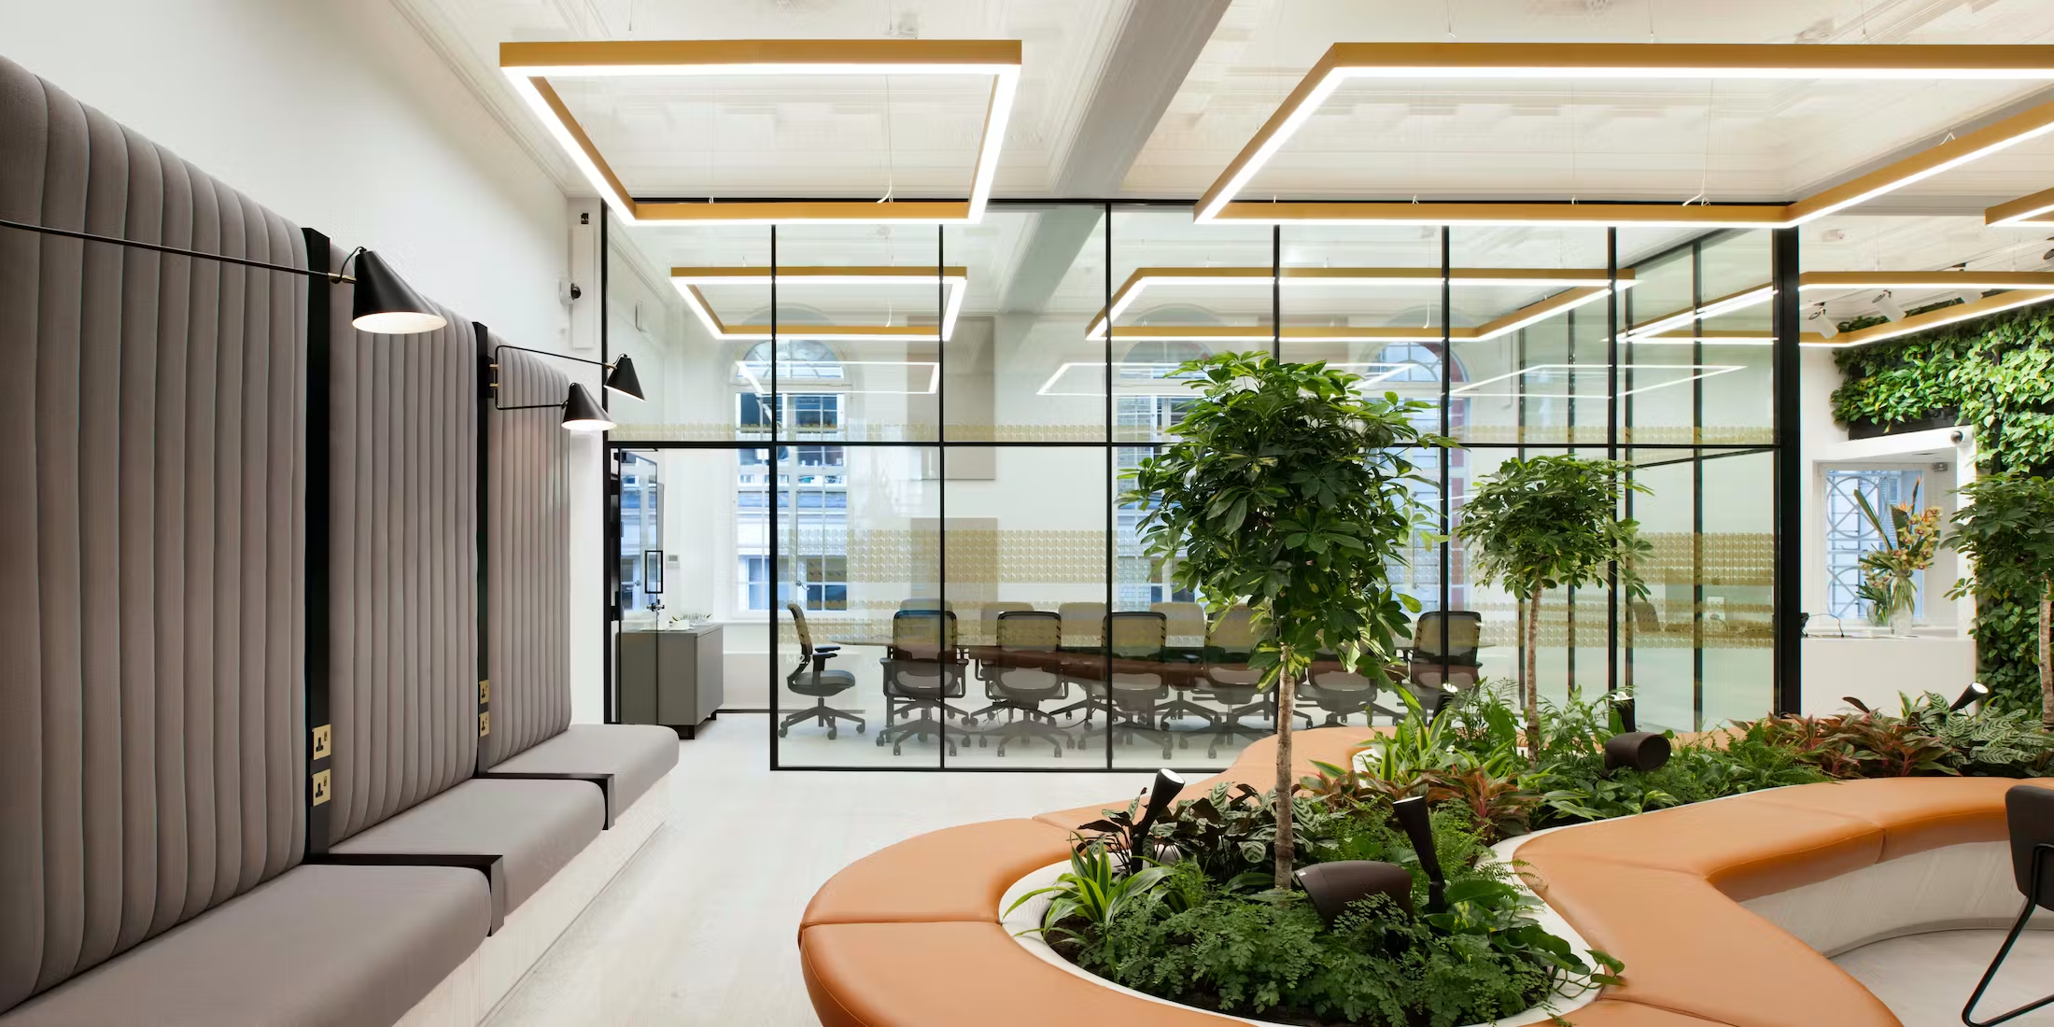

One Heddon Street
A WELL Case Study
Notes:
A Well-Being Oasis in the Heart of London: A Case Study of One Heddon Street
Hello! My name is Sally, and I am delighted to present this course series from GBRI “Healthy Buildings, Healthy Lives: WELL Case Studies“, where we look at amazing WELL building projects from around the world.
This is Case Study 1 – “A Well-Being Oasis in the Heart of London: A Case Study of One Heddon Street.”
This module can be taken stand-alone or as part of the series depending on your interest and credential maintenance requirements.

Slide 4


About GBRI
Notes:
GBRI is an online education platform that provides gamified courses on sustainability & social impact. Our mission is to make sustainability resources affordable and accessible to everyone around the world.

Slide 5
About GBRI
Notes:
GBRI, headquartered in New York City, is a recognized education partner of USGBC (U.S. Green Building Council) and an education provider for AIA (American Institute of Architects). We also collaborate with other organizations such as the UN SDGs (United Nations Sustainable Development Goals), CHPS (Collaborative for High Performance Schools), and the Rhode Island Energy Efficiency Council. Our presence extends globally, allowing us to reach a wide audience with our educational offerings.

Slide 6

Let’s join hands not only to build a greener world but also an equitable one!
Notes:
We strongly believe that a truly sustainable future should be inclusive and fair, where every individual is treated equally. Our mission is to provide accessible and affordable sustainability, health, and wellness resources to people worldwide.
At GBRI, we offer a diverse range of sustainability courses encompassing topics such as Energy, Water, LEED, Net Zero Buildings, Green Schools, Energy Modeling, Daylighting, BIM, Health, and Wellness, among others. With hundreds of courses available, our learning hub serves as a comprehensive platform to fulfill all your sustainability education needs.

Slide 7





About GBRI

Slide 8

More than 400 courses to choose from
Notes:
With more than 400 online courses and 23,000 students world-wide - GBRI is the premier sustainability education provider in the world. Since 2010, more than 100,000 students have taken GBRI courses.

Slide 9
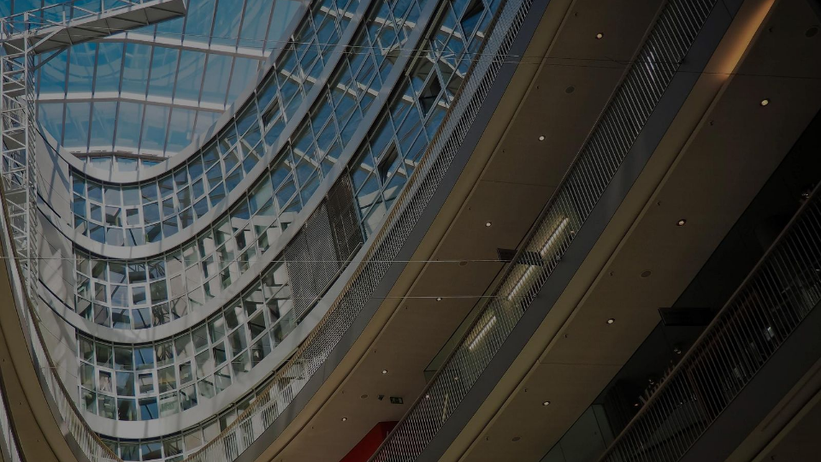

Transforming our World:
the 2030 Agenda for Sustainable Development
Notes:
GBRI is proud to be a partner of the United Nations in its 2030 Agenda, collaborating to create and promote sustainable solutions.

Slide 10


















Notes:
FREE courses and social experiments related to the 17 sustainable development goals you see listed here.
GBRI’s course – ‘Healthy Buildings, Healthy Lives: WELL Case Studies’ is aligned with Goal #3 – Good Health and Well-being, Goal #6 – Clean Water and Sanitation, and Goal #13 - Climate Action.

Slide 11






Description
Tour one of the WELL certified buildings
Learn about the WELL Building Standard and how the WELL criteria are utilized to evaluate green building projects.
Notes:
Alright, let’s get started. Welcome aboard on this journey into the heart of London, where One Heddon Street stands as an oasis of well-being amidst the bustling city life. This course is designed to navigate through this remarkable example of the WELL Building Standard's application.
As we delve deeper, we'll gain insight into the practical implementation of WELL principles and how they contribute to creating healthier, more sustainable spaces.

Slide 12
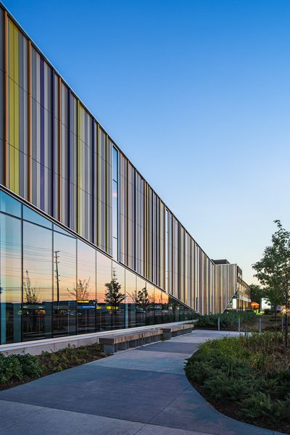

Provide a comprehensive overview of the WELL Building Standard
Detail the specific features incorporated in the latest version of the WELL Building Standard.
Highlight and explain the top three benefits of healthy buildings.
Analyze real-world project examples to demonstrate the application of the WELL Building Standard.
Identify and comprehend wellness design strategies used to achieve sustainability goals within the context of the WELL Building Standard.
Objectives
Notes:
Listed here are the course objectives. We will start with a comprehensive overview of the WELL Building Standard, including its origins and development. We will detail the specific features incorporated in the latest version of the WELL Building Standard, and highlight and explain the top three benefits of healthy buildings.
Using One Heddon Street as our focal point, we will analyze real-world project examples to demonstrate the application of the WELL Building Standard. We will identify and comprehend wellness design strategies used to achieve sustainability goals within the context of the WELL Building Standard.

Slide 13

“We shape our buildings, and afterwards our buildings shape us.”
Winston Churchill
Notes:
I love this quote from Winston Churchill-
“We shape our buildings, and afterwards our buildings shape us.”
Considering we spend 90% of our time indoors, buildings are an inseparable part of our lives. We sleep, rest and bond with our family in homes. We study in school buildings, work in office spaces and meet our friends in a park or restaurant for dinner…buildings are everywhere, and we cannot ignore them, and to a very good degree they shape who we are.

Slide 14

WELL Building Standard
Notes:
So, let’s see, when and where did the WELL Rating System start?
In 2014, IWBI which stands for International WELL Building Institute, launched the WELL Building Standard after a six-year, expert peer review process that spanned three feedback phases featuring scientists, practitioners and medical professionals from around the world.

Slide 15

Copyright© 2020 by International WELL Building Institute PBC. All rights reserved.
Notes:
The mission behind WELL is universal: Advance health in the places where we spend our lives.

Slide 16
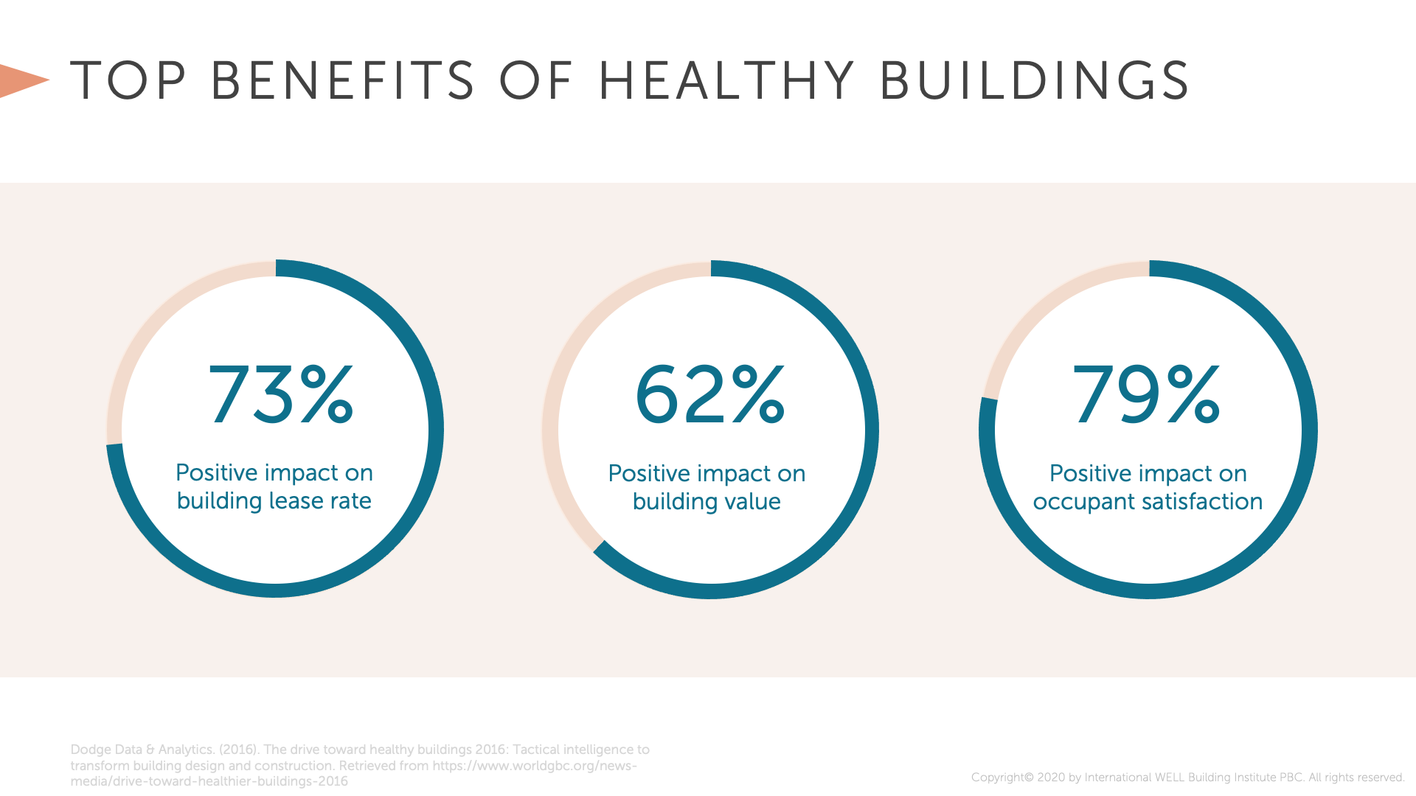
Notes:
According to the Dodge Smart Market Report, the top Benefits of Healthier Building Investments according to building owners are
73% positive impact on building lease rate
62% positive impact on building value
79% positive impact on occupant satisfaction

Slide 17
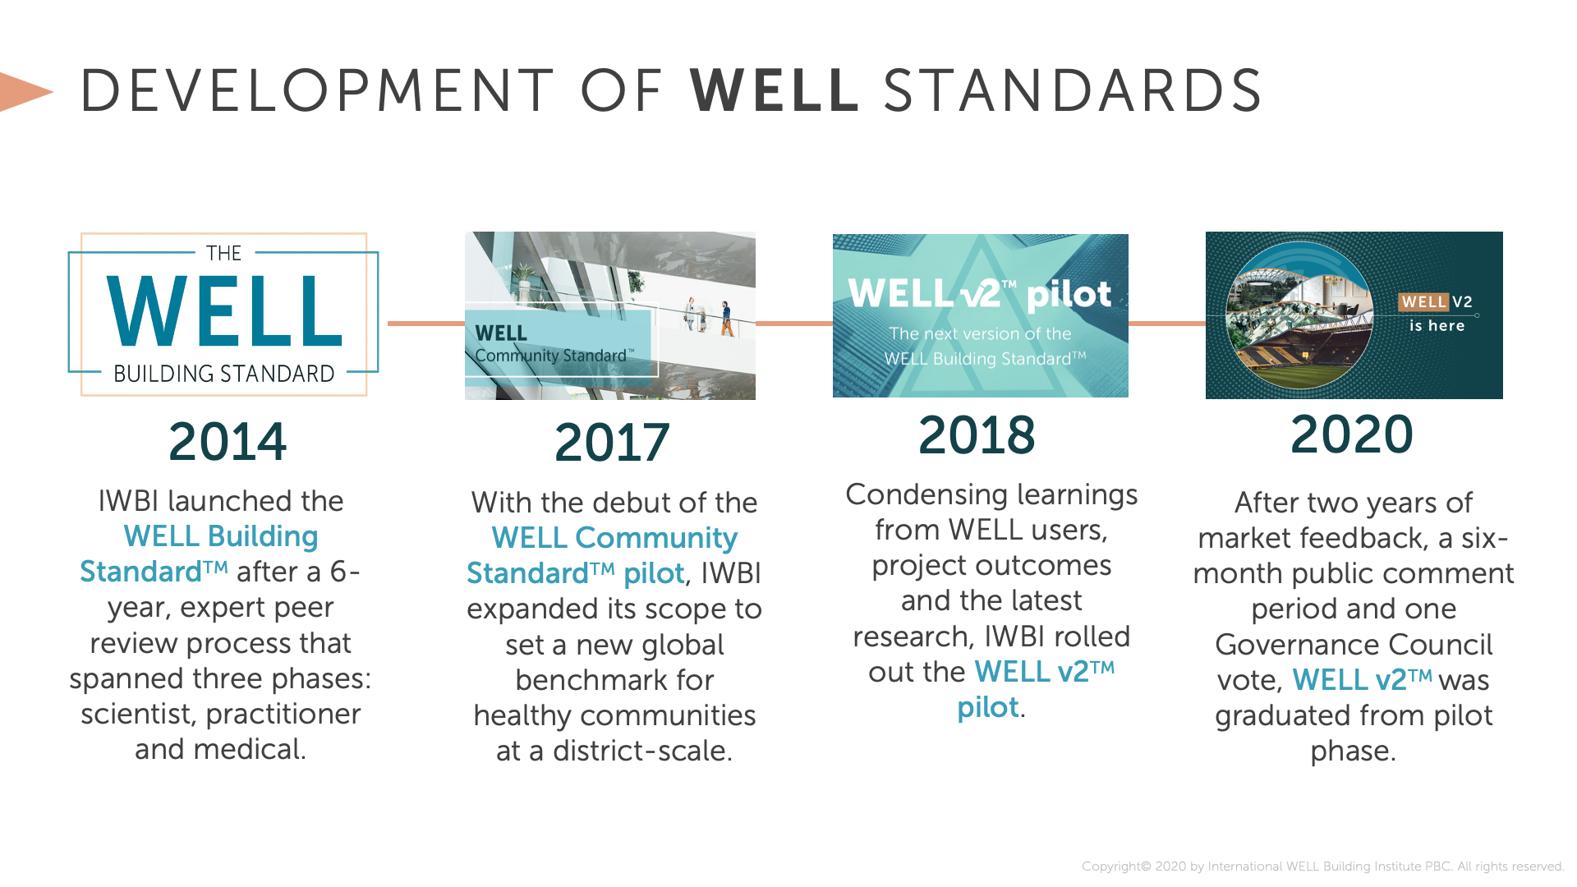
Notes:
The WELL Building Standard is a performance-based system for measuring, certifying, and monitoring features of the built environment that impact human health and well-being. It is administered by the International WELL Building Institute (IWBI). The standard has evolved over time, with two significant versions: WELL v1 and WELL v2.
WELL v1: The first version of the WELL Building Standard, WELL v1, was introduced in 2014. It focused on seven core concepts, known as "Concepts," which were further divided into a total of 105 features. The seven Concepts were Air, Water, Nourishment, Light, Fitness, Comfort, and Mind.
WELL v2: WELL v2, introduced in 2018, represented a significant evolution of the WELL Building Standard. It was designed to be more flexible, inclusive, and accessible, aiming to better address the diverse needs of various building types and global regions. Instead of the previous seven Concepts, WELL v2 introduced ten broader concepts.

Slide 18
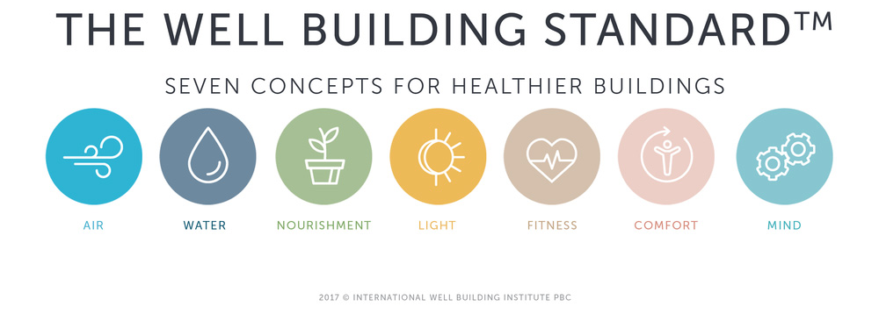
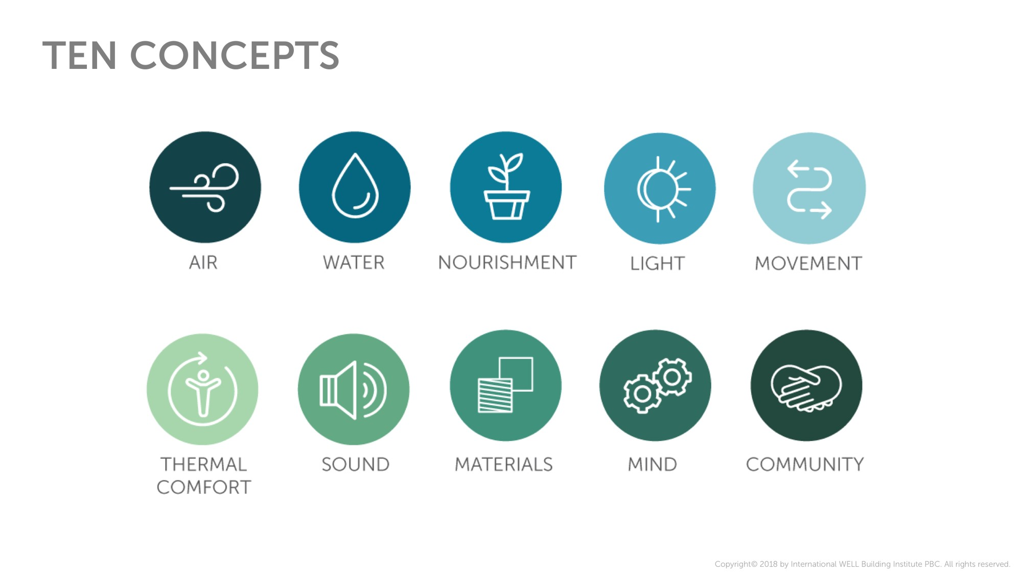
v1
v2
Notes:
Listed here are the concepts on which the WELL Building Standard is focused on.
WELL v1 comprises of seven concepts namely; Air, Water, Nourishment, Light, Fitness, Comfort and Mind.
WELL v2 comprises of ten concepts namely; Air, Water, Nourishment, Light, Movement, Thermal Comfort, Sound, Materials, Mind and Community.

Slide 19
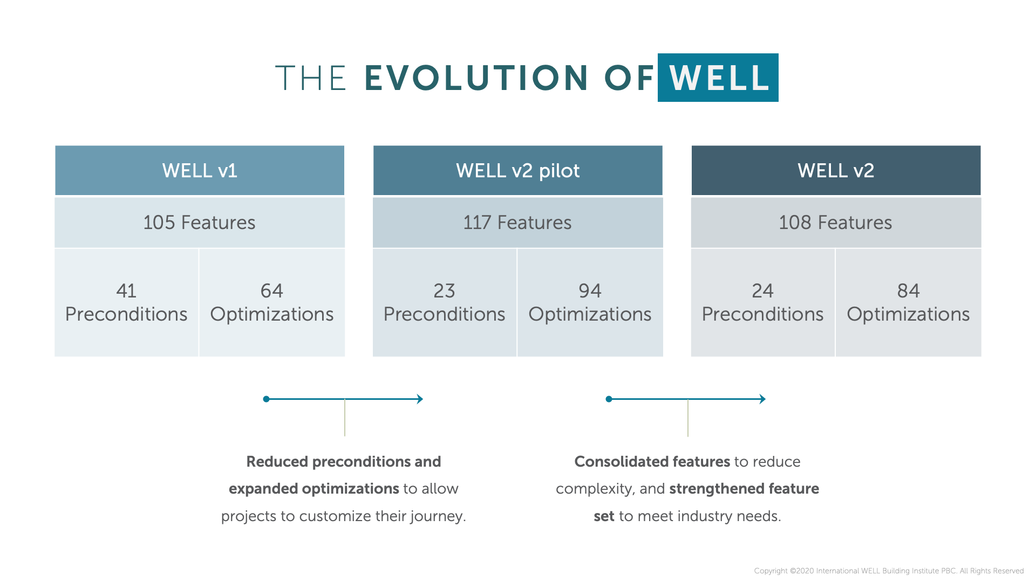
Notes:
Each Concept consists of features that address specific aspects of human health and well-being. Unlike WELL v1, which followed a prescriptive approach, WELL v2 adopted a more performance-based structure.
In the WELL v2, preconditions are reduced, and the optimizations are expanded to allow projects to customize their WELL journey.

Slide 20
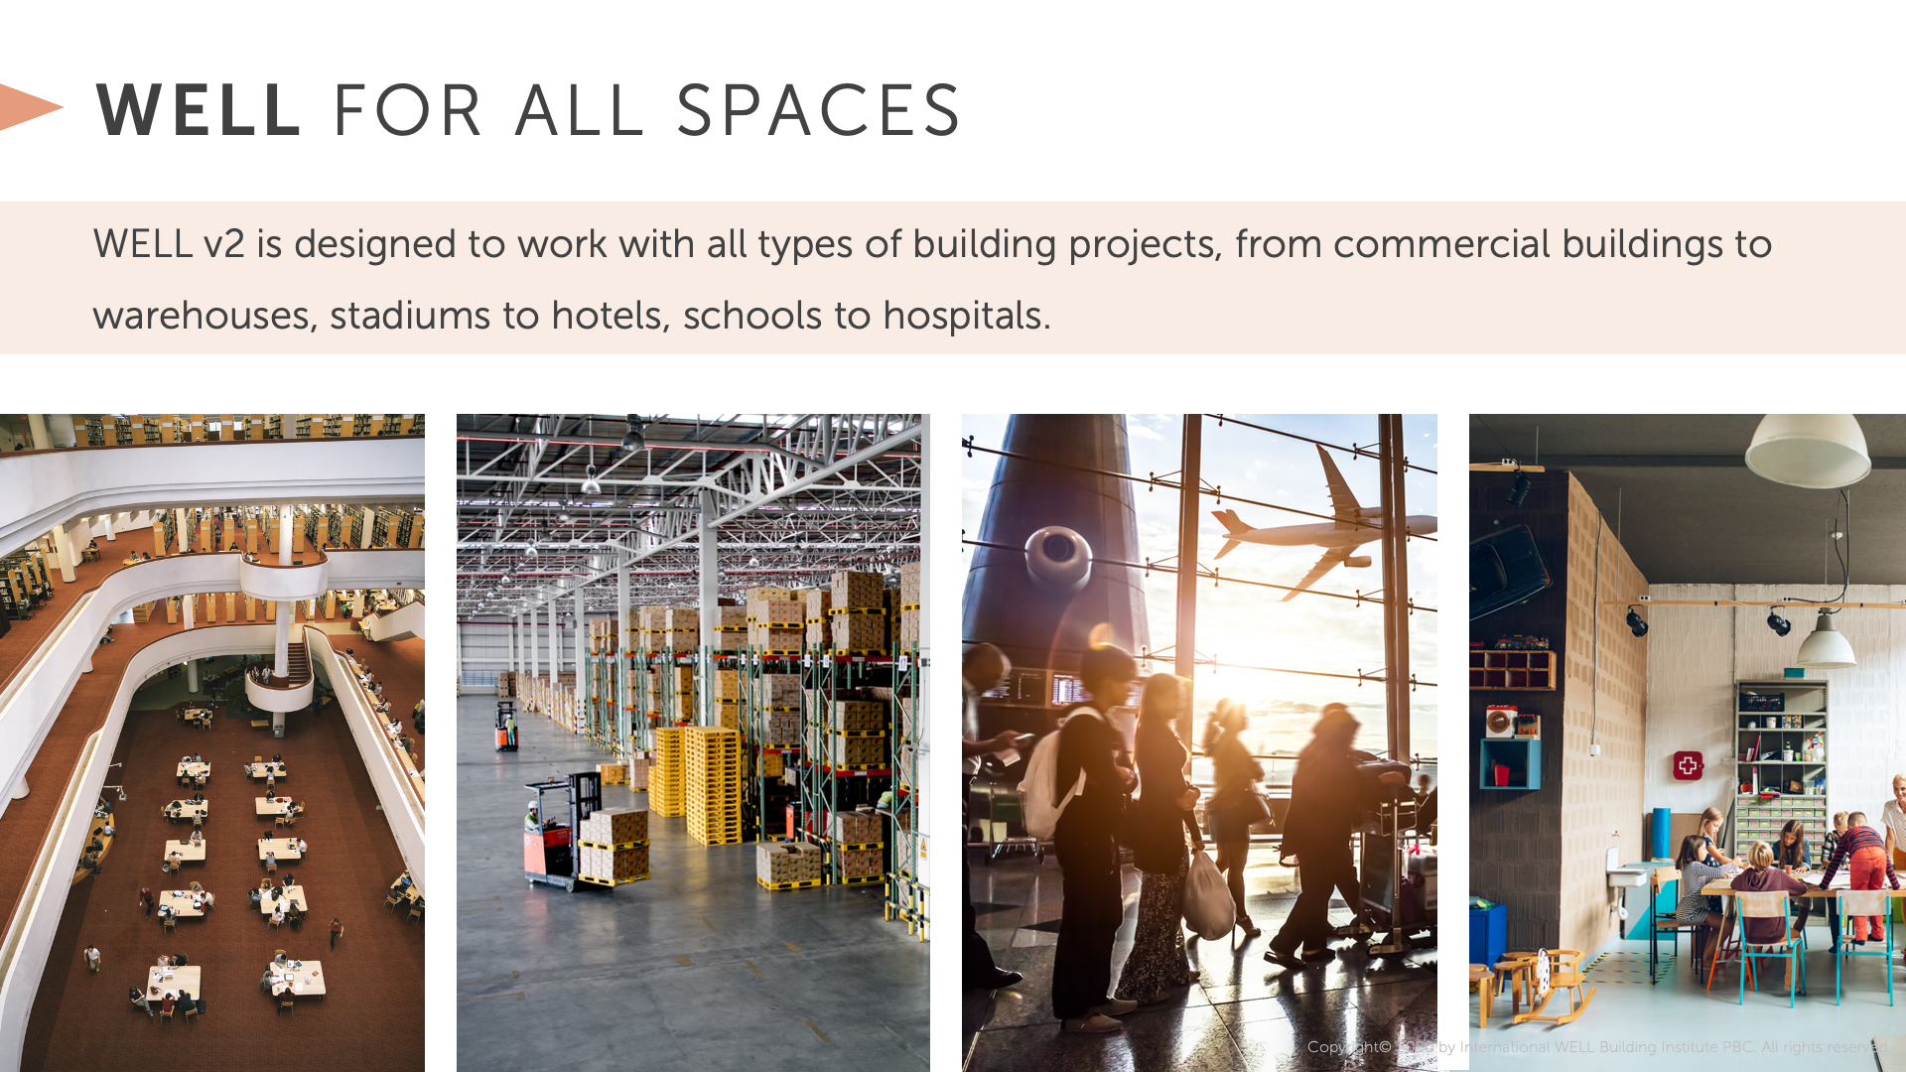
Notes:
Launched in 2014, the WELL Building Standard has come a long way! With presence in more than 125 countries, the WELL Building Standard is all about advancing health in the places where we spend our lives as you mentioned.
That said - WELL v2 is designed to work with all types of building projects, from commercial buildings to warehouses, stadiums to hotels to hospitals. With our experience with the pandemic, we know no building was spared and it makes the most sense to guard all buildings where we spend a good portion of our lives.

Slide 21
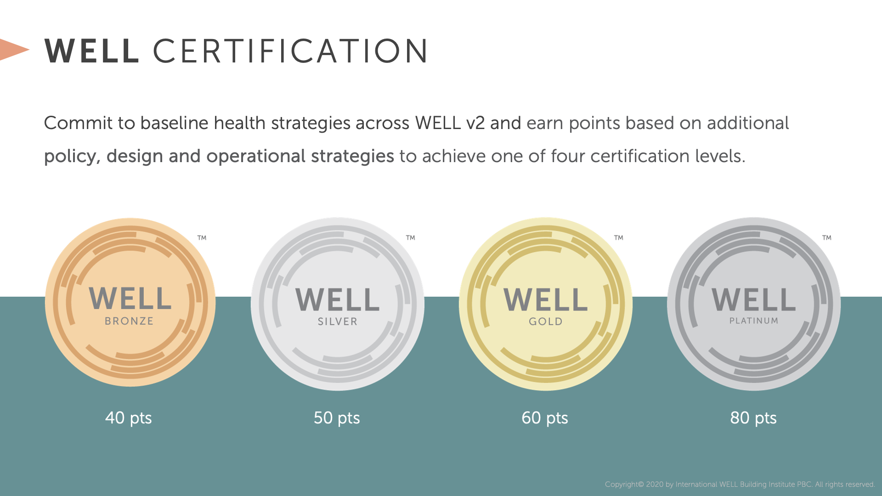

v1
3 Levels of Certifications in WELL v1:
SILVER
Preconditions-100%
GOLD
Preconditions-100%
Optimization- 40% or more
PLATINUM
Preconditions-100%
Optimization- 80% or more
Notes:
There are 3 levels of certifications in WELL v1:
Silver for achieving 100% preconditions
Gold for achieving 100% preconditions and at least 40% optimizations
Platinum for achieving 100% preconditions and at least 80% or more optimizations.

Slide 22
v2
Notes:
There are 4 levels of certifications in WELL v2:
WELL Bronze for achieving at least 40 points
WELL Silver for achieving at least 50 points
WELL Gold for achieving at least 60 points
WELL Platinum for achieving at least 80 points.

Slide 23

A Well-Being Oasis in the Heart of London
One Heddon Street
A Case Study of
Let’s Get Started
Notes:
Now that we have an overview of the WELL certification, let’s get started with our first WELL case-study.
A Well-Being Oasis in the Heart of London: A Case Study of One Heddon Street
One of the top WELL Building Projects, ‘One Heddon Street’, one of The Crown Estate’s flexible office spaces, has achieved WELL Certification at the Platinum Level – making it the world’s first fully fitted co-working space to achieve this certification.

Slide 24
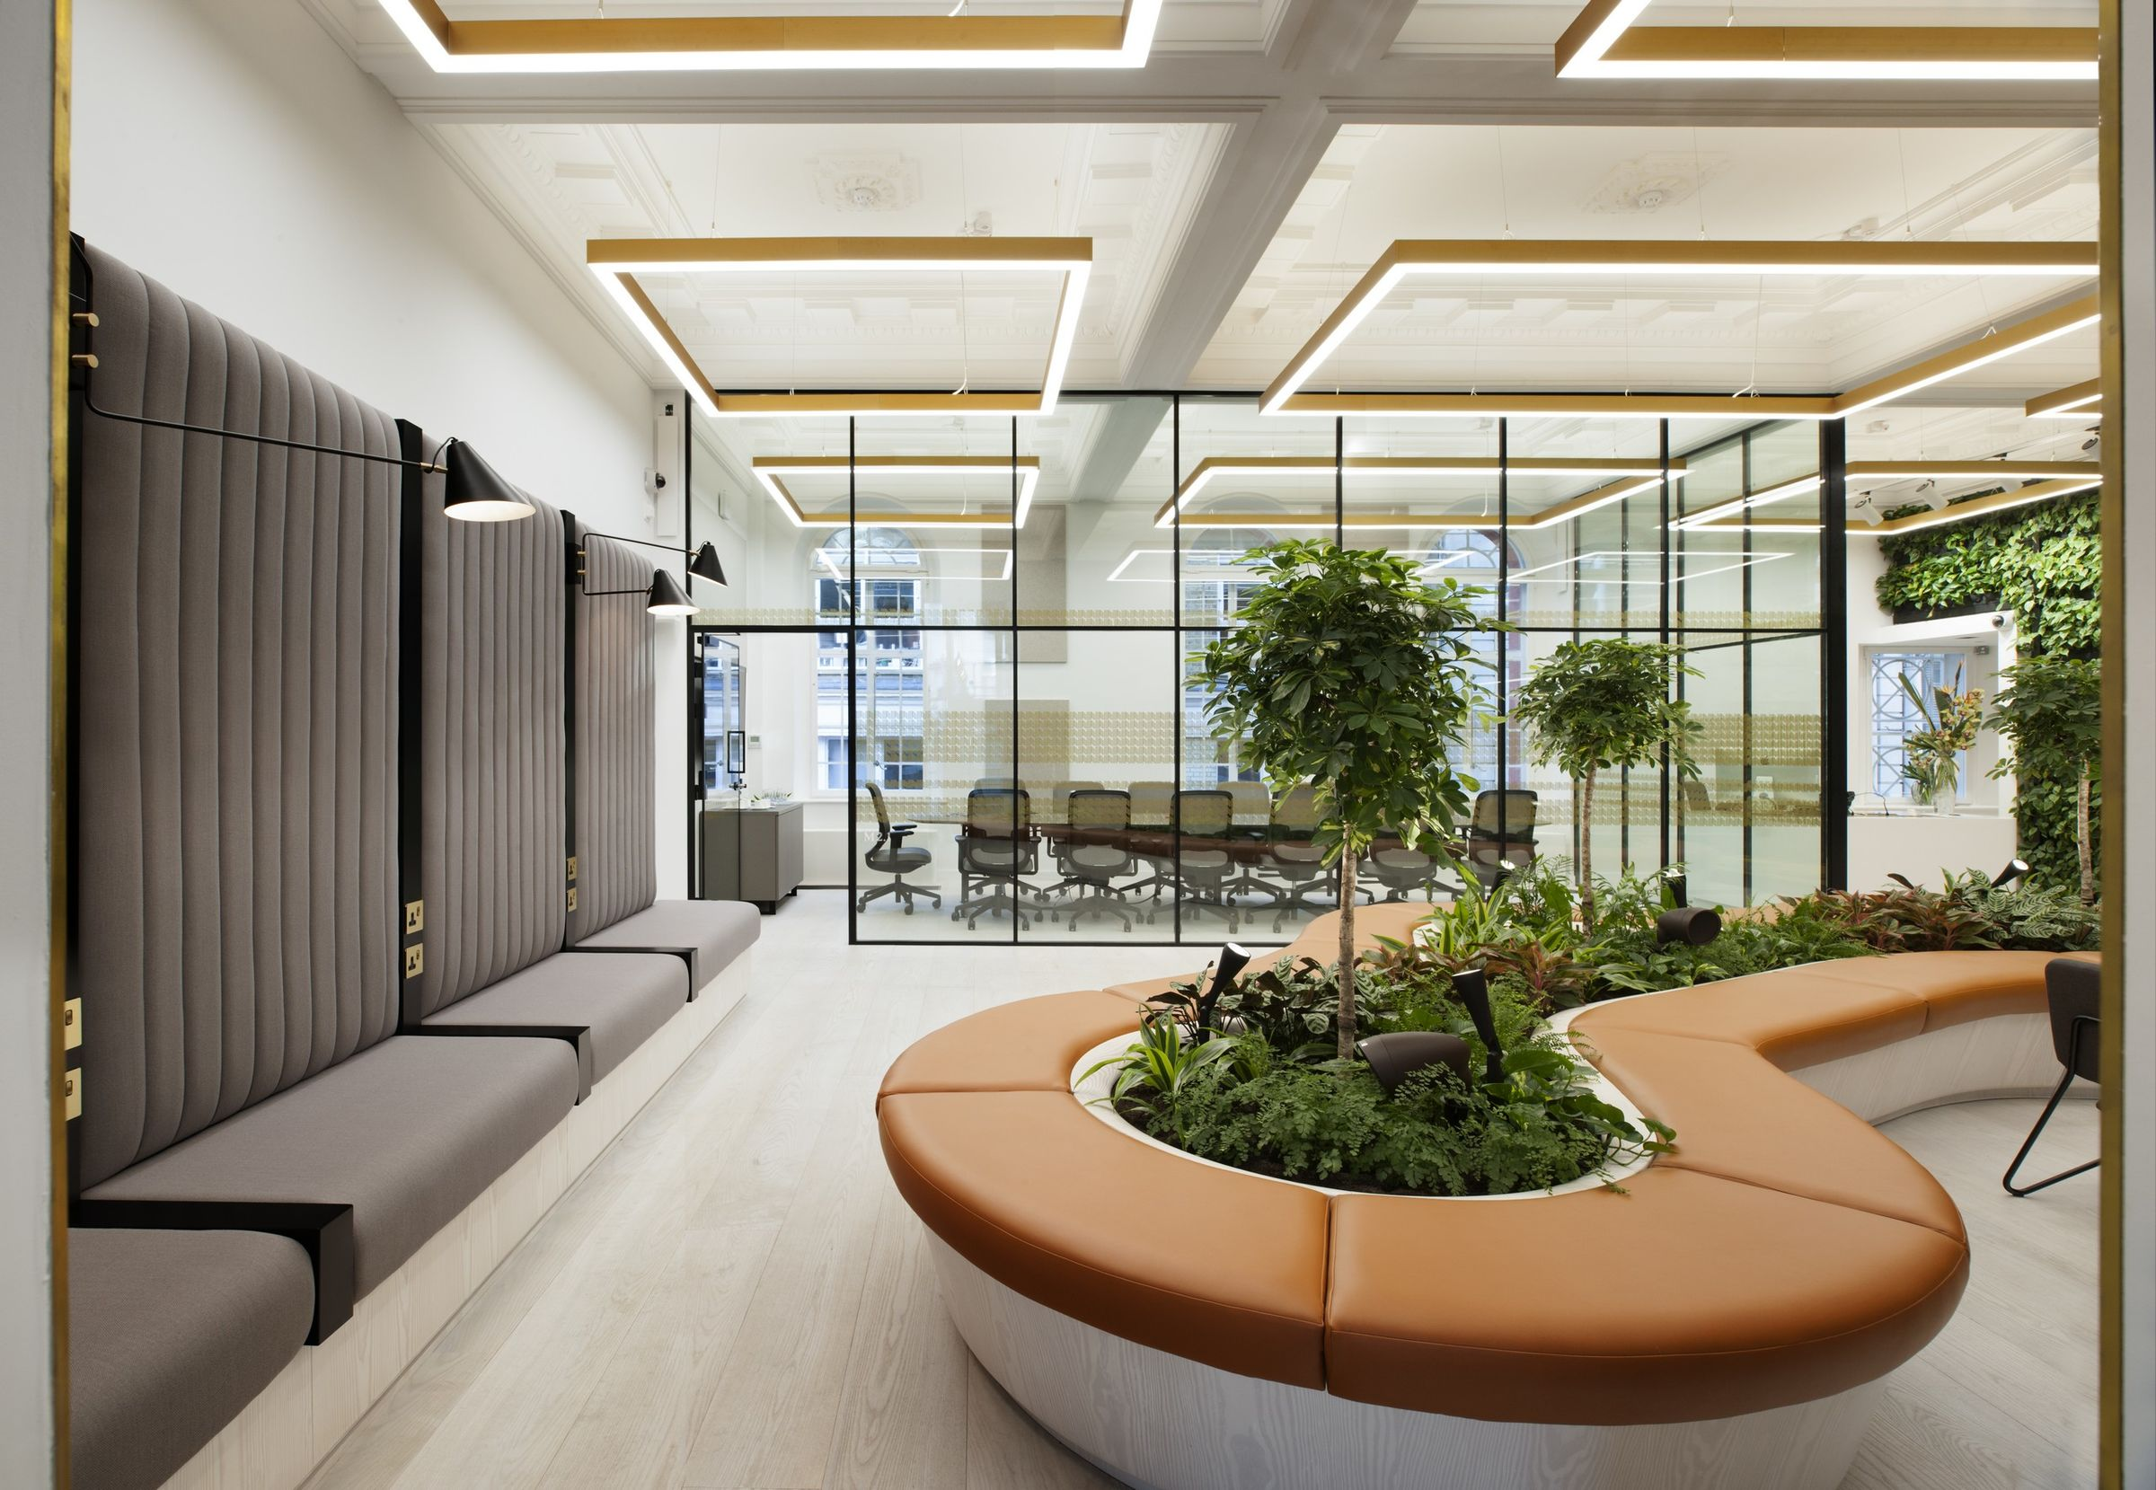
One Heddon Street
Image Source: https://archello.com/project/one-heddon-street
Notes:
One Heddon Street, located in the vibrant district of Mayfair, London, has undergone a remarkable transformation, embracing the principles of WELL certification to create a holistic well-being oasis in the heart of the city. This case study examines how Heddon Street's comprehensive approach to design, operations, and policies has elevated the well-being of its residents, employees, and visitors, setting new standards for sustainable urban living.

Slide 25
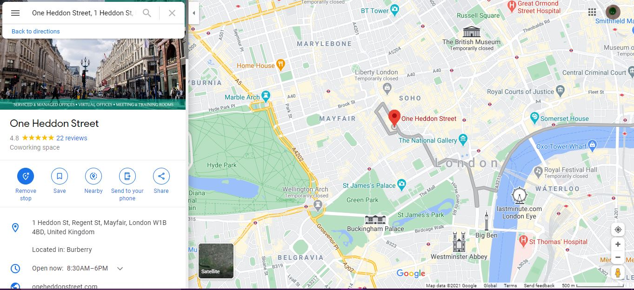
One Heddon Street
Notes:
Situated on the corner of London’s famous Heddon Street, this Grade II listed building has played host over the years to a meat market, tea rooms, restaurant and, famously, the New Gallery Kinema.
The launch heralds a new strategic direction for offices across The Crown Estate’s Central London portfolio, as the business pivots to offer a much broader range of workspaces and services, for new and existing office customers, across Regent Street and St James. The building houses a wide range of services that go beyond traditional book lending, to include cultural orientation, social integration, employment skills, and access, to technology and knowledge.

Slide 26


One Heddon Street project was commissioned
One Heddon Street
Achieved WELL Certification
2016
2019
2021
One Heddon Street project completed
Image Source: https://archello.com/project/one-heddon-street
Notes:
The One Heddon Street project was commissioned in February 2016 and it was completed in 2019. The project achieved WELL Certification in 2021.

Slide 27
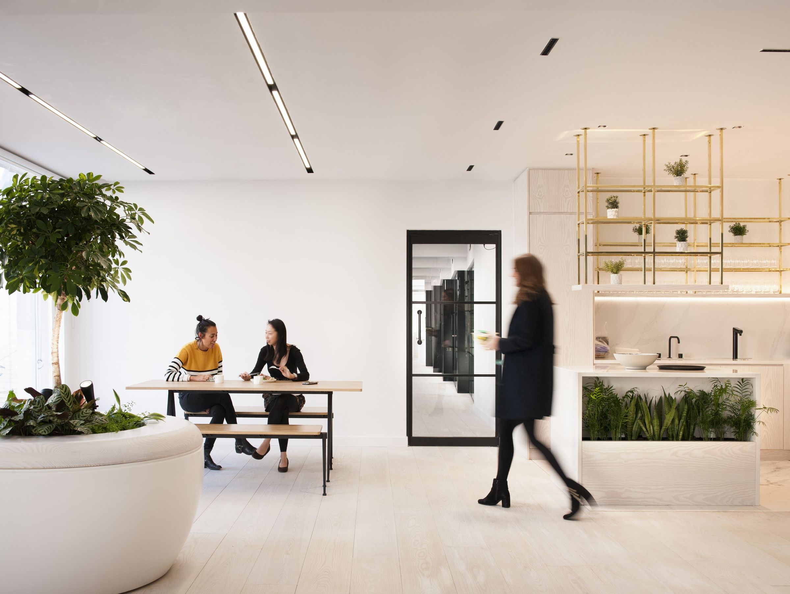






Previously developed land
Architect: Barr Gazetas
Size: 26,000 sq.ft
Owner: Crown Estate
Locaion: Mayfair, London, UK
Typology: Offices
Image Source: https://archello.com/project/one-heddon-street
Notes:
Let’s understand the project’s quick facts. Listed here is the core team, for our project which fall under the building program type “Offices”
Crown Estate is the owner of the project built on a previously developed land. The project is designed by Barr Gazetas. One Heddon Street offers 26,000 sq ft of the highest quality workspace over six floors, providing a range of working styles, with a variety of open and private offices, meeting rooms, and break-out spaces, as well as a flexible venue space that can be used for co-working and for members events.

Slide 28
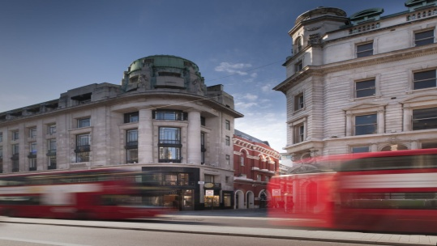
One Heddon Street Team
Engineer - Structural:
Waterman Group
Quantity Surveyor: Burnley Wilson Fish
General Contractor: BW.
Project Manager: Dendy Byrne
M&E / Sustainability: Engineer Mecserve
One Heddon Street
Architect – Barr Gazetas Ltd
Project Cost of construction, excluding furnishing: NA
Image Source: https://archello.com/story/63461/attachments/photos-videos
Notes:
Here’s the entire project team that contributed to the success:
Client: The Crown Estate
Architect: Barr Gazetas Ltd
Project Manager: Dendy Byrne
Quantity Surveyor: Burnley Wilson Fish
Structural Engineer: Waterman Group
General Contractor: BW
M&E / Sustainability: Engineer Mecserve

Slide 29
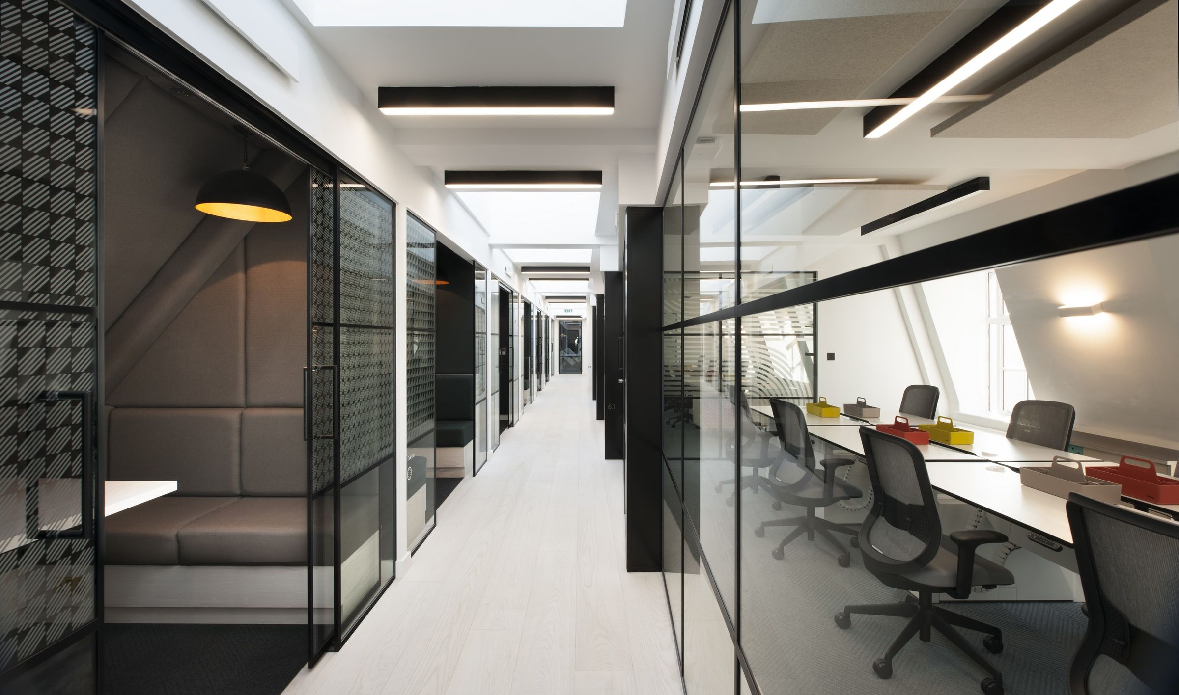
The One Heddon Street
Vision: Aims to foster creativity in an elegant and calm environment.
Image Source: https://archello.com/project/one-heddon-street
Notes:
In realizing the vision, Barr Gazetas has transformed the existing building with a design that aims to foster creativity in an elegant and calm environment. Gazetas’ design places users at its heart, with a strong focus on wellness.

Slide 30
“One Heddon Street has been a hugely exciting project for us to work on. Our design places people at its heart, with the use of natural materials creating a warm, welcoming space aimed at fostering creativity. Focusing on wellbeing and sustainability, we have used high-quality finishes, natural daylight and plants to create a calm and healthy working environment. The offices are simple, effective and beautiful with uplifting views across the one of the world’s most famous streets.”
- Jon Eaglesham, Managing Director at Barr Gazetas
Image Source: https://archello.com/project/one-heddon-street
Notes:
Jon Eaglesham, Managing Director at Barr Gazetas, said: “One Heddon Street has been a hugely exciting project for us to work on. Our design places people at its heart, with the use of natural materials creating a warm, welcoming space aimed at fostering creativity. Focusing on wellbeing and sustainability, we have used high-quality finishes, natural daylight and plants to create a calm and healthy working environment. The offices are simple, effective and beautiful with uplifting views across the one of the world’s most famous streets.”

Slide 31
WELL Certification Strategy
With wellness a key factor for co-working space, pursuing WELL certification was a fantastic way to demonstrate the credentials of the building.
Image Source: https://archello.com/project/one-heddon-street
Notes:
With wellness a key factor for co-working space, pursuing WELL certification was a fantastic way to demonstrate the credentials of the building. The design was at an advanced stage when the decision was made to seek WELL certification. However, the design only required small modifications to meet the WELL criteria, due to the health and wellbeing criteria already embedded into The Crown Estate’s Development Sustainability Principles, which the project was already fulfilling.

Slide 32
Notes:
The project is certified under WELL v1. As discussed earlier, the WELL Building Standard version 1 is focused on these seven concepts : Air, Water, Nourishment, Light, Fitness, Comfort and Mind.
Let’s look into the strategies adopted by the project for each concept.

Slide 33


Integration
Air
1
Notes:
The first concept is ‘Air’. The WELL Building Standard for Air promotes clean air through reducing or minimizing the sources of indoor air pollution, requiring optimal indoor air quality to support the health well-being of building occupants.

Slide 34
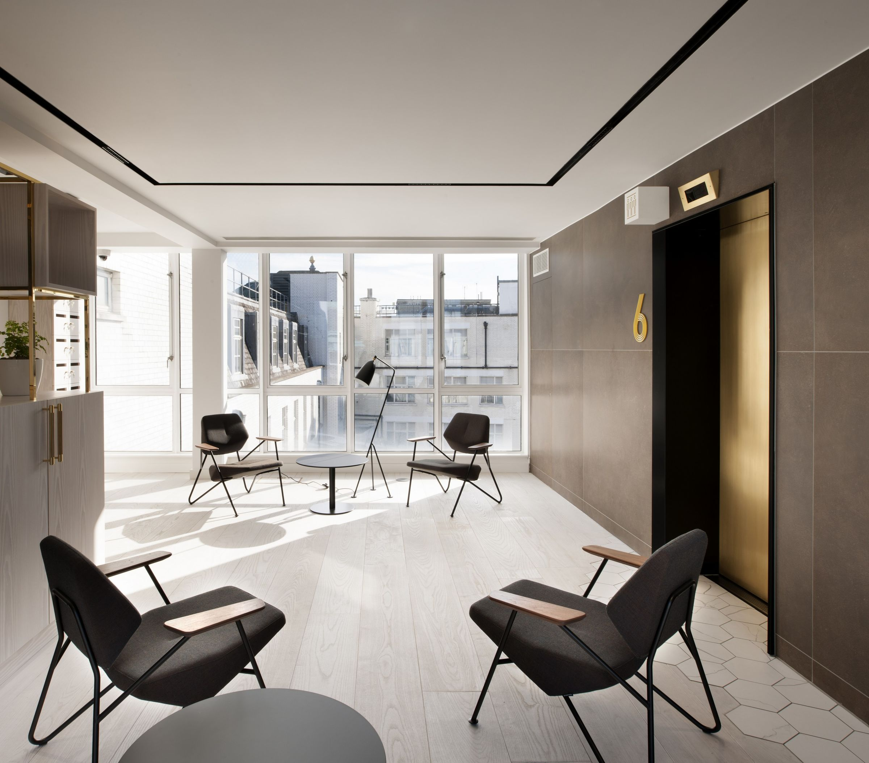
Indoor Air Quality
Enhanced fresh air supply to the offices at a rate 50% above the minimum recommended level, with no recycled air
Image Source: https://archello.com/project/one-heddon-street
Notes:
To ensure better Indoor Air Quality, Enhanced fresh air is supplied to the offices at a rate 50% above the minimum recommended level, with no recycled air.

Slide 35
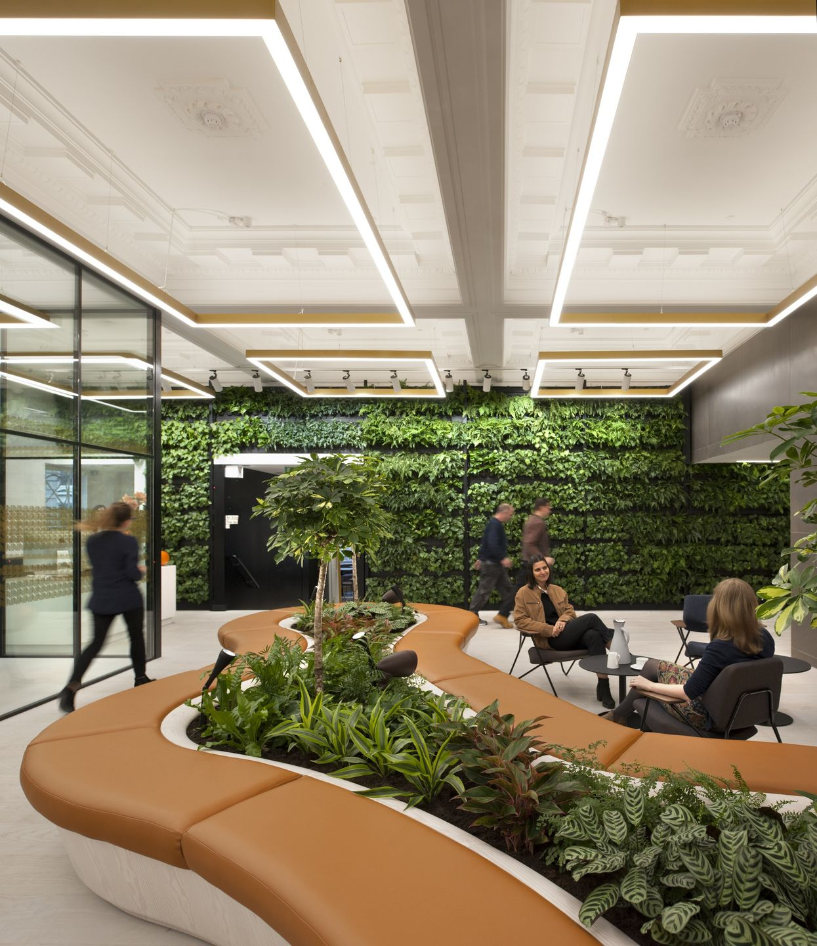
Air
Greenery is focused
Plants selected is based on air purifying qualities that
  Reduces Stress
  Improve Concentration
  Enhance Mood
  Creativity
Image Source: https://archello.com/project/one-heddon-street
Notes:
Gazetas’ design emphasis has been placed on greenery, with a living wall in the reception area, as well as bespoke planters on each floor.
The plants themselves have been carefully selected for their air purifying qualities, creating a pleasant atmosphere that aims to reduce stress, improve concentration, and enhance mood and creativity. These include Aglaonema stripes, Sansevieria Zeylanica, Zamioculca Zamiifolia, Nephrolepis Exaltata and Asplenium Nidus.

Slide 36

Air
Choice of materials and finishes was made to create:
  Light
  Airy
  Welcoming Space For Members
Image Source: https://archello.com/project/one-heddon-street
Notes:
The choice of materials and finishes within One Heddon Street was made by Barr Gazetas with the clear ambition to create a light, airy and welcoming space for members to experience and enjoy.

Slide 37
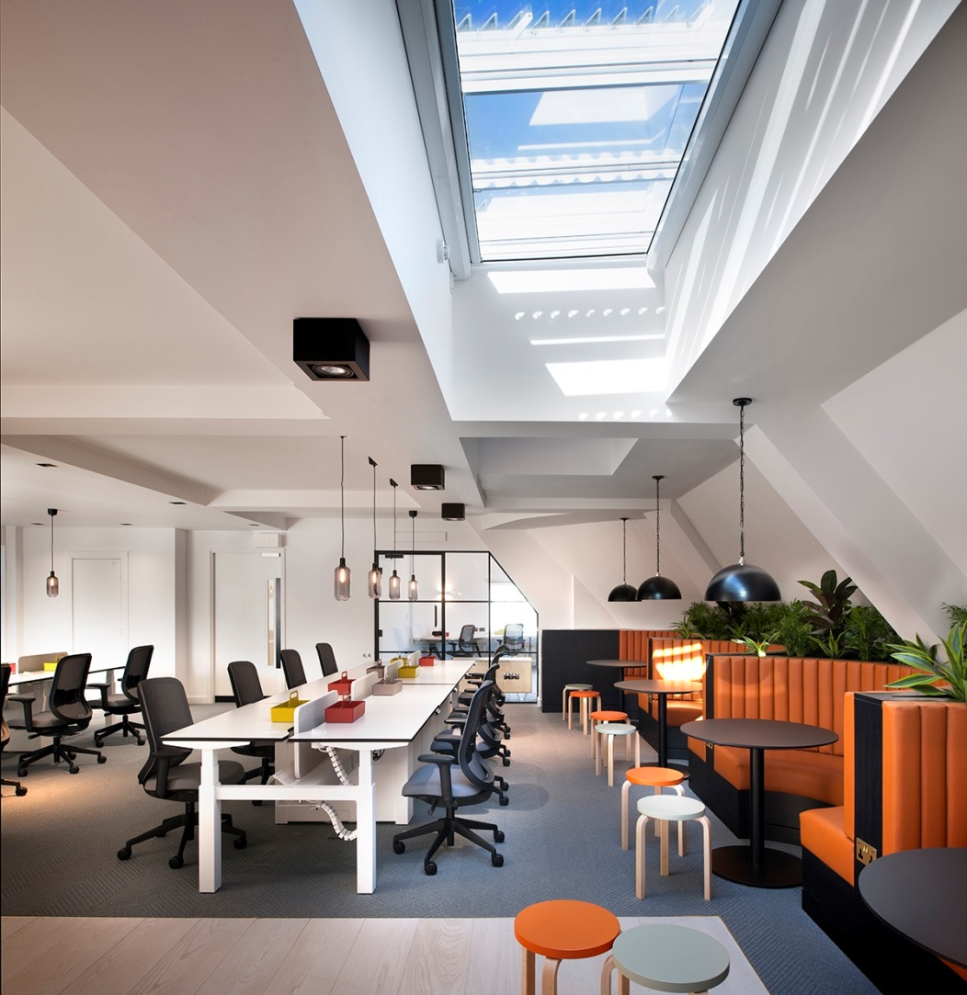
Air
A selection of furniture, fixture and finishes with low VOC content to maintain healthy indoor air quality levels
Image Source: https://archello.com/project/one-heddon-street
Notes:
Low-VOC (Volatile Organic Compounds) materials and finishes were used throughout to improve indoor air quality and create healthier living and working environments.

Slide 38
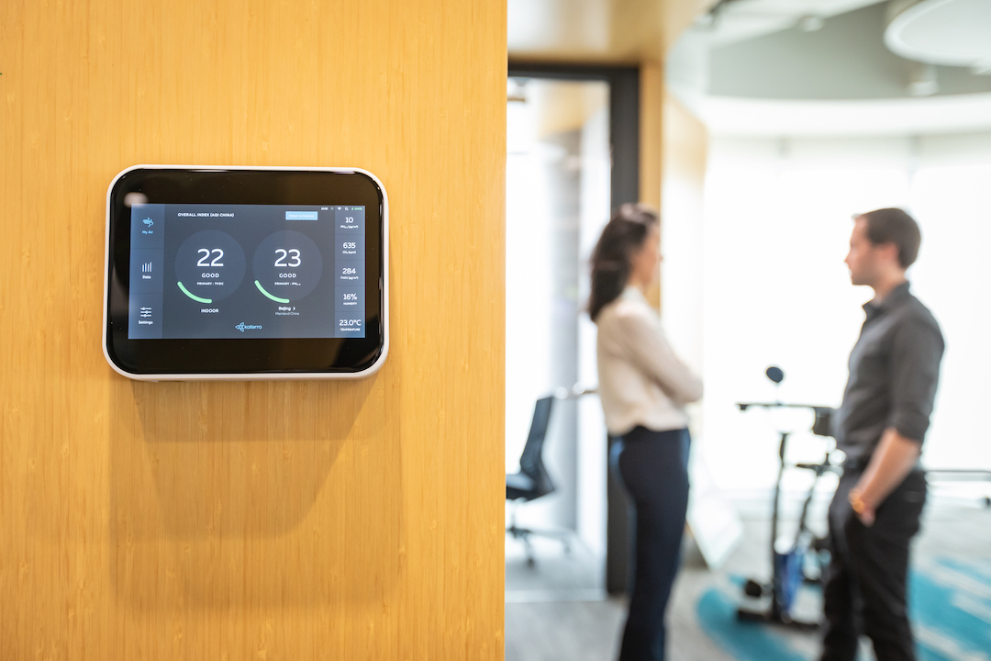
Air
Air quality monitoring system with a dashboard displayed in the reception.
Image Source: https://learn.kaiterra.com/en/resources/indoor-air-quality-monitoring-guide
Notes:
Building performance, such as ventilation and infiltration rates, is highly variable and has a direct effect on indoor air quality. To maintain ideal performance metrics, the project is continuously gathering data using an Air quality monitoring system with a dashboard displayed in the reception. Collecting this data allows individuals to be aware of and promptly fix any deviations in indoor quality metrics.

Slide 39


2
Water
Notes:
The 2nd concept is ‘Water.’ Clean drinking water is a prerequisite for optimal health. More than two-thirds of the human body is comprised of water, a major component of cells, and the medium for the transport of nutrients and waste throughout the body. The Institute of Medicine (IOM) recommends that women consume approximately 2.7 liters [91 oz] and men 3.7 liters [125 oz] of water per day (from all sources including drinking water, other beverages and food).
The WELL Building Standard seeks to simultaneously preserve water while enhancing its quality for human health in the context of different uses. It promotes safe and clean water through the implementation of proper filtration techniques and regular testing for building occupants to receive optimal quality of water for various uses.

Slide 40

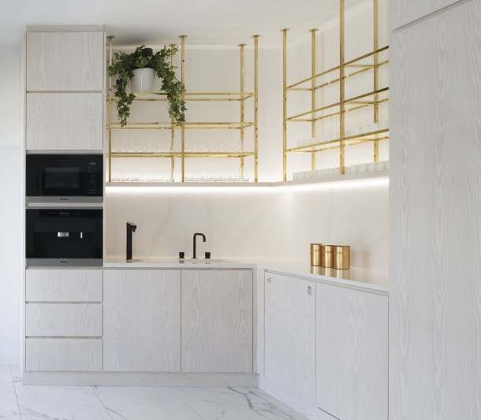
Water
All water supplied to amenity areas is drinkable and filtered water is available in the kitchens on every floor to encourage hydration.
Image Source: https://archello.com/story/63461/attachments/photos-videos/4
Notes:
All water supplied to amenity areas is drinkable and filtered water is available in the kitchens on every floor to encourage hydration.

Slide 41
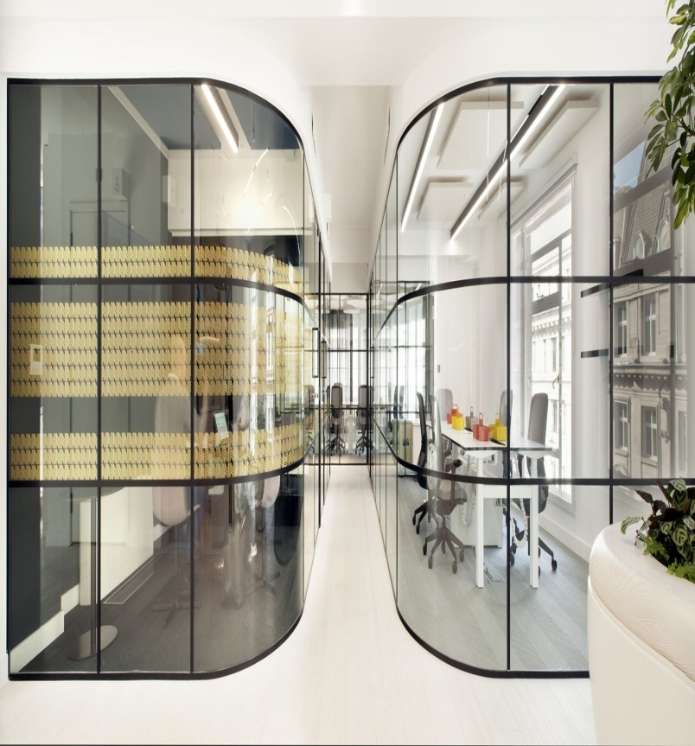
Water
Water quality tests are conducted periodically to ensure the highest standards are maintained.
Image Source: https://www.officelovin.com/2019/02/10/inside-the-crown-estates-new-london-coworking-space/
Notes:
Water quality tests are conducted periodically to ensure the highest standards are maintained.

Slide 42


Nourishment
3
Notes:
The 3rd concept is ‘Nutrition.’ Nutrition plays a key role in health maintenance, weight management and chronic disease prevention. However, adherence to the dietary recommendations in the U.S. as well as worldwide is poor. In the U.S., half of the population consumes sugar-sweetened beverages (SSBs) on any given day, with a quarter of the population consuming over 200 calories from SSBs daily.
The WELL Building Standard recognizes this and seeks to implement design strategies and policies within the built environment that increase access to healthy food options, enable people to make more informed dietary choices and lead to better health and well-being.

Slide 43
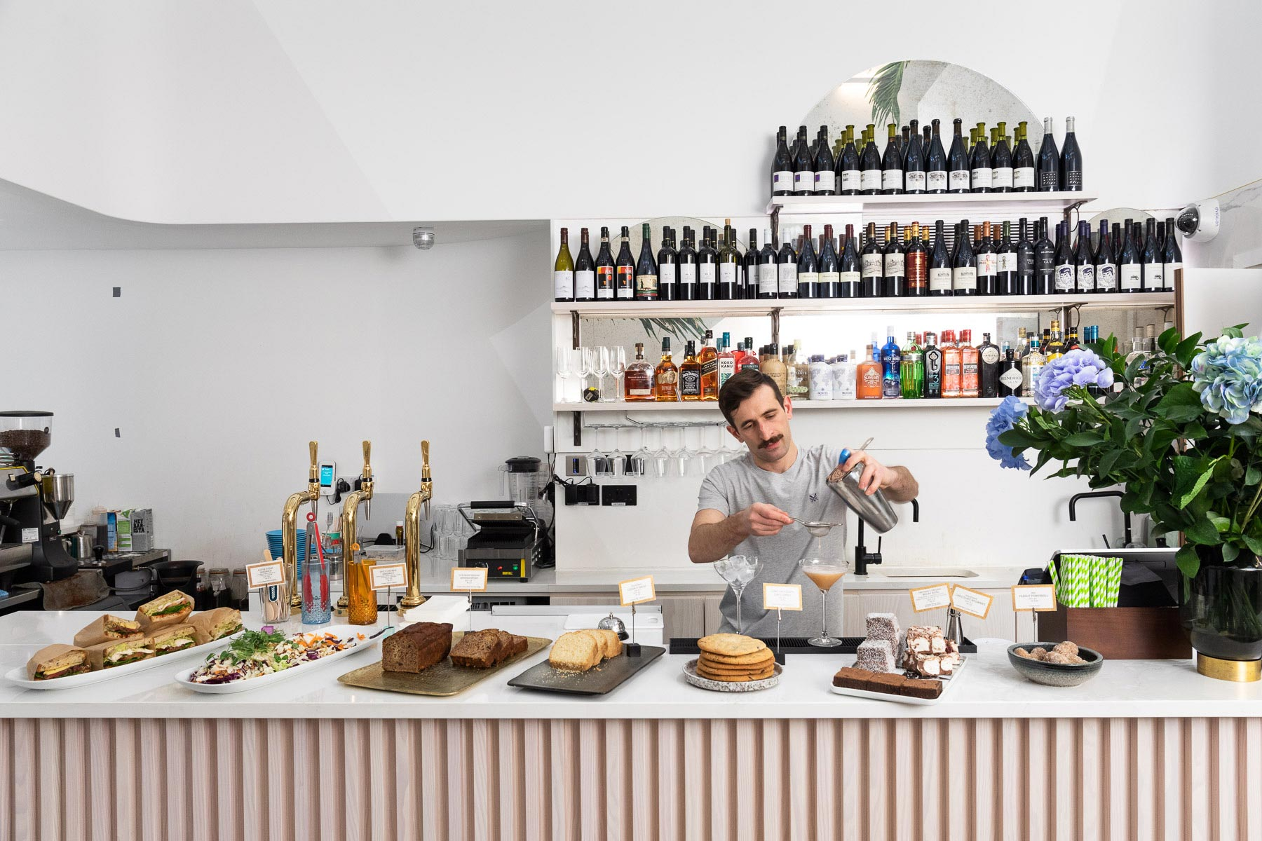
Nourishment
Complimentary fruit provided for members.
Image Source: https://oneheddonstreet.com/
Notes:
Regular consumption of fresh fruits is the cornerstone of a healthy diet and can lower the risk of cancer, diabetes, heart disease and obesity. To promote the consumption of fruits, complimentary fruit is provided for all the members.

Slide 44
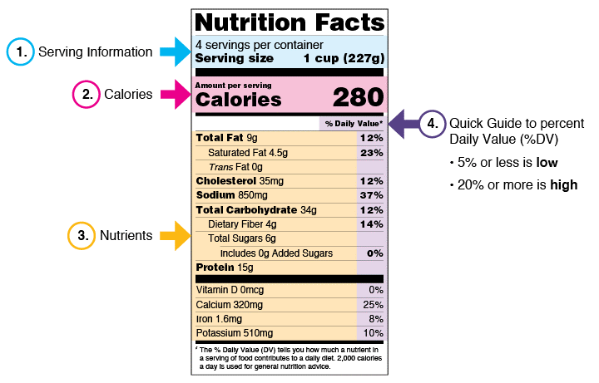
Nourishment
Nutritional Information and Special Diets
Image Source: https://opentextbooks.clemson.edu/hlth4150spring2020/chapter/food-and-calories/
Notes:
Menus provide nutritional information and cater to various dietary preferences, accommodating a diverse range of culinary tastes.

Slide 45
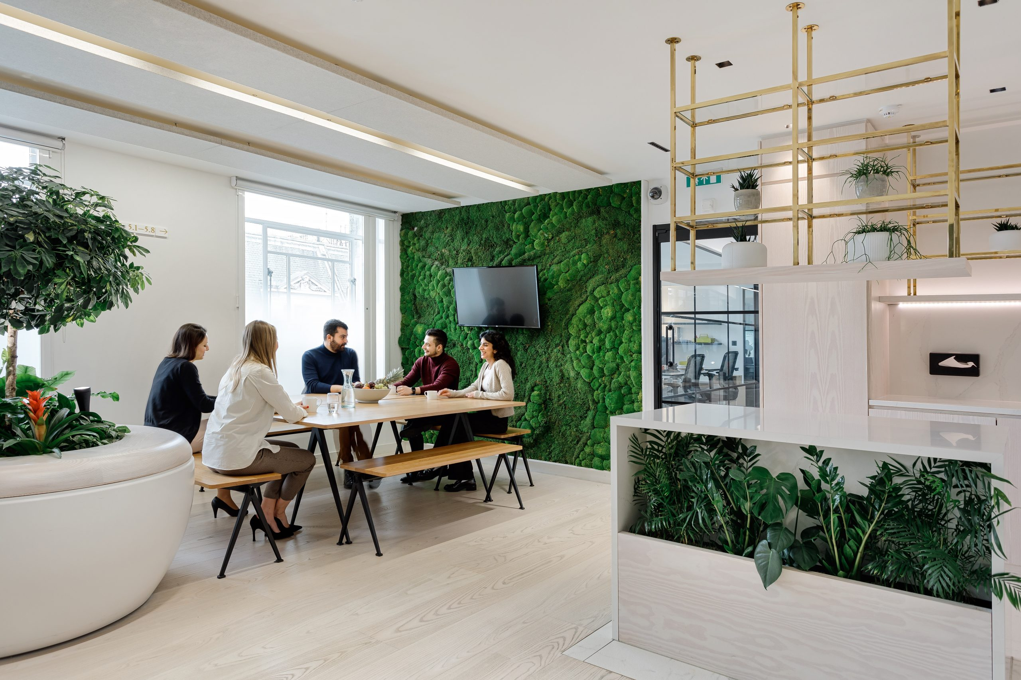
Nourishment
Provided communal eating spaces to encourage mindful eating behaviors and socialization.
Image Source: https://oneheddonstreet.com/
Notes:
Demanding work schedules and a lack of communal eating spaces can lead people to eat in isolation during meal breaks. Distracted eating at workstations while doing work, reading, watching television or listening to the radio may result in eating more, both immediately and during later food intake. Eating attentively and placing focus on the process of eating, on the other hand, may lead to better control of food intake. Time spent in break areas can lead to better eating habits, encourage social interactions, and help reduce stress.
One Heddon Street has provided communal eating spaces to encourage mindful eating behaviors and socialization.

Slide 46

Nourishment
Emphasis On Locally Sourced, Organic Produce
Image Source: https://www.colorado.edu/ecenter/2021/03/17/positive-impact-organic-foods
Notes:
The project offers an array of health-conscious dining options, with an emphasis on locally sourced, organic produce.

Slide 47
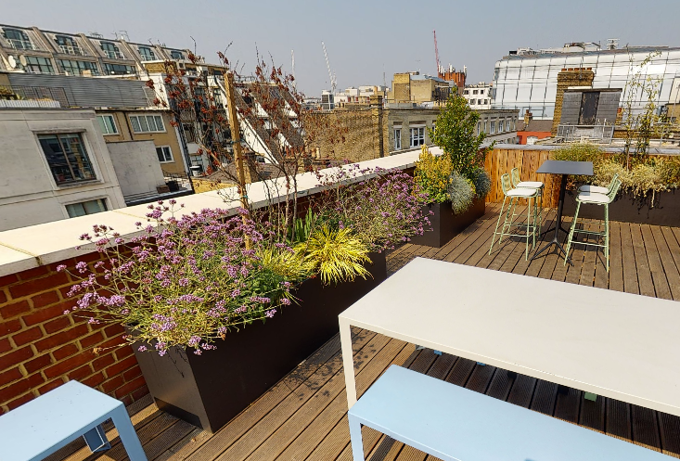
Nourishment
To improve access to fresh produce, Herb garden is provided on the terrace.
Image Source: https://oneheddonstreet.com/
Notes:
Gardening or the cultivation of produce and herbs increases access to healthy, fresh and nutrient-rich foods and allows individuals to be more engaged with food production processes. Studies show that gardening can lead to better eating habits and more positive perceptions of overall health and has been associated with lower BMI as well as lower odds of overweight and obesity.
To improve access to fresh produce, Herb garden is provided on the terrace. This promotes wellbeing and social interaction.

Slide 48


Light
4
Notes:
The next concept is ‘Light.’ The WELL Building Standard for Light provides illumination guidelines that are aimed to minimize disruption to the body’s circadian system, enhance productivity, support good sleep quality and provide appropriate visual acuity where needed.

Slide 49

“
“Every floor enjoys healthy levels of natural daylight which supports circadian rhythms and healthy sleep.”
”
Image Source: https://www.officelovin.com/2019/02/10/inside-the-crown-estates-new-london-coworking-space/
Notes:
Workspace layout designed to maximize natural daylight for all desks to support circadian rhythms and healthy sleep. All offices have windows to maximize light levels, vital for both physical and psychological wellbeing.

Slide 50

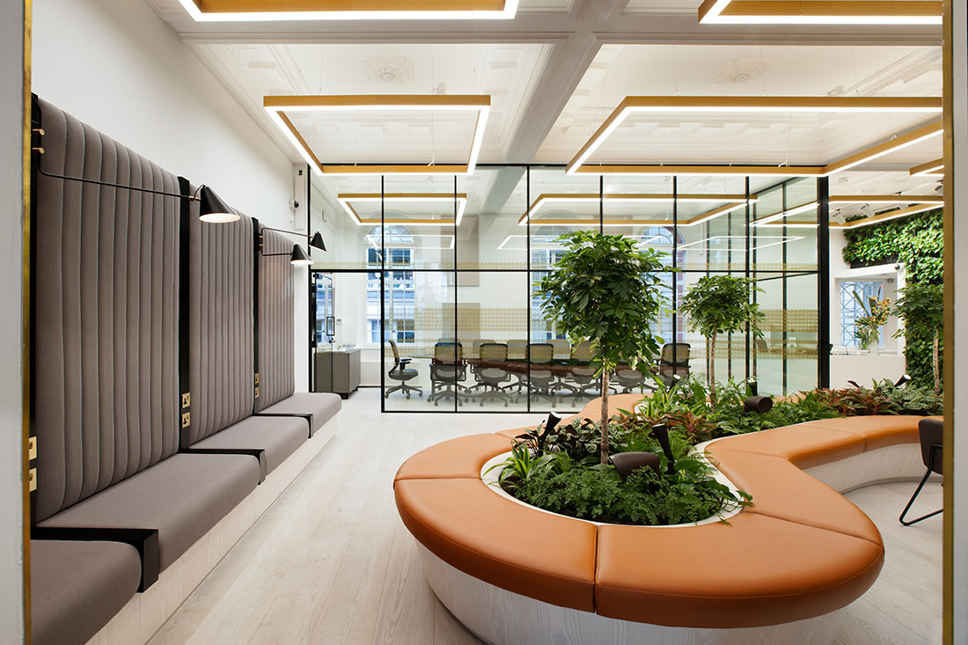
Light
Natural daylight has also been prioritized, with glass partitions
Image Source: https://www.officelovin.com/2019/02/10/inside-the-crown-estates-new-london-coworking-space/
Notes:
In order to cater to a range of working styles and office sizes across each floor, whilst balancing greenery and natural light, Planet’s range of high-performance glazed partitions and doors delivered on creating a modern and flexible working environment.
Natural daylight has also been prioritized, with glass partitions throughout allowing light to filter through the office floors.

Slide 51
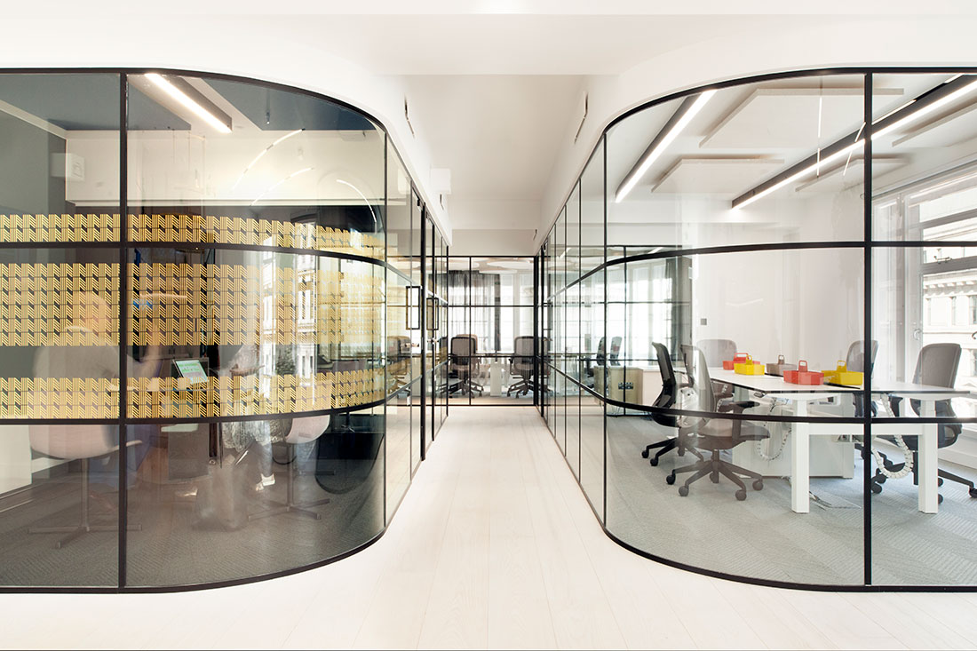
Light
LOFT IsoTec glazed doors with access-controlled cylinders
On level six, LOFT20 screens were installed with EclipseTec glass sliding doors
Image Source: https://www.officelovin.com/2019/02/10/inside-the-crown-estates-new-london-coworking-space/
Notes:
To provide a unified appearance, these were complemented by integral LOFT IsoTec glazed doors with access-controlled cylinders – all black polyester powder coated to maintain a consistent look throughout the interior. On level six, LOFT20 screens were installed with EclipseTec glass sliding doors to offer unrivalled acoustic performance and a soft open and close function.

Slide 52
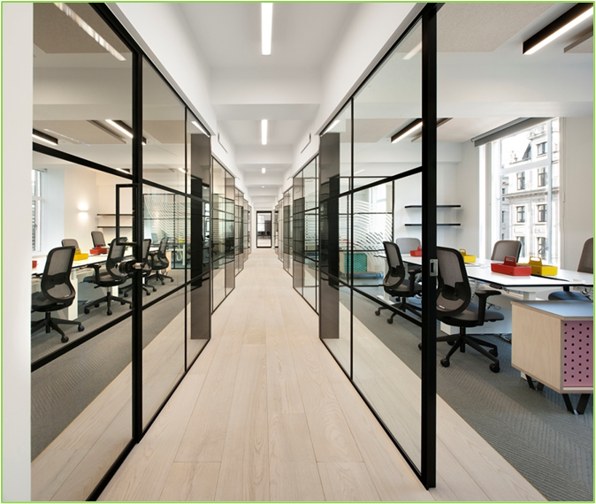
Light
Planet installed the LOFT54 industrial framed double glazed partitioning system for crosswalls
Offering exceptional privacy due to an impressive 45 dB(Rw) acoustic rating
Image Source: https://archello.com/story/63461/attachments/photos-videos
Notes:
For the meeting rooms and communal areas on levels one to five, Planet installed the LOFT54 industrial framed double glazed partitioning system for crosswalls, whilst offering exceptional privacy due to an impressive 45 dB(Rw) acoustic rating. LOFT20 office fronts were stepped resulting in a distinctive visual feature within the corridors.

Slide 53
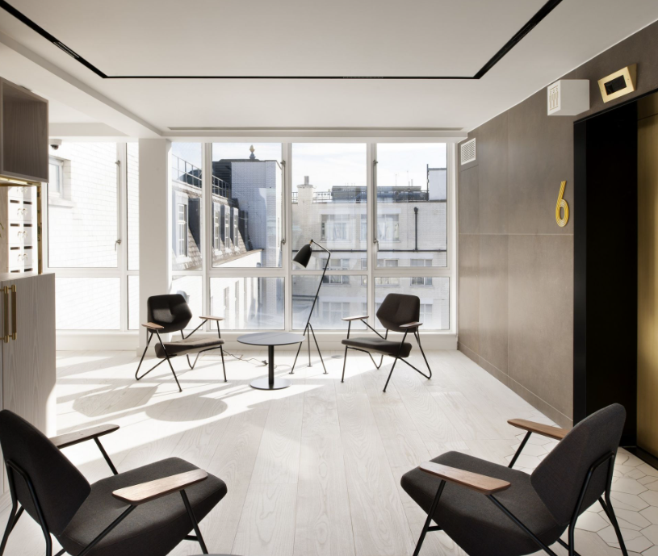
Light
Planet’s LOFT FireTec fire rated single and double doors
Incorporating electric hold-open overhead door closers, the doors are linked to the fire alarm system
Image Source: https://archello.com/story/63461/attachments/photos-videos/9
Notes:
The office scheme also featured Planet’s LOFT FireTec fire rated single and double doors at the end of the corridors. Incorporating electric hold-open overhead door closers, the doors are linked to the fire alarm system which keeps fire protection doors closed in the event of a fire. Offering superlative fire performance of up to 60/60 (Ei60) fire rating, FireTec doors require minimal framing, whilst allowing for maximum transparency and stunning aesthetics.

Slide 54


Fitness
5
Notes:
The 5th concept is ‘Fitness.’ The Centers for Disease Control (CDC) define fitness as “the ability to carry out daily tasks with vigor and alertness, without undue fatigue, and with ample energy to enjoy leisure-time pursuits and respond to emergencies”. Regular physical activity is essential to achieve optimal health, including weight management, chronic disease prevention and fitness maintenance. The American College of Sports Medicine, among others, recommends that all healthy adults engage in at least 30 minutes of moderate-intensity aerobic activity five days per week, and muscle-strengthening activities at least two days per week. However, the majority of people today are physically inactive. Modern transportation, labor saving conveniences and sedentary jobs have created an environment in which millions of people fail to achieve the minimum level of activity necessary to help prevent type 2 diabetes, metabolic syndrome, obesity, heart disease and other chronic conditions.
The WELL Building Standard recognizes the physical activity-promoting policies and strategies that can be implemented in the built environment to encourage physical activity and reduce sedentariness, thus helping to combat obesity and other chronic diseases.

Slide 55
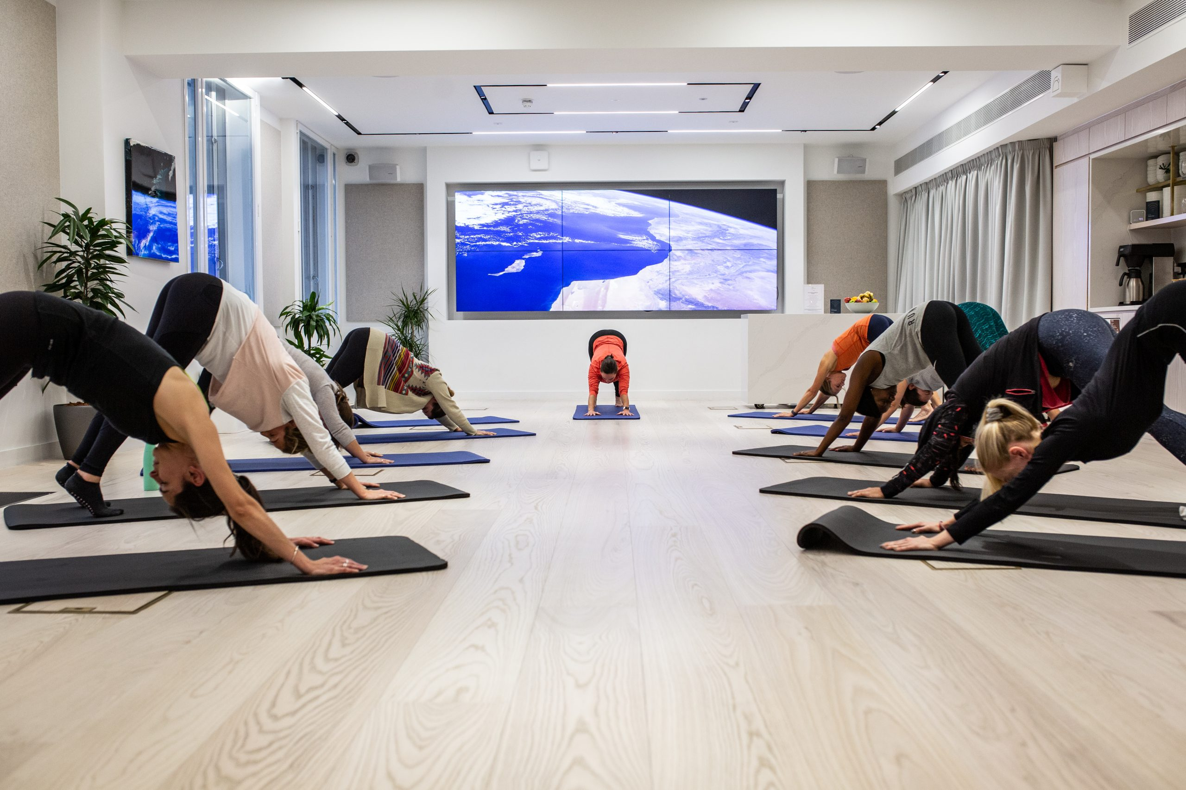
Fitness
Hosting wellbeing events to support wellbeing of the One Heddon Street Community, such as:
  exercise classes
  lunch and learns around stress
  creative workshops such as bauble and wreath making at Christmas
Image Source: https://oneheddonstreet.com/
Notes:
A dedicated wellness center in One Heddon Street provides fitness facilities, group exercise classes, and wellness workshops, promoting physical activity and mental well-being within the community. The center also offers mindfulness sessions, yoga classes, and other stress-reduction activities. The project also hosts creative workshops such as bauble and wreath making at Christmas.

Slide 56
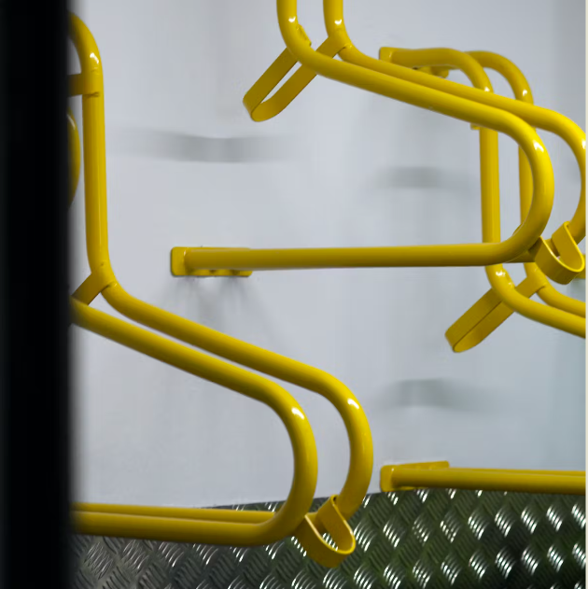
Fitness
Cycle parking spaces for 16 bikes, six Brompton lockers and shower facilities for active lifestyles.
Image Source: https://barrgazetas.com/projects/one-heddon-street
Notes:
To promote daily physical activity through the provision of onsite support for active commuting, the project has provided cycle parking spaces for 16 bikes, six Brompton lockers and shower facilities for active lifestyles.

Slide 57
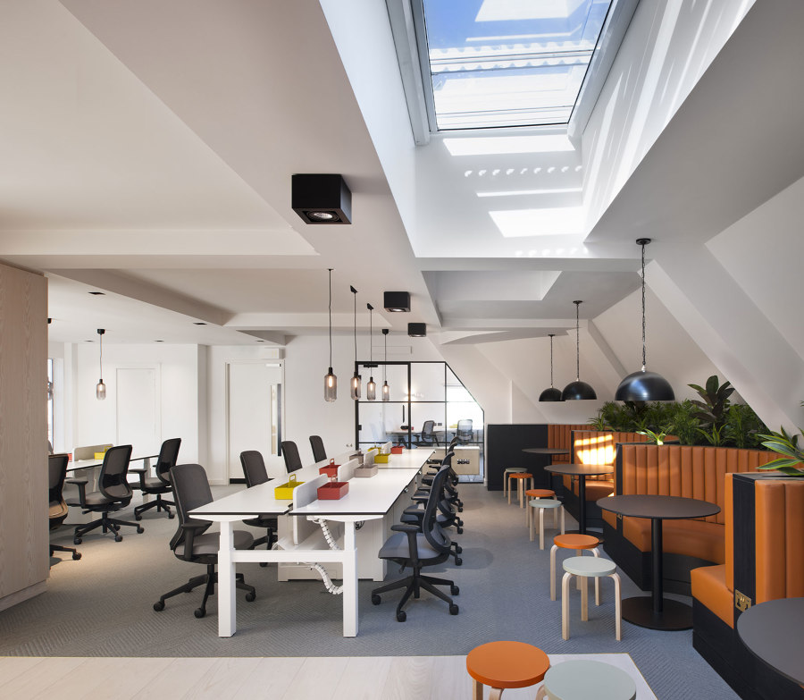
Fitness
Ergonomic furniture to encourage movement during the working day
Image Source: https://www.architonic.com/en/project/aram-one-heddon-street/20165131
Notes:
Most individuals spend the majority of their time indoors in a seated position. Prolonged sitting is associated with a number of adverse health conditions, including an increased risk of cancer, weight gain, and greater fatigue and back discomfort.
The goal is to reduce sedentary behavior by making active workstations readily available to occupants. Nearly all desks provided in One Heddon Street are ergonomic, so people can sit or stand, encouraging movement during the working day.

Slide 58

Comfort
6
Notes:
Next concept is ‘Comfort.’ Employee surveys show that acoustic problems are a leading source of dissatisfaction within the environmental conditions of an office. As acoustic comfort is determined in part by the physical properties and contents of environments. The WELL Building Standard aims to shape spaces to mitigate unwanted indoor noise levels and reduce exterior noise intrusion in order to enhance social interaction, learning, satisfaction and productivity. While noise is ubiquitous, we are able to adopt policies, technologies and practices that ensure quieter acoustical environments and minimize our exposure to harmful and unnecessary sound.
Thermal comfort is another factor that plays a large role in the way we experience places where we live and work. The WELL Building Standard takes a holistic approach to thermal comfort and provides a combination of strategies to address occupant issues.

Slide 59
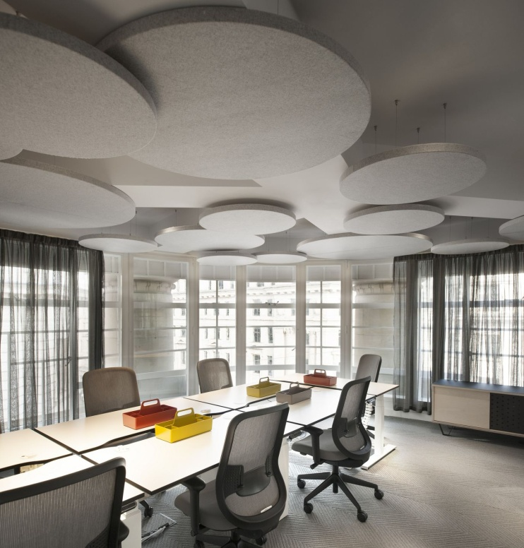
Acoustic Performance
Acoustic management reduces mechanical noise and vibration to improve productivity.
Image Source: https://archello.com/story/63461/attachments/photos-videos
Notes:
The installation of acoustic management throughout One Heddon Street, reduces mechanical noise and vibration to improve productivity.

Slide 60

Thermal Comfort
To maximize and personalize thermal comfort among all occupants, individual controls are provided.
Smart monitoring system installed to optimize energy efficiency
Image Source: https://www.istockphoto.com/photo/save-energy-reducing-electricity-use-gm624547296-109798625
Notes:
User controls put people in charge of their own thermal comfort, without the need to adjust the building temperature. Thermal comfort preferences are highly individual, based on a variety of factors, and so it would be nearly impossible to find indoor thermal comfort conditions that satisfy everyone. Providing individual controls enables occupiers to adjust conditions to their needs, resulting in improved comfort and expansion of thermal comfort acceptability limits. All internal spaces are monitored by a smart system platform which monitors thermal comfort in real time to optimize energy efficiency in the building and provide insightful analytical data on thermal comfort preferences.

Slide 61


Mind
7
Notes:
The 7th concept is ‘Mind.’ The building where we live, and work can offer an atmosphere that supports a healthy mental resulting in significant psychological and physical benefits. Interventions to mediate stress can either be direct or indirect. This includes providing access to therapies that help promote relaxation and address mental or emotional trauma, instituting policies that improve sleep hygiene or encourage altruism and community engagement, and promoting the use of sensor technologies that increase awareness of physiological and environmental factors to inform positive behavioral changes.
The WELL Building Standard recognizes the features of the built environment and identifies workplace policies that can be implemented to positively impact mood, sleep, stress levels and psychosocial status in order to promote and enable overall occupant health and well-being.

Slide 62
Biodiversity
Calm and Relaxing Area are Provided by:
  Living Wall
  Indoor Garden
  Planting Trees
Image Source: https://archello.com/story/63461/attachments/photos-videos
Notes:
Biophilic design was emphasized throughout, with a living wall in reception and bespoke planters on every floor. Plants were carefully selected for their air purifying qualities, to create a pleasant atmosphere that reduces stress, improves concentration, and enhances creativity.

Slide 63
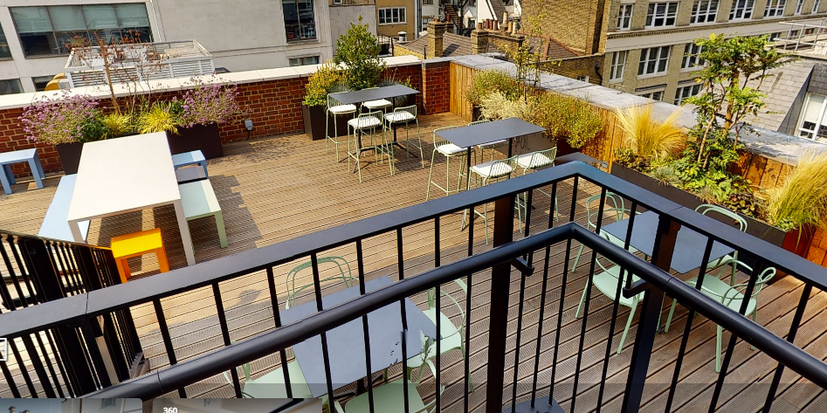
Biodiversity
Communal terrace with planting and seating for all occupiers to enjoy.
Image Source: https://archello.com/story/63461/attachments/photos-videos
Notes:
To support occupant emotional and psychological well-being, the project has provided a communal terrace with planting and seating for all occupiers to enjoy.

Slide 64
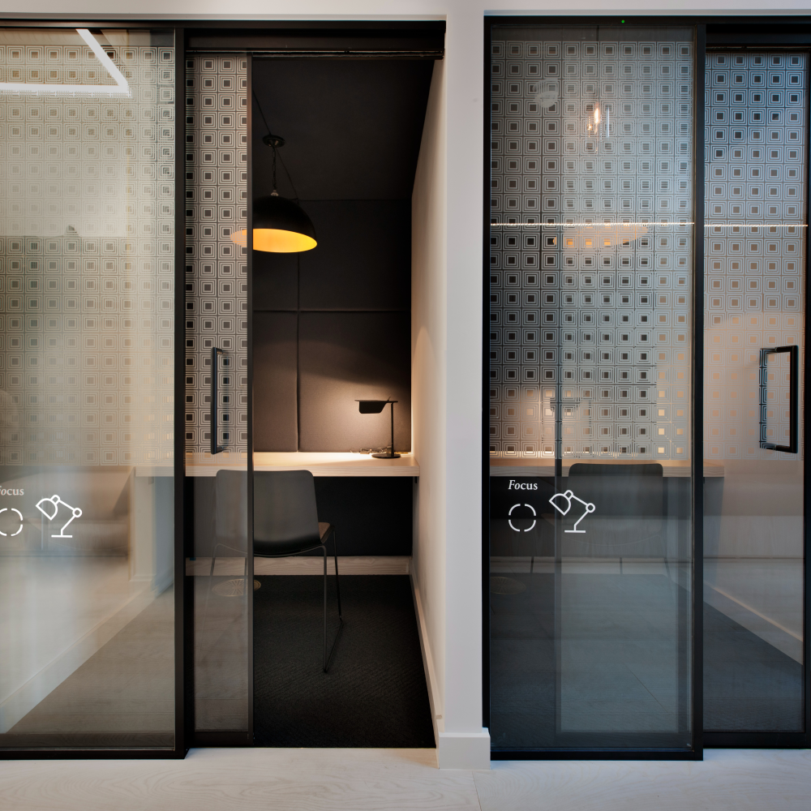
Flexible Workspace
To reduce distractions, mitigate stress and enable focused work, the project has provided flexible workspaces.
Image Source: https://radiiplanetgroup.com/en/planet/projects/one-heddon-street/
Notes:
Healthy work environments should be designed to mitigate stress and optimize productivity, and should therefore be sufficiently adaptable to working, focusing, collaborating and resting as needed. Research demonstrates that the presence of a variety of workspaces that enable individuals to adjust their environments and choose the degrees of engagement is associated with job satisfaction and group cohesiveness.
To reduce distractions, mitigate stress and enable focused work, the project has provided flexible workspaces like quiet booths.

Slide 65

Community Engagement
Regular community meetings allow stakeholders to voice their opinions, fostering a sense of ownership and connection to the district.
Image Source: https://oneheddonstreet.com/#features
Notes:
One Heddon Street actively engages with its residents and employees through wellness initiatives, social events, and surveys to gather feedback and assess the well-being impact of their programs. Regular community meetings allow stakeholders to voice their opinions, fostering a sense of ownership and connection to the district.

Slide 66
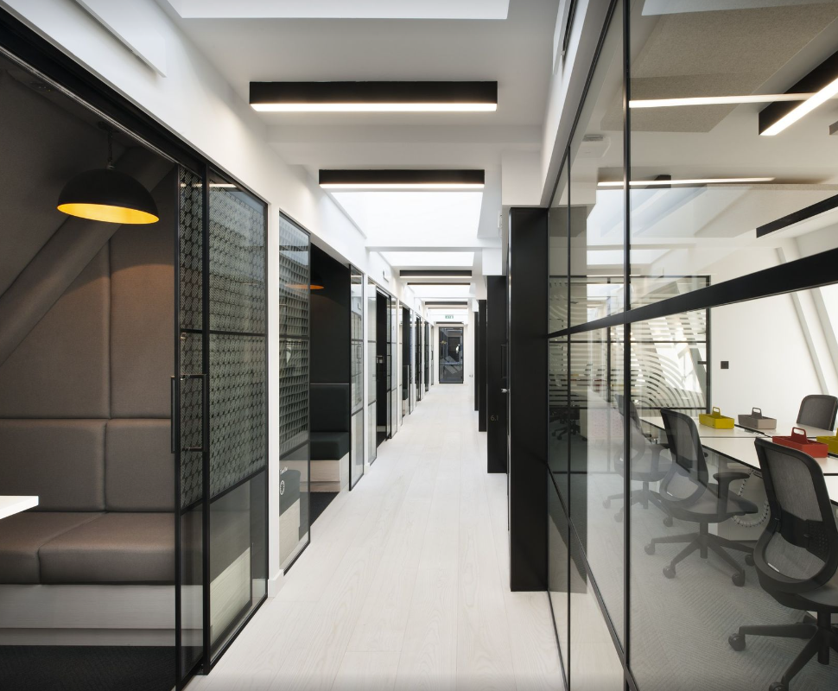
Challenge
As materials needed to be as natural as possible, and certified, there was a limitation on the materials that can be used.
The materials palette was inspired by the rich heritage of Mayfair and the client's vision for quality, well-crafted spaces. Marble and brass complement modern materials, including textured chevron carpet, timber flooring and joinery alongside black aluminum glazed partitions and doors.
Image Source: https://archello.com/story/63461/attachments/photos-videos/7
Notes:
A constraint from the targeting the WELL standard was actually a “nice limitation,” says Jon Eaglesham, Managing Director at Barr Gazetas, namely that materials needed to be as natural as possible, and certified. “It makes it harder to find the (natural, durable and sustainable) materials, there’s less available to you, but what there is very nice.” Mayfair’s “rich past” was used for inspiration, with classic materials such as marble and brass complemented by more modern counterparts like chevron carpet, ash and Douglas fir for flooring and bespoke joinery, and black aluminum for frames to partitions and doors.

Slide 67
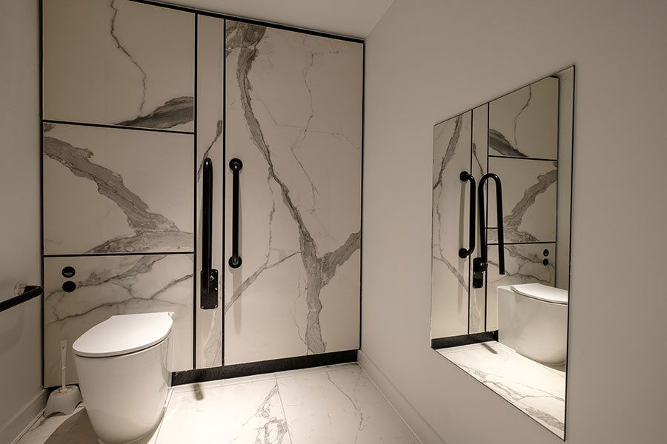
Unique washroom space
The brass effect accessories were paired with marble vanity splash backs and oak veneer toilet cubicles to create a distinctive washroom design
Image Source: https://www.washroom.co.uk/casestudies/1-heddon-street-london/
Notes:
The team created and installed new washrooms for all five levels of the building as part of this project – all featuring a stunning combination of marble and brass, offering the perfect balance between contemporary and traditional styles.
The brass effect accessories including wall-mounted taps, coat hooks, handles and cubicle locks, were paired with marble vanity splash backs and oak veneer toilet cubicles to create a distinctive washroom design. With washroom accessories now available in a wide range of different finishes, the trend to move away from standard stainless steel washroom accessories in certainly one to watch.

Slide 68

Additional Wellbeing Initiatives
The Crown Estate hosts a wellbeing programme for customers, including yoga, pilates and kickboxing sessions, lunch and learns, and creative workshops.
Image Source: https://www.kingstaryoga.co.uk/workshops
Notes:
Now that we have discussed the WELL strategies implemented in the project, lets look at some additional wellbeing initiatives around the One Heddon Street.
The Crown Estate hosts a wellbeing programme for customers, including yoga, pilates and kickboxing sessions, lunch and learns, and creative workshops. Over 2020-21, the programme was moved online because of Covid-19. About 2800 customers from across the Central London portfolio attended fitness classes and approx. 1300 customers attended talks, covering topics such as financial wellbeing, nutrition and sleep.

Slide 69
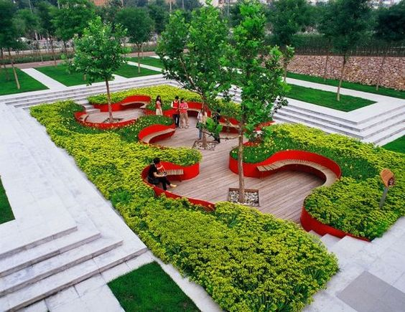
Additional Wellbeing Initiatives
Created a greener, safer and more accessible urban space:
  Additional paving space to improve the visitor experience and support social distancing
  New cycle lanes for safe and active travel
  Seating to support social interactions
  Tree planting and greenery to boost biodiversity and improve air quality
Image Source: https://www.trendhunter.com/trends/bridge-gardens-by-turenscape
Notes:
The Crown Estate and Westminster City Council have delivered interim plans for Regent Street to help create a greener, safer and more accessible West End. These include 5,000m2 of additional paving space to improve the visitor experience and support social distancing, new cycle lanes for safe and active travel, and seating to support social interactions and relaxation, along with sustainable tree planting and greenery to boost biodiversity and improve air quality.

Slide 70
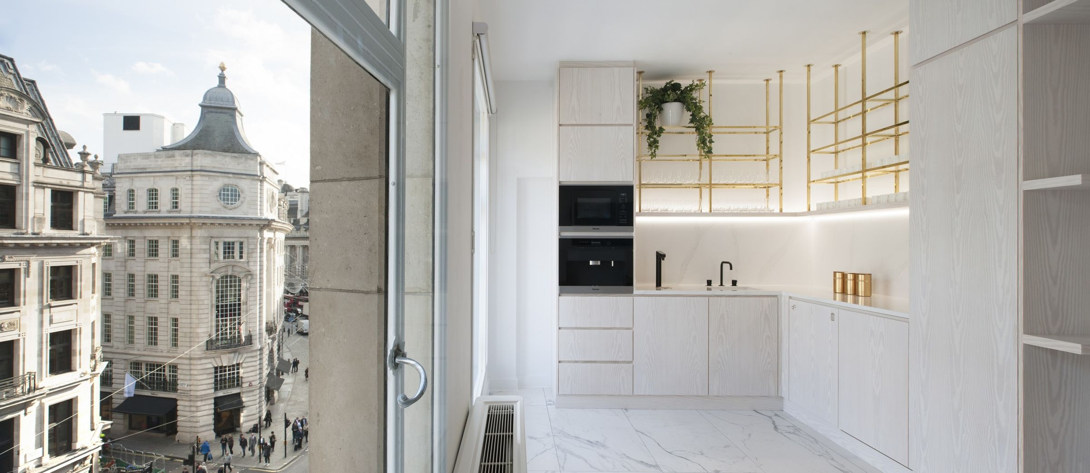
“
As we adjust to the effect of Covid 19, we’re all more aware than ever of the impact our working environment can have on our health, comfort and productivity. One Heddon Street is the latest of our workspaces to deliver the very highest standards of health and wellbeing for its occupants, reflecting the evolving needs of modern businesses and their staff, and we’re thrilled to have this recognized by WELL
”
Director Statement
Image Source: https://www.officelovin.com/2019/02/10/inside-the-crown-estates-new-london-coworking-space/
Notes:
James Cooksey, Director of Central London at The Crown Estate commented-
“As we adjust to the effect of Covid 19, we’re all more aware than ever of the impact our working environment can have on our health, comfort and productivity. One Heddon Street is the latest of our workspaces to deliver the very highest standards of health and wellbeing for its occupants, reflecting the evolving needs of modern businesses and their staff, and we’re thrilled to have this recognized by WELL.”

Slide 71

“One Heddon Street” Awards
2019
Hubble Awards’ Health & Wellness Award
Image Source: https://archello.com/story/63461/attachments/photos-videos
Notes:
The project has also successfully achieved “Hubble Awards- Health & Wellness Award” in 2019.

Slide 72
Operational Challenge
Enhanced air quality monitoring, water sampling, temperature checks and audits to maintain WELL Platinum standards during operation
Image Source: https://www.officelovin.com/2019/02/10/inside-the-crown-estates-new-london-coworking-space/
Notes:
WELL is a performance-based system. Every project is verified through on-site testing in operation. Maintaining the WELL Platinum during operation can be a challenge.
At One Heddon Street, The Crown Estate has introduced enhanced air quality monitoring, water sampling, temperature checks and audits as standard for the in-house engineering team. They have also piloted new cleaning protocols, in terms of choice of products and undertaking team training. Alongside the rollout of the One Heddon Street community wellbeing programme across the wider portfolio, this approach to cleaning is now being applied across The Crown Estate’s whole Central London portfolio.

Slide 73
Learnings from One Heddon Street
Holistic Approach to Well-Being
Human-Centered Design
Daylight and Biophilic Design
Sustainable Material Selection
Education and Awareness
Measurement and Performance
Image Source: https://archello.com/project/one-heddon-street
Notes:
Now that we have covered the WELL strategies implemented by One Heddon Street, lets look into our learnings:
Holistic Approach to Well-Being: Achieving WELL Platinum certification requires a comprehensive approach to promoting human health and well-being. One Heddon Street emphasized a holistic design, addressing various aspects of wellness, including air quality, lighting, water, nutrition, fitness, and mental well-being.
Human-Centered Design: The project placed a strong focus on human-centered design principles, considering the needs and preferences of occupants to create a comfortable, productive, and healthy environment.
Daylight and Biophilic Design: One Heddon Street prioritized maximizing natural daylight and incorporating biophilic design elements, connecting occupants with nature and positively influencing their well-being.
Sustainable Material Selection: The project have used low-VOC materials and sustainable building practices to ensure a healthy indoor environment and minimize environmental impacts.
Education and Awareness: Raising awareness among occupants about the wellness features and promoting healthy behaviors enhanced the effectiveness of WELL-certified spaces.
Measurement and Performance: The project continuously monitor and assess the performance of various wellness features to ensure that the building maintains its high standards over time.
One Heddon Street stands as a testament to the transformative power of WELL principles in creating thriving, sustainable urban communities. By prioritizing the well-being of its inhabitants and visitors, One Heddon Street has become a beacon of urban renewal and a model for future developments seeking to embrace the holistic approach to human health and happiness. Its success serves as an inspiration for other urban centers worldwide to integrate WELL certification principles into their design, operations, and policies, ultimately shaping healthier and more vibrant cities for generations to come.

Slide 74
Benefits faced by One Heddon Street
Enhancing customer appeal
Empowering members to be healthier and happier, which supports productivity.
Supporting customers’ own wellbeing goals
Piloting new wellbeing features
Encouraging best practice across the industry
Positive feedback from customers
Image Source: https://archello.com/project/one-heddon-street
Notes:
What are the some of the benefits faced by One Heddon Street by implementing WELL strategies?
Enhancing customer appeal. One Heddon Street has successfully attracted a broad range of businesses, including technology, media, finance, real estate, retail, construction and recruitment, from start-ups to established companies.
Empowering members to be healthier and happier, which supports productivity. The Crown Estate believes that WELL certification will boost customer confidence, due to knowing that they are returning to a workplace where health and wellbeing are prioritized, including best practice standards for air filtration and high levels of fresh air.
Supporting customers’ own wellbeing goals. There is growing customer interest in WELL certification, as evidenced at The Marq, where The Crown Estate delivered the shell and core to WELL Gold and a customer is progressing towards WELL Platinum certification for their space.
Piloting new wellbeing features, which The Crown Estate is now rolling out on additional projects across Central London and its Regional portfolio through its Development Sustainability Principles.
Encouraging best practice across the industry, with the project team taking lessons from One Heddon Street onto future projects.
Positive feedback from customers at One Heddon Street includes:
“The variety of spaces makes for greater collaboration and helps us adopt different working styles, leading to better work and a better atmosphere within the team.” Nick Ellsom, Founder of Fast Thinking
“We wanted to find a co-working space that represented our culture, beliefs and brand values. After an extensive market search, we were introduced to Heddon Street, which was just what we were looking for. The location is excellent, and the space clearly has wellbeing at its core. We can’t wait to move in and enjoy all the benefits of Heddon Street!” Jess Sturkey, Finance Director at Philip Kingsley

Slide 75
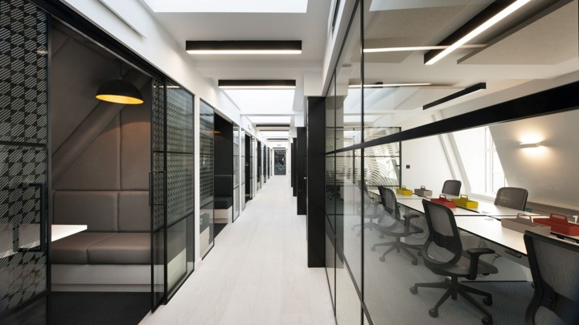
“The variety of spaces makes for greater collaboration and helps us adopt different working styles, leading to better work and a better atmosphere within the team.”
“We wanted to find a co-working space that represented our culture, beliefs and brand values..”
Nick Ellsom, Founder of Fast thinking
Jess Sturkey, Finance Director at Philip Kingsley
Nick Ellsom, Founder of Fast thinking
Notes:
Positive feedback from customers at One Heddon Street includes:
“The variety of spaces makes for greater collaboration and helps us adopt different working styles, leading to better work and a better atmosphere within the team.” Nick Ellsom, Founder of Fast Thinking
“We wanted to find a co-working space that represented our culture, beliefs and brand values. After an extensive market search, we were introduced to Heddon Street, which was just what we were looking for. The location is excellent, and the space clearly has wellbeing at its core. We can’t wait to move in and enjoy all the benefits of Heddon Street!” Jess Sturkey, Finance Director at Philip Kingsley

Slide 76
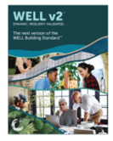







CONCLUSION – WELL Certification Roadmap
Pre-design & Planning of a Project
WELL Building Standard
Implementation - Design & Construction
3rd Party (GBCI) Documentation Review
Prepare & Submit Documentation
Occupancy & Operations
3rd Party (GBCI or approved by GBCI) Performance Verification
WELL Certification
Performance Review & WELL Recertification
Notes:
Now that we have completed a case-study, let’s summarize the whole WELL journey by going through the WELL Certification Roadmap.
Once a project is proposed, the project goes through different phases, which includes:
Pre-design and Planning: This phase involves setting wellness goals, conducting feasibility studies, and selecting the appropriate WELL certification level using the WELL Building Standard.
Implementation- Design and Construction: During this phase, the project team implements wellness strategies in the building's design and construction, such as incorporating biophilic elements, optimizing lighting, and selecting sustainable materials.
Occupancy and Operations: Once the building is completed, the focus shifts to ensuring ongoing WELL compliance through operational strategies, occupant engagement, and maintenance practices.
Documentation: The implemented strategies are documented for compliance as per the documentation guidelines mentioned in the WELL Building Standard.
3rd Party (GBCI) Documentation Review & Performance Verification: Once the documentation is submitted, a 3rd party reviews it and performs on-site verification.
WELL Certification: Once the 3rd party verifies, the project achieves the WELL Certification as per the points approved.
Performance Review and Re-certification: Periodic reviews and re-certifications are necessary to assess the building's performance, make improvements, and maintain WELL certification over time. Recertification is required every 3 years from the initial certification.

Slide 77
CONCLUSION – 3 Key Aspects of WELL
Interdisciplinary Collaboration
Human-Centered Design
Performance-Based Approach
Notes:
Listed here are the 3 key aspects of WELL Certification.
Interdisciplinary Collaboration: WELL Building Standard demands the collaboration among architects, designers, engineers, health professionals, and building operators to effectively implement WELL features.
Human-Centered Design: WELL Building Standard emphasizes the importance of creating spaces that prioritize occupant health, well-being, and productivity through evidence-based design strategies.
Performance-Based Approach: WELL Building Standard is a performance-based standard, meaning that buildings must demonstrate ongoing compliance and positive health outcomes for occupants.

Slide 78

CONCLUSION – Embracing the Potential of WELL v2
Flexibility and Global Applicability
Latest Research and Expertise
Positive Impact on Occupants
Notes:
As discussed in the start, WELL v2, also known as the WELL Building Standard version 2, is the second version of the WELL Building Standard. WELL v2 was introduced in 2018 as an evolution of the original WELL v1. It represents a significant advancement in the understanding of the connections between buildings and human health, incorporating the latest scientific research and industry expertise. WELL v2 takes a more holistic and flexible approach to promote human well-being by addressing a broader range of health and wellness factors.

Slide 79

Notes:
That concludes our first WELL case-study. Hope you enjoyed learning about this amazing project!
At this time, I also want to thank all our instructors, research associates, designers, and production team who help with all our courses, and exam prep.
Our un-sung hero or rather heroes for this series is our team of sustainability ambassadors who represented us at the National Convention for students in Architecture in India.
Please explore other GBRI courses on this platform and our climate change ambassador program.
Thank you!

Slide 80
https://oneheddonstreet.com/#features
https://barrgazetas.com/projects/one-heddon-street
https://www.betterbuildingspartnership.co.uk/world-first-wellbeing-crown-estate%E2%80%99s-one-heddon-street
https://www.betterbuildingspartnership.co.uk/crown-estates-one-heddon-street-achieves-platinum-well-certification
https://www.architonic.com/en/project/aram-one-heddon-street/20165131
https://archello.com/project/one-heddon-street
https://radiiplanetgroup.com/en/planet/projects/one-heddon-street/
Course Resources
Image Source: https://archello.com/story/63461/attachments/photos-videos
Notes:
Here’s the list of links to further reading and resources for those interested in learning more about One Heddon Street.
https://oneheddonstreet.com/#features
https://barrgazetas.com/projects/one-heddon-street
https://www.betterbuildingspartnership.co.uk/world-first-wellbeing-crown-estate%E2%80%99s-one-heddon-street
https://www.betterbuildingspartnership.co.uk/crown-estates-one-heddon-street-achieves-platinum-well-certification
https://www.architonic.com/en/project/aram-one-heddon-street/20165131
https://archello.com/project/one-heddon-street
https://radiiplanetgroup.com/en/planet/projects/one-heddon-street/

Slide 81


Notes:
Thank you Lekshmi, Harsha, Simran, Aishwarya, Aparna, and Sam for representing GBRI and promoting our Climate Change Ambassador program among more than 3000 students at this convention by running 9 sessions in a span for 4 days. Also, thanks to Liesl for creating our climate change song which you will see towards the end of this course.
Please explore other GBRI courses on this platform and our climate change ambassador program.
Thank you!

Slide 82


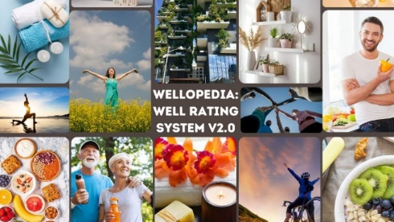


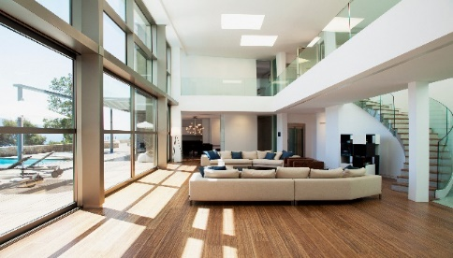
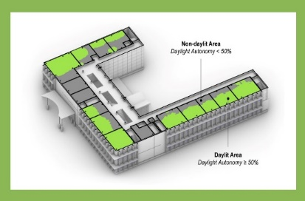

Explore More WELL Courses From GBRIonline.org
I am doing WELL v2. Are You?
WELLopedia v2: The ins and outs of the WELL Building Standard v2
Let There Be Light: An Illuminating Introduction to Daylighting
Daylighting in Green Building Rating Systems: A Focus on LEED and WELL

Slide 83

Become a GBRI Wellness Ambassador

Slide 84








Explore More Courses From GBRIonline.org
Contractor's Corner: Mastering LEED BD+C Waste Management under v4.1
Beyond the Building: Conquering Outdoor Water Conservation within LEED v4.1
Aquatic Alchemy: Unraveling LEED v4.1 Indoor Water Use Reduction & Strategies
Drips to Drops: Strategies and Mastery of LEED v4.1 Process Water Use Credit

Slide 85
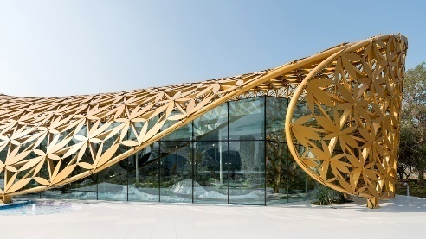






Explore More Courses From GBRIonline.org
Biophilic Design: A Truly Sustainable Design
From ABCs to STEM: Biophilic Design for Schools
Get Well Soon: Biophilic Design for Healthcare
Orange is the new Green: Biophilic Design for Prisons

Slide 86




Explore More Courses From GBRIonline.org
Sustainability, Health & Wellness Courses
LEED & WELL Exam Prep
LEED v4: Through the eyes of a Contractor
Corporate Sustainability Reporting: Getting Started
LEED Exam Prep for Green Associates, BD+C and O+M
LEED v4 Online Modules
Nature’s Marvels: Innovation in Natural Building Design
Sustainable Olympics: A Gold Medal Winner
WELL AP Exam Prep Quizzes and Mock Exams
WELL AP Exam Prep Study Guide Package

Slide 87
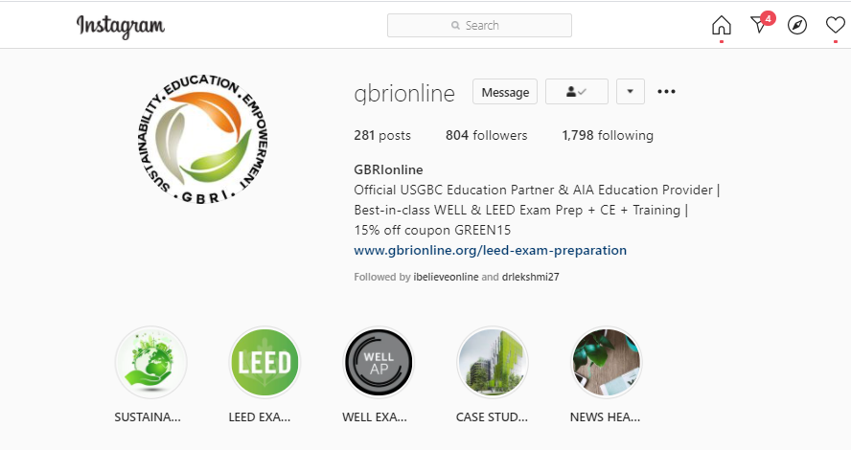
https://www.instagram.com/gbrionline/

Slide 88

Please don’t forget to review our course!

