Slide 1




LEED

Slide 2









Integrative Design Credit
LEED Categories
Location & Transportation
9
Sustainable Sites
Water Efficiency
Areas
Energy & Atmosphere
Materials & Resources
8
Indoor Environmental Quality
Categories
Innovation
Regional Priority
Notes:
The LEED Green Building Rating System revolves around these 8 categories, each addressing essential aspects of green buildings as outlined above. However, the 9th element, which is not a LEED category, is the Integrative Process.

Slide 3

Online Modules
LEED v4 Process: History of LEED
LEED v4.0
Formation of GBCI - 2008
LEED V1.0
LEED v2.1
LEED v5.0
1993
2000
2005
2009
2002
2023
2025
1998
2007
2013
LEED v2.0
LEED v2.2
Formation of USGBC
LEED v5.0 (Beta)
LEED 2009 or v3.0
Notes:
Let’s look at some evolutionary characteristics of LEED.
Let’s start with looking at the history of LEED . The USGBC was founded in 1993, as a non-profit community of leaders. At present, the USGBC has more than 15,000 member organizations.
The ﬁrst LEED Pilot Project Program, also referred to as LEED Version 1.0, was launched in August 1998. After extensive modiﬁcations, the LEED Green Building Rating System Version 2.0 was released in March 2000. This rating system was called the LEED Green Building Rating System for New Commercial Construction and Major Renovations, or LEED-NC.
As the LEED rating system evolved and matured, the program undertook new initiatives, including working with international communities, addressing new building types, etc.
In 2007, the GBCI was established as a separately incorporated entity with the support of the USGBC. As you are aware, GBCI administers the LEED professional accreditation programs independently. A side note, we are not owned by GBCI or USGBC.
Since Version 1.0, LEED has undergone many, which subsequently evolved into LEED 2009 (the current version). At present, the industry is at the threshold of yet another version (LEED v4.0) which was launched in November 2013. Even though the new version has come out, LEED 2009 will be open for project registration until June 27, 2015. This is a good information to note for design and construction professionals working on LEED 2009 projects.
As LEED AP candidates – you don’t have to memorize these dates. This just shows LEED has come a long way from version 1.0 to V4. You need to remember that the previous version of LEED or LEED 2009 is still open for LEED Project registrations which means projects are not required to register under the latest version of LEED yet. In addition, for projects currently registered under LEED 2009 - certification will be available until June 30 – 2021.Which means projects that are currently registered under LEED 2009 or projects that will register until June 27th 2015 will have until June of 2021 to submit the final documentation and certify the project.

Slide 4
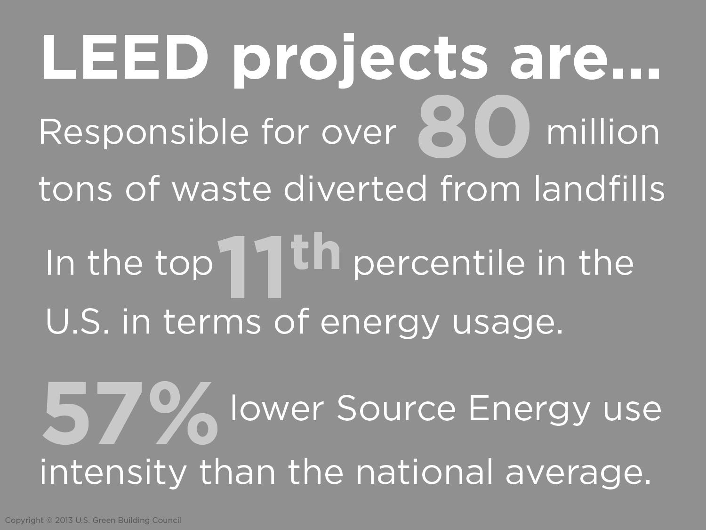

Notes:
Previous versions of LEED have already had a significant impact on the built environment. LEED v4 is about taking that impact to the next level.
According to a recent study by USGBC, LEED Projects are responsible for diverting over 80 million tons of waste from landfills. by 2030 that number is expected to grow to 540 million tons.
A review of data from 195 LEED projects found the buildings are in the top 11th percentile in the U.S. in terms of energy usage, have an Energy Source Score of 89/100 points, a 57% lower Source Energy use intensity than the national average, and that’s reported through the E.P.A. portfolio manager. These buildings were compared to similar buildings that EPA surveys using CBECs (commercial building energy consumption survey).
This information was shared with you to show the impact LEED projects are making. For exam prep – you don’t have to memorize any of these numbers on screen.

Slide 5
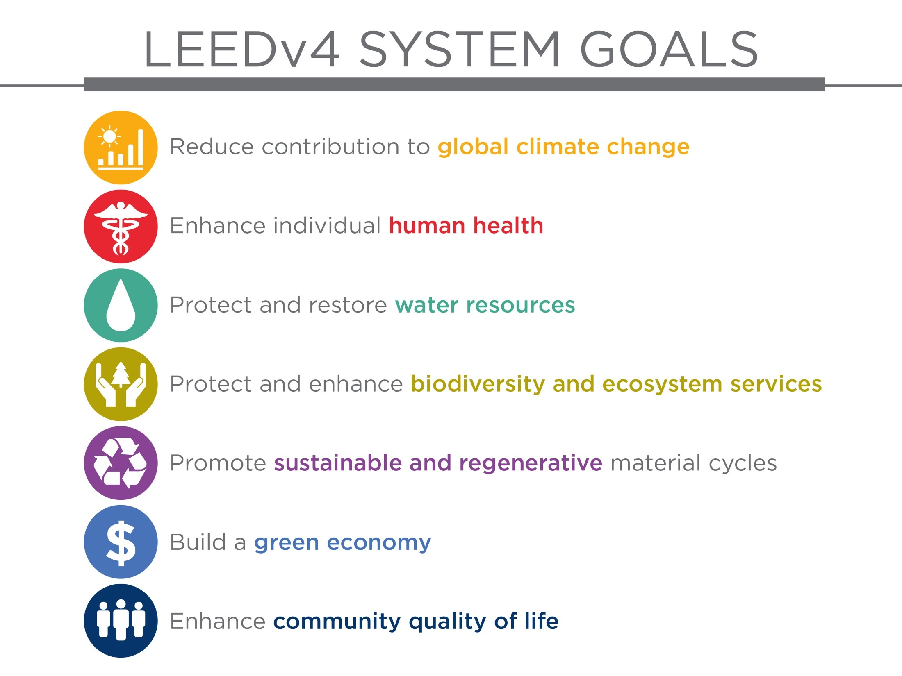
Notes:
As a market transformation instrument, LEED engages building project teams in a way that connects strategies to a defined set of goals. LEED’s system goals are referred to as “Impact Categories.” Seven Impact Categories were developed and approved by the LEED Steering Committee for incorporation into
LEED v4. These Impact Categories answer the question: “What should a LEED project accomplish?”
x Reverse or reduce Contribution to Global Climate Change
x Enhance Individual Human Health and Well-Being
x Protect and Restore Water Resources
x Protect, Enhance and Restore Biodiversity and Ecosystem Services
x Promote Sustainable and Regenerative Material Resources Cycles
x Build a Greener Economy
x Enhance Social Equity, Environmental Justice, and Community Quality of Life
The v4 system goals are intended to be things that we want LEED projects to be good at. Instead of thinking about reducing the negative impact associated with the consumption of water or the conversion of water, we want the buildings to actually think about protecting and restoring water resources, not just doing what's bad.
In addition to shifting from a “do less harm” to a “do more good” mindset, LEED expanded the scope of its goals to truly encompass the triple bottom line of people, planet, and profit.
You’ll see highlighted and enhanced in LEED V4 are issues related to human health and issues related to community quality of life.
Optional
When the U.S. Green Building Council launched LEED over a decade ago, it created a foundation for
sending market signals to the building industry to move toward sustainable alternatives. LEED provided a
way to quantify benefits that had previously been considered too difficult to quantify in a consistent manner,
putting things like energy and water efficiency, green materials and indoor air quality on the radar screen of
building projects around the country and the world. These market signals opened up potential for new
products and services, and incentivized new measures.

Slide 6
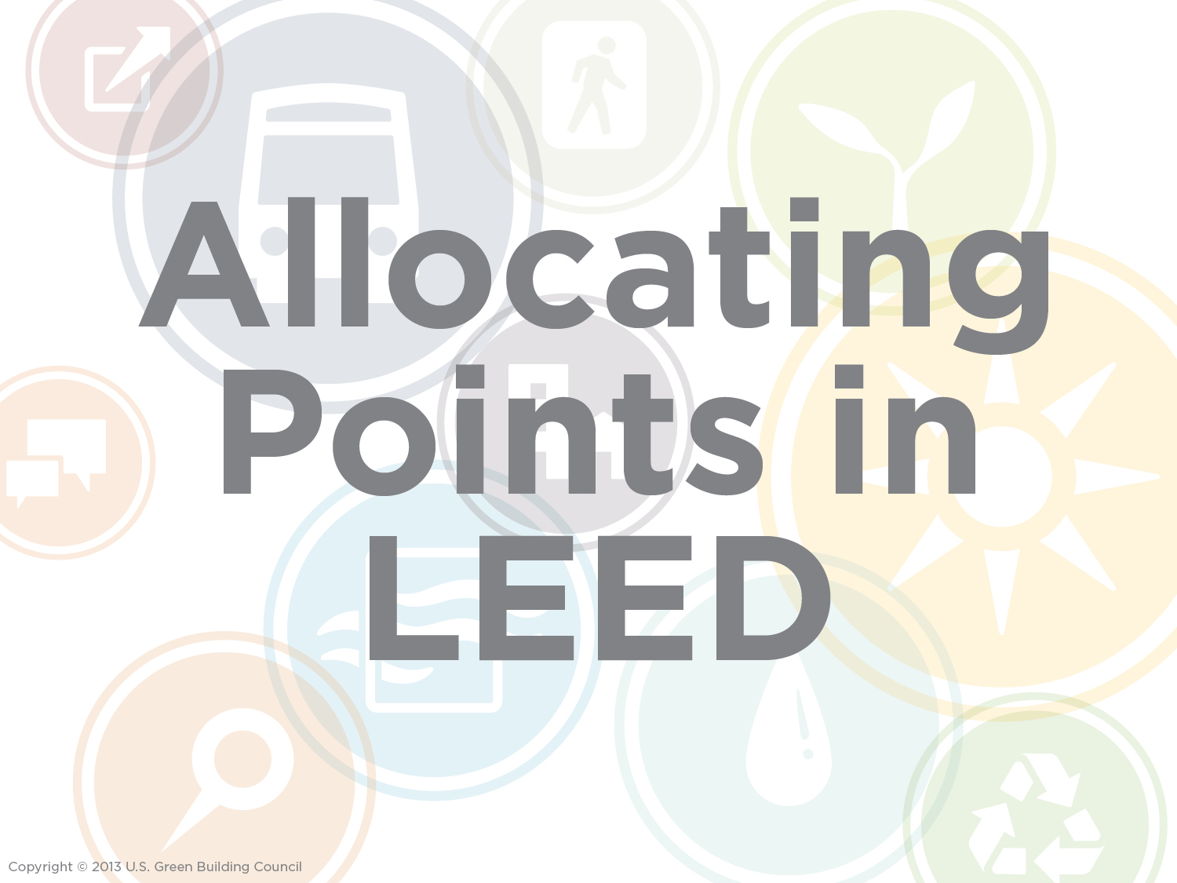
Relative efficacy – Benefit Duration - Controllability of effect
Notes:
With these system goals as a basis, USGBC went through a process of evaluating credit outcomes and assigning them a point value accordingly.
USGBC used 3 association factors – Relative efficacy – Benefit Duration and Controllability of effect to measure and scale credit outcome to a given impact categories we showed on previous slide.
They essentially went through and figured out what the relative efficacy of the credit is - a measure of whether and how strong the credit outcome is associated to the goal component being assessed relative to other credits. They looked at what the duration is - how long the benefits or consequences of the credit outcome can be expected to last. And what the controllability of the project team is – that is who the benefit of the credit outcome depends on.
By assessing these three parameters they end up with a mechanism that allows them to be able to articulate across those system goals, what the benefit of achieving that credit is. USGBC team went through and looked at each of the impact categories, gave them a relative waiting of the system goals which allowed that to inform how they then figure out what the most important credit in the rating system happens to be. USGBC had done the weeding out and assessment of what are the biggest issues and help teams know what to do first.

Slide 7
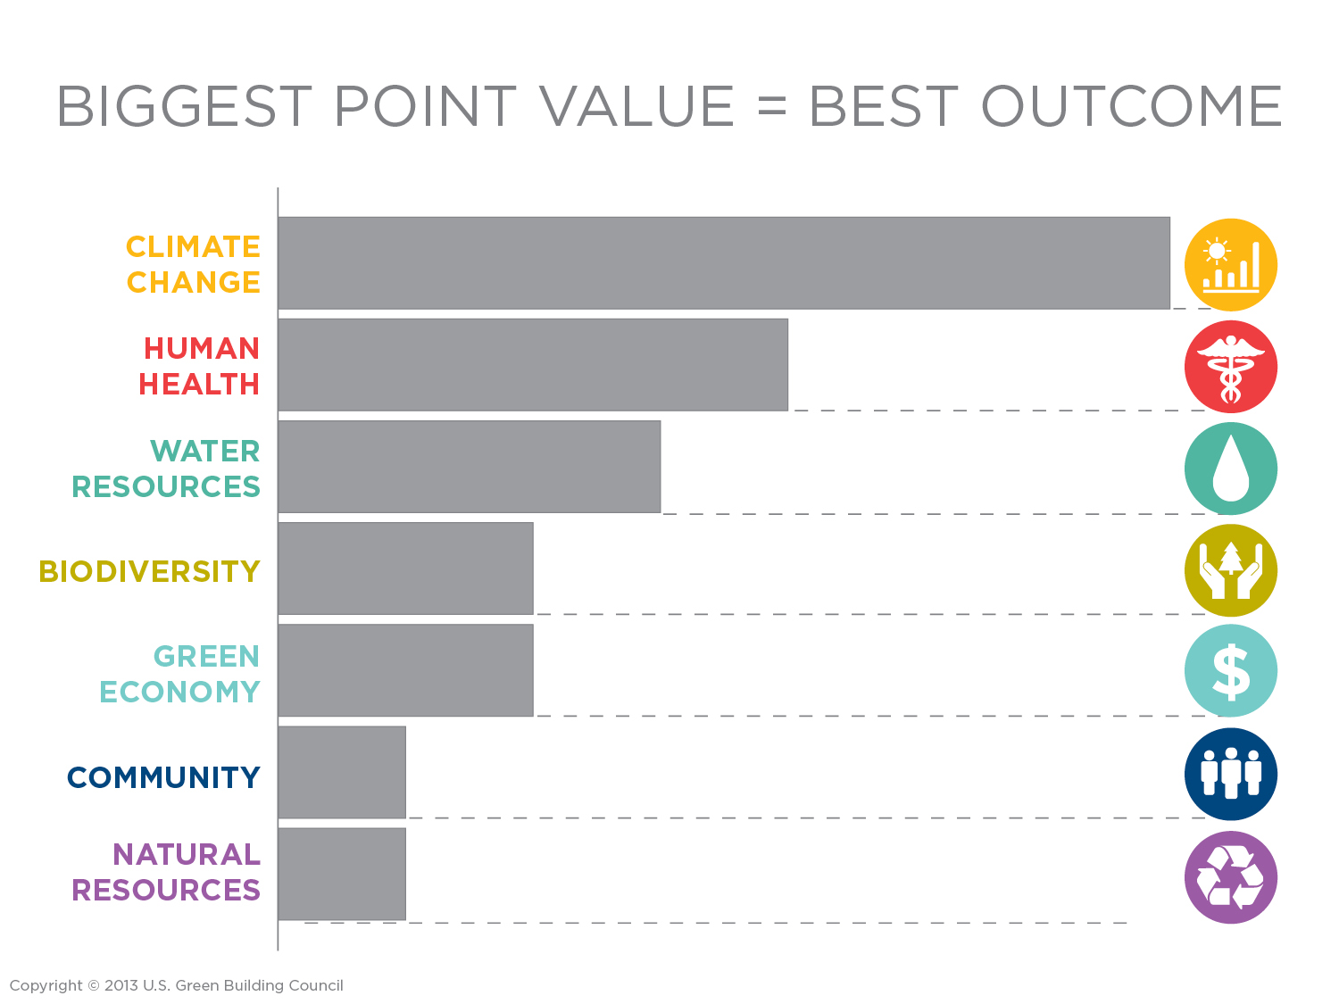
35%
20%
15%
10%
10%
5%
5%
Notes:
By using this process to assign the highest point values to credits that will have the greatest impact, LEED v4 provides project teams with the most efficient map of environmental good. By prioritizing the credits worth the most points, teams will be applying the strategies that will result in higher performing buildings.
From the standpoint of how this influences a project team, it established a prioritization of credits and how that actually changes the way project teams act. Since certain credits worth so many points that they're difficult to ignore and still achieve LEED platinum. It is virtually impossible and likely inherently economically irrational to not get a good score on the energy efficiency category and be a LEED platinum project. What they’re trying to do is make sure that they prioritized the right things with the credit ratings, and by doing so make sure that project teams focus on the right credits in the right order to maximize the outcomes of the goals of the LEED rating system.
Assessment of what project teams need to do first – go for the credits with the highest amount of points;
By pursuing these credits, positioned to have the best positive outcome; shifts away from old negative idea of “point grabbing” in LEED to making sure that the higher point credits have a higher environmental benefit too.
Teams should feel confident that earning these points in LEED means they are making a strong positive environmental impact.

Slide 8
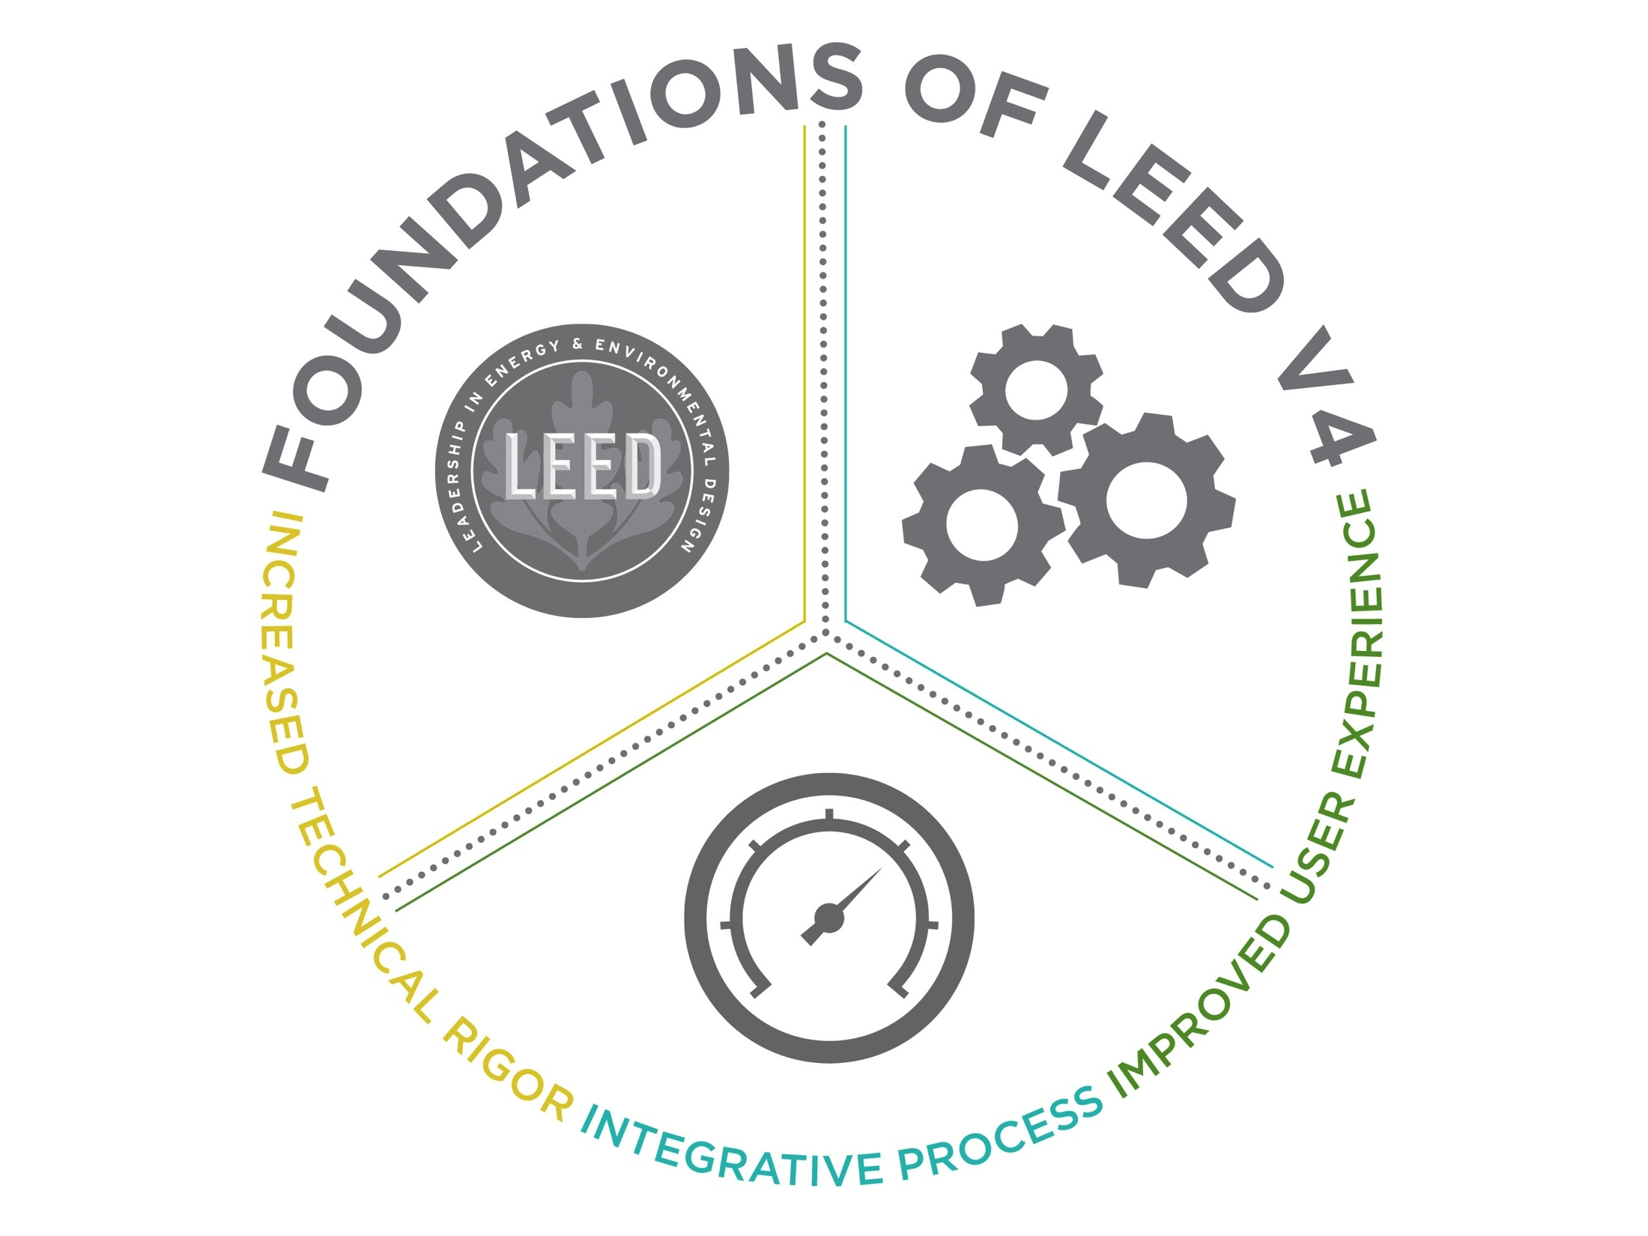
Notes:
At its core, the LEED v4 program builds from the foundation and alignment of LEED 2009. It focuses on increased technical rigor, integrative process, and improved user experience

Slide 9

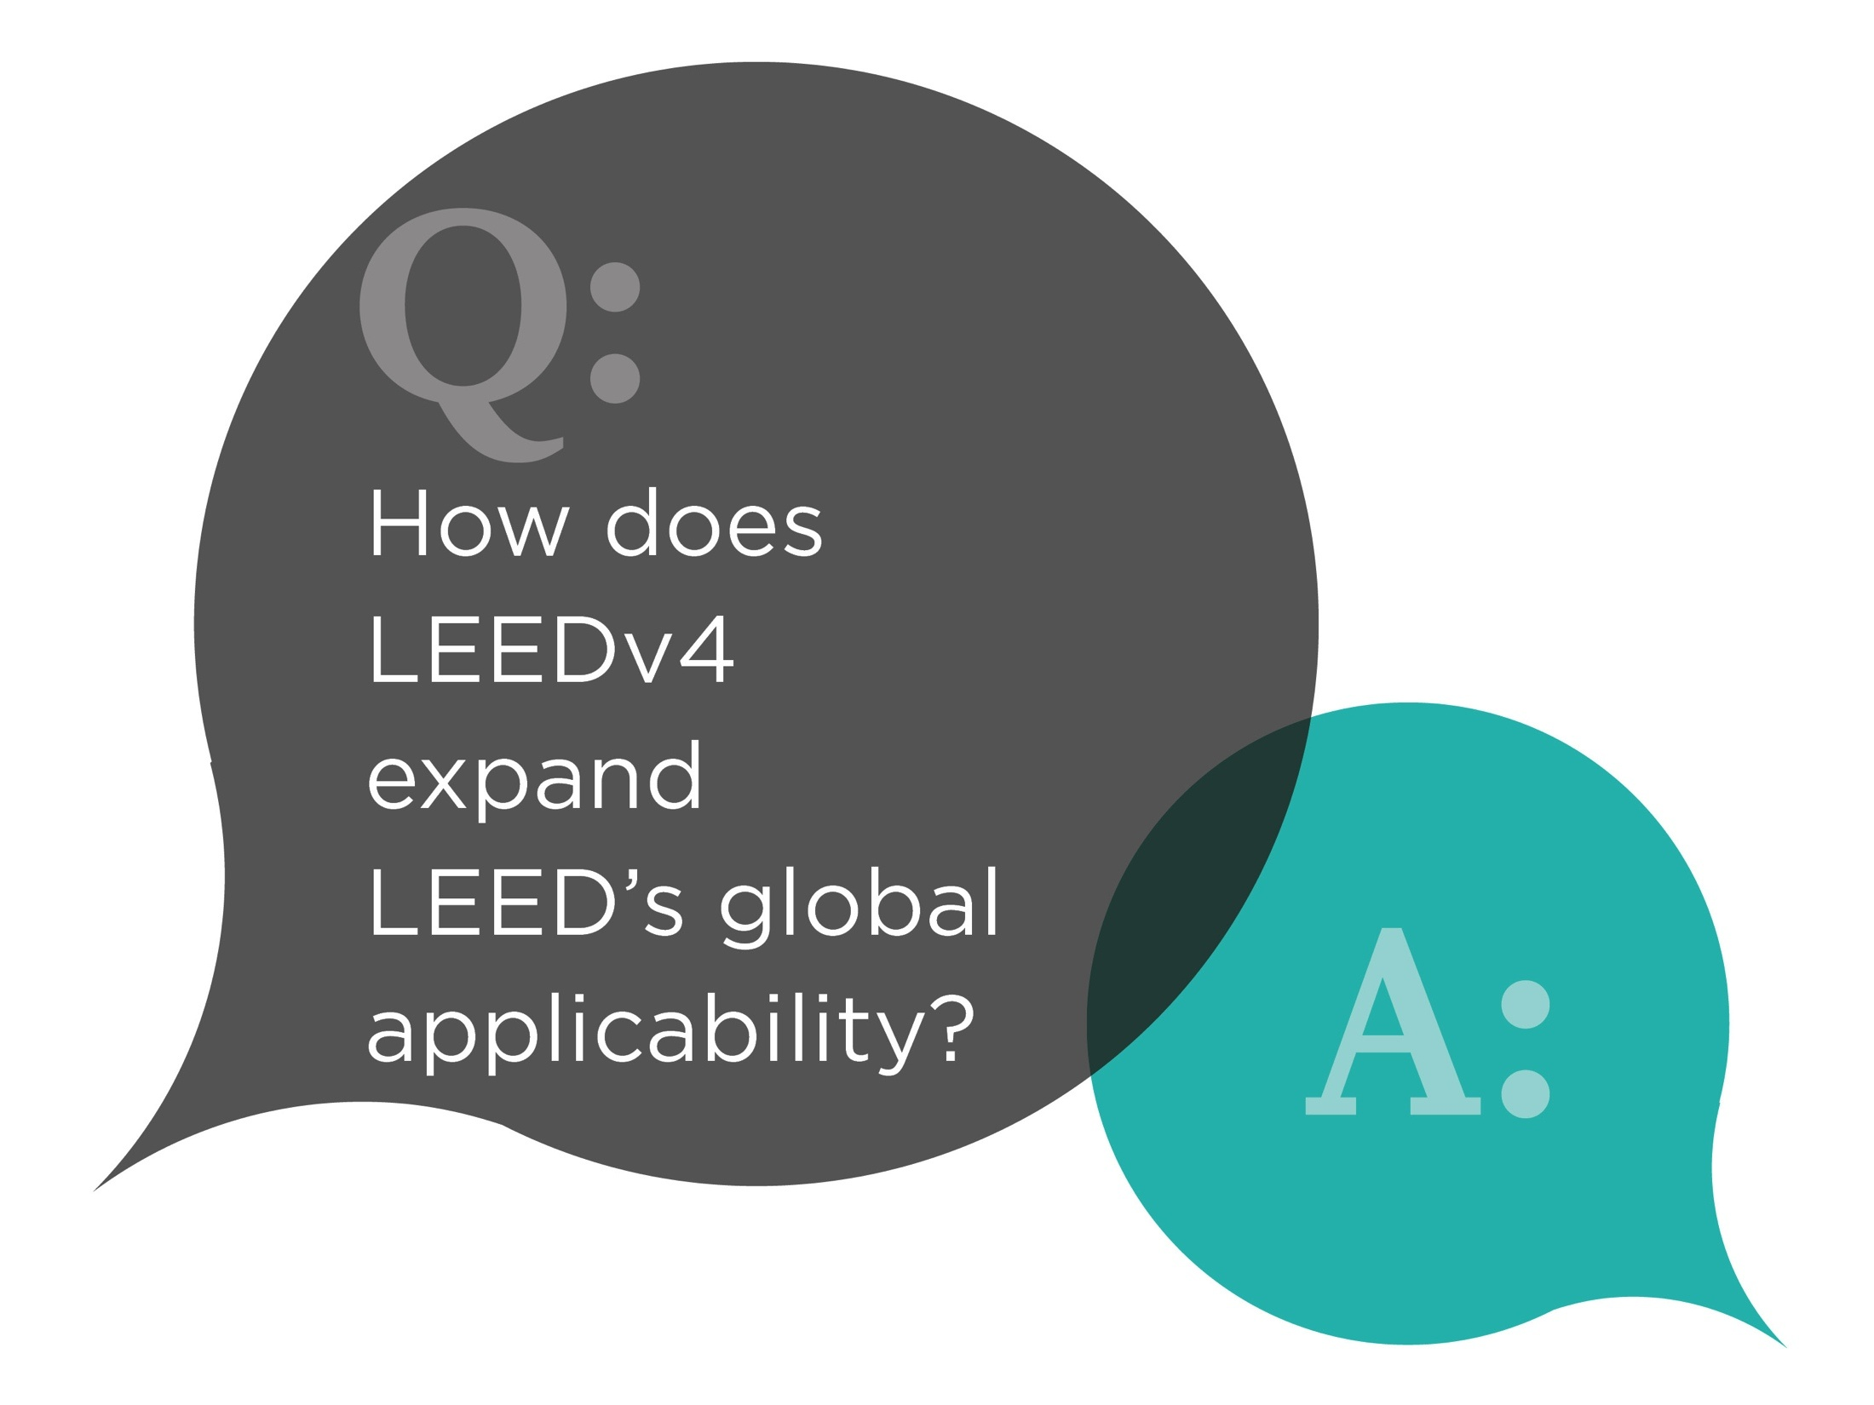
Notes:
So - Read from slide

Slide 10
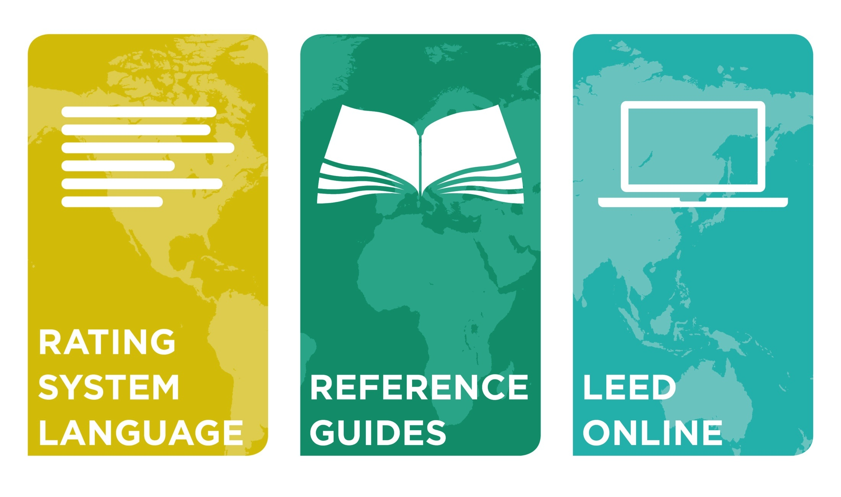
Notes:
LEED v4 expands LEED’s global adaptability in following ways – by customizing - rating system language, reference guides and LEED online.
Let’s look at Rating System Language – It incorporates metric units. In the rating system, U.S.-centric language, standards, requirements and definitions have been replaced wherever possible with globally acceptable alternatives.
Speaking of Reference Guide:
International and global data & examples are included
Provide tips on common issues faced by international projects will be provided for many credits
-The web based reference guide will allow for regional guidance to be added as local equivalencies are identified
Let’s see how LEED online has evolved for global adaptation - As many of you know, LEED Online is the portal that all LEED projects utilizes to communicate and transmit information to USGBC review team.
LEED online under v4
- Will support the use of metric units for all aspects of documentation, from calculations to supporting documents in an automated format.
- It also will allow local equivalencies to be identified and used in lieu of U.S. based requirements.

Slide 11
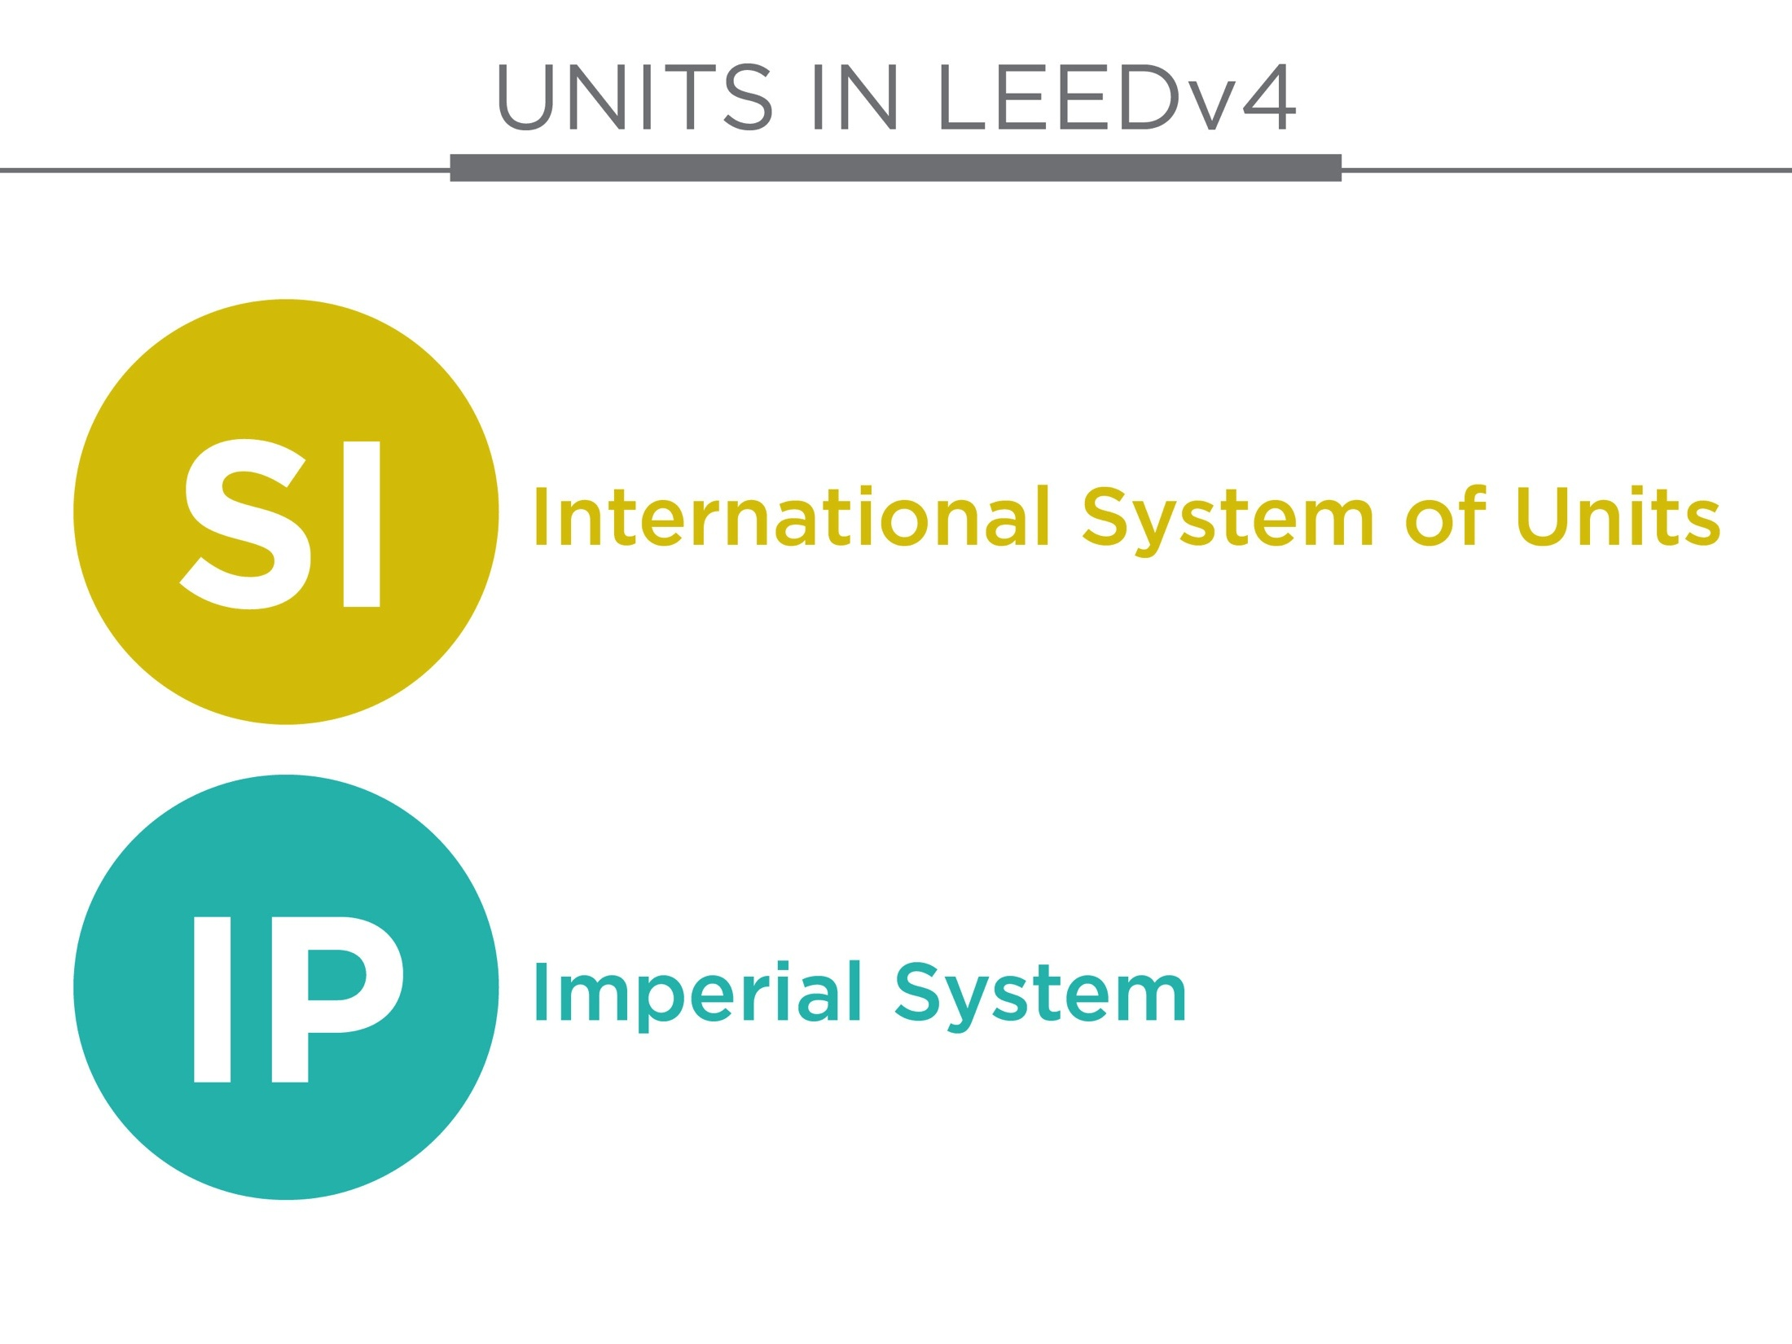
Notes:
All measurements and calculations are shown in both SI and IP to represent the different systems used around the world.

Slide 12
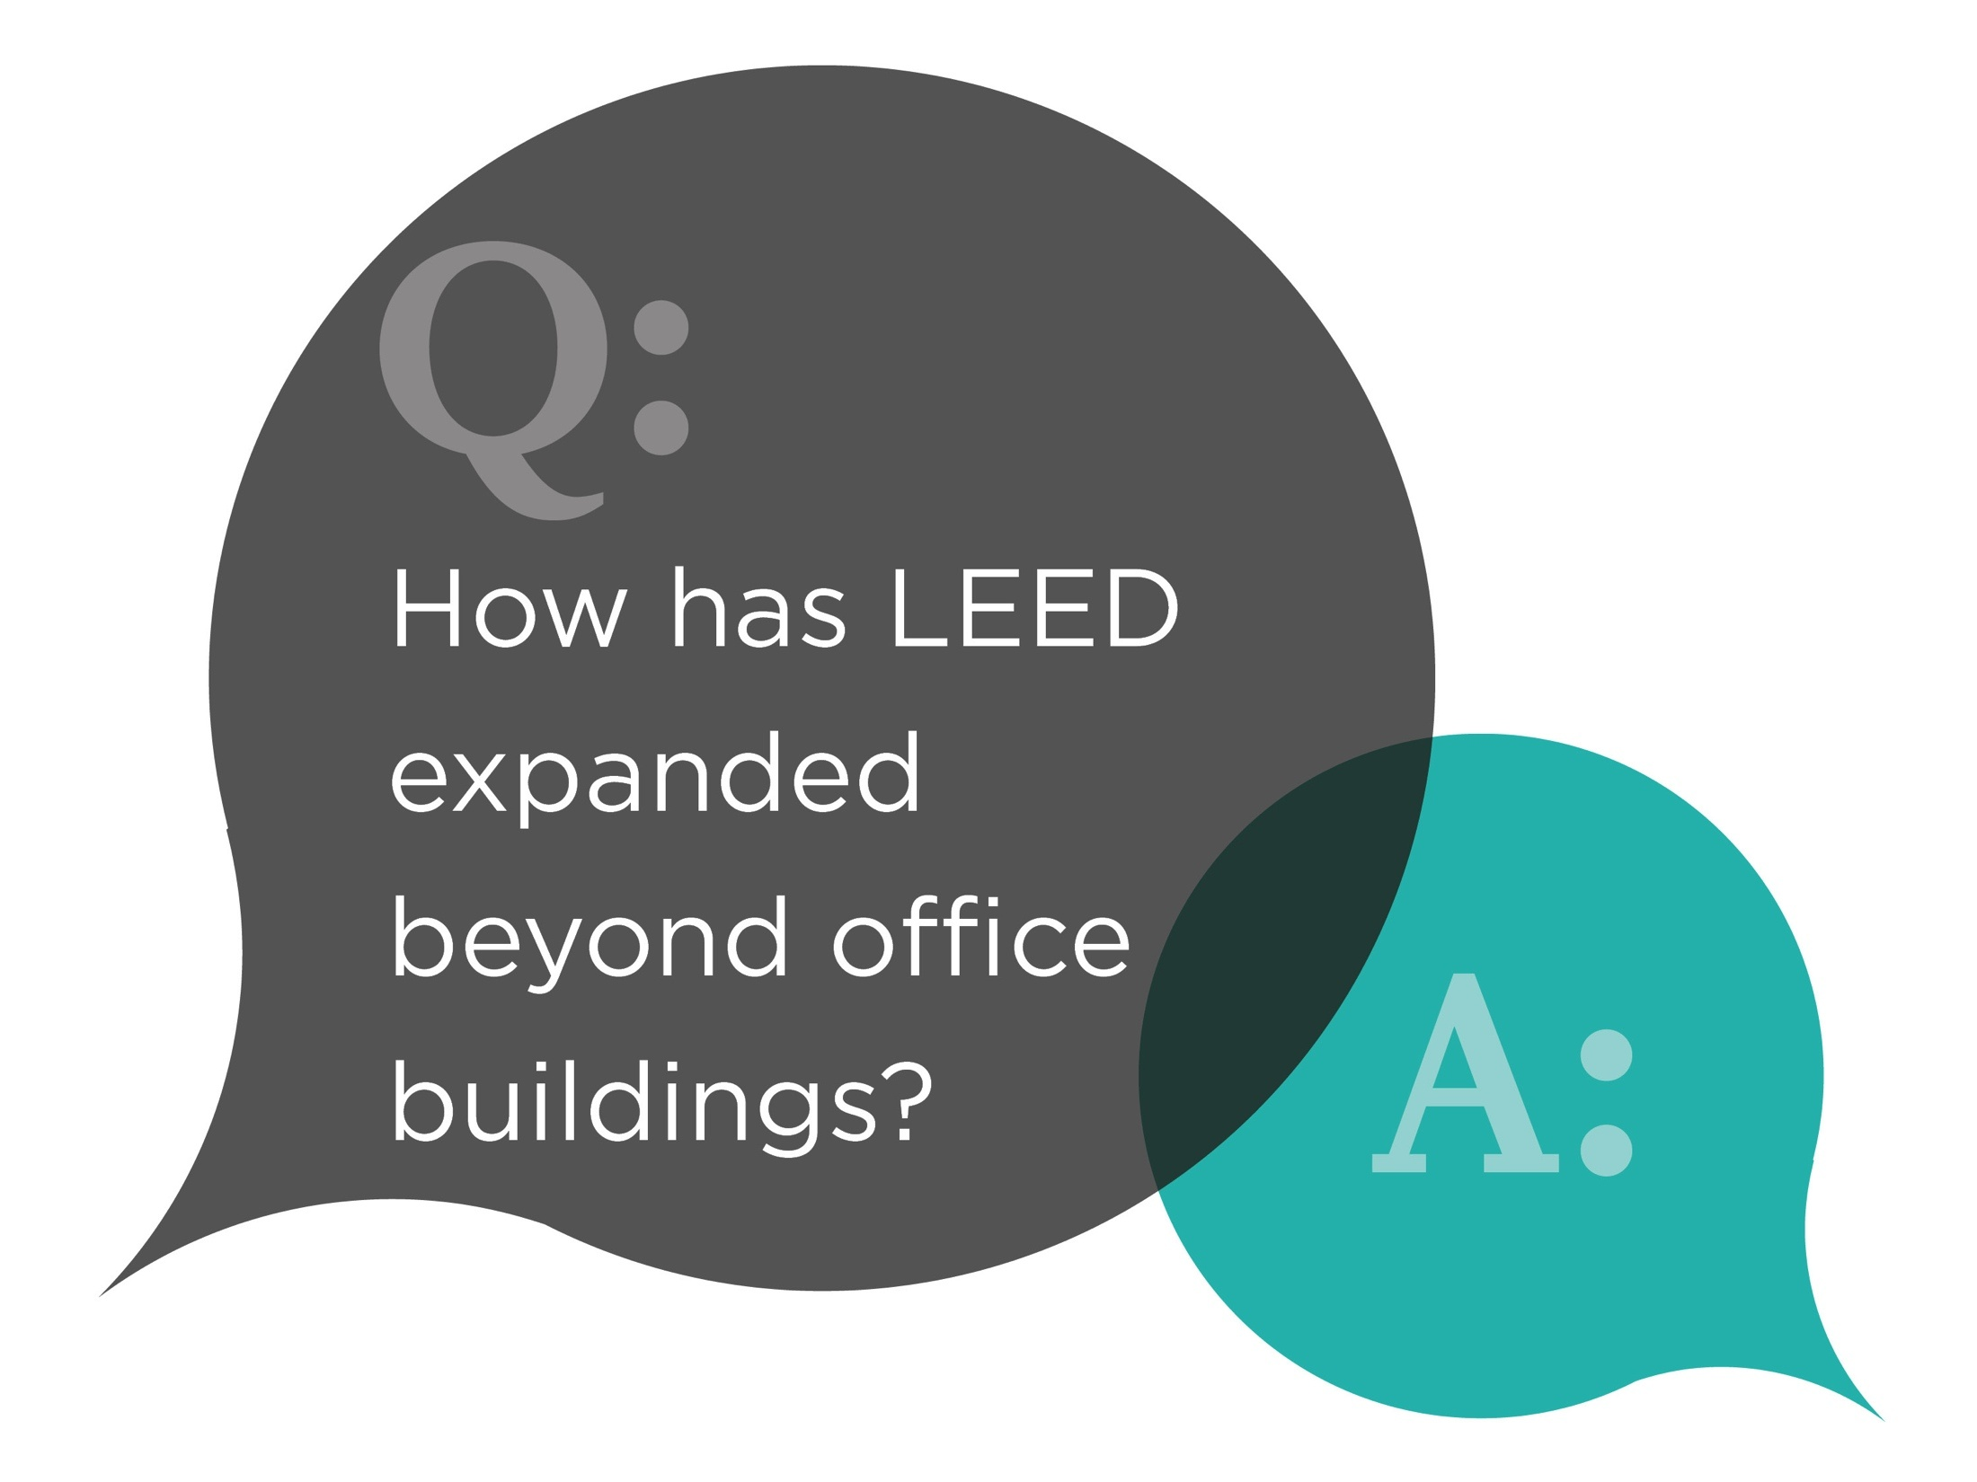
Notes:
Read from slide

Slide 13
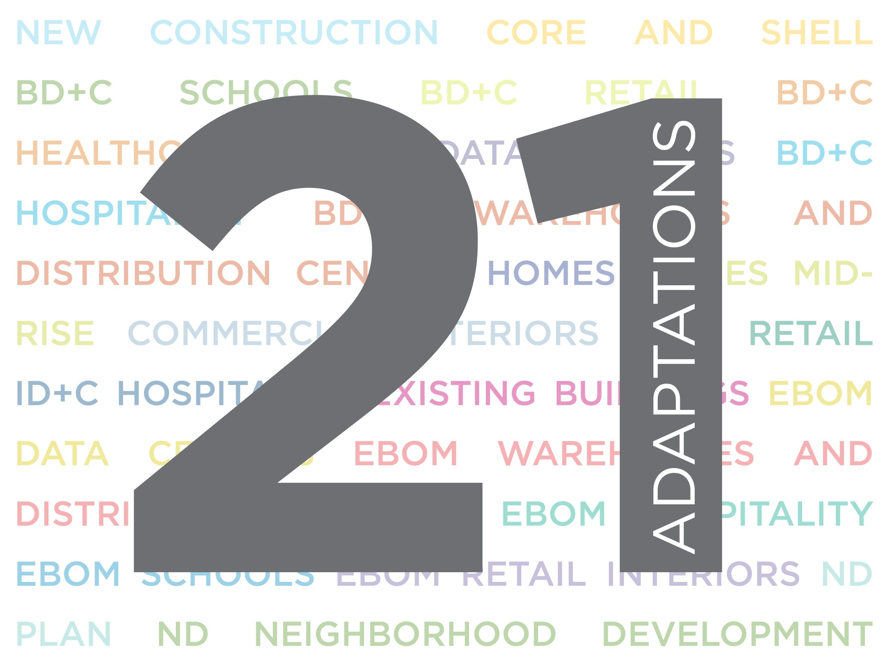
21
Notes:
One LEED means more solutions for more building types While LEED v4 represents one rating system; it supports 21 different building types making LEED more appropriate for more projects..such as hospitality, retail, ware house, data centers, core and shell and schools to name a few

Slide 14
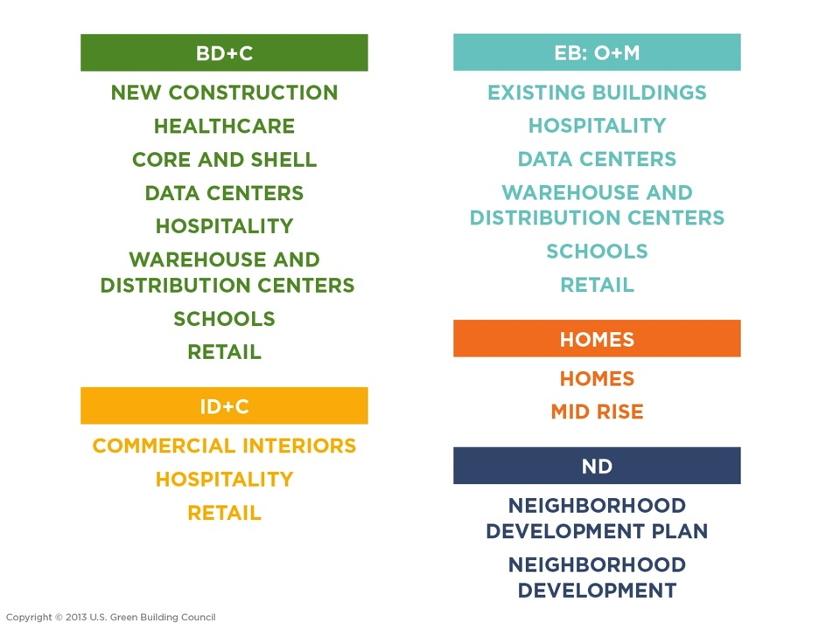
Notes:
Here is the list of all 21 different project types….The list is impressive and it may appear complicated but it makes LEED more appropriate for more project types.

Slide 15
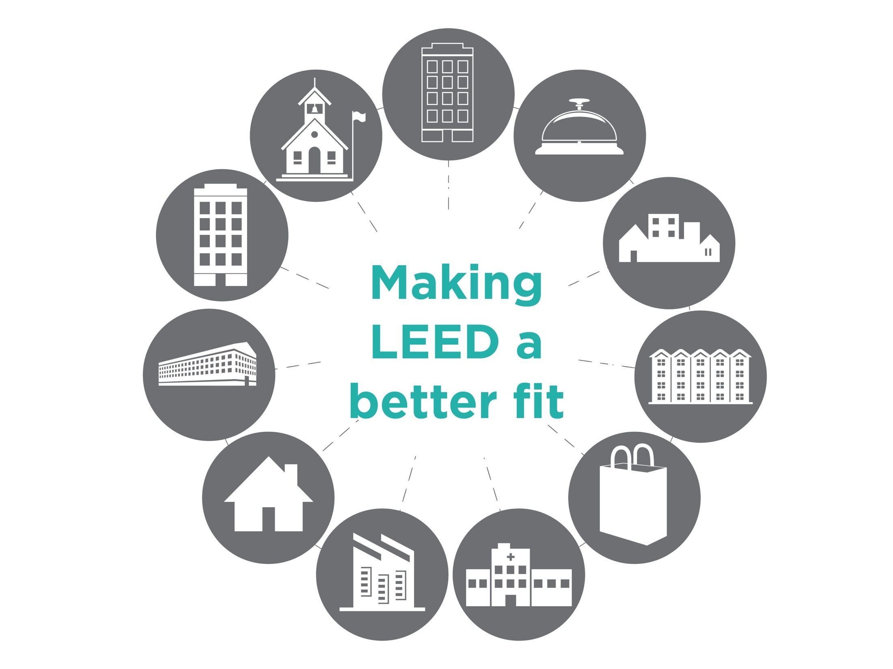
Notes:
More adaptations will help spur market transformation more effectively.
LEED v4 expands upon previous work to address the specific and unique needs of particular space types. These needs might be driven by occupants a facility serves, regulatory requirements, or unique resource needs.
By recognizing the unique needs of specific space types LEED removes barriers, moving us closer to market transformation
Each of these market sectors have unique needs and adaptations to the rating systems allows LEED to appropriately address those needs.
The goal was not to make LEED easier for new market types but to take into consideration the unique needs and challenges

Slide 16
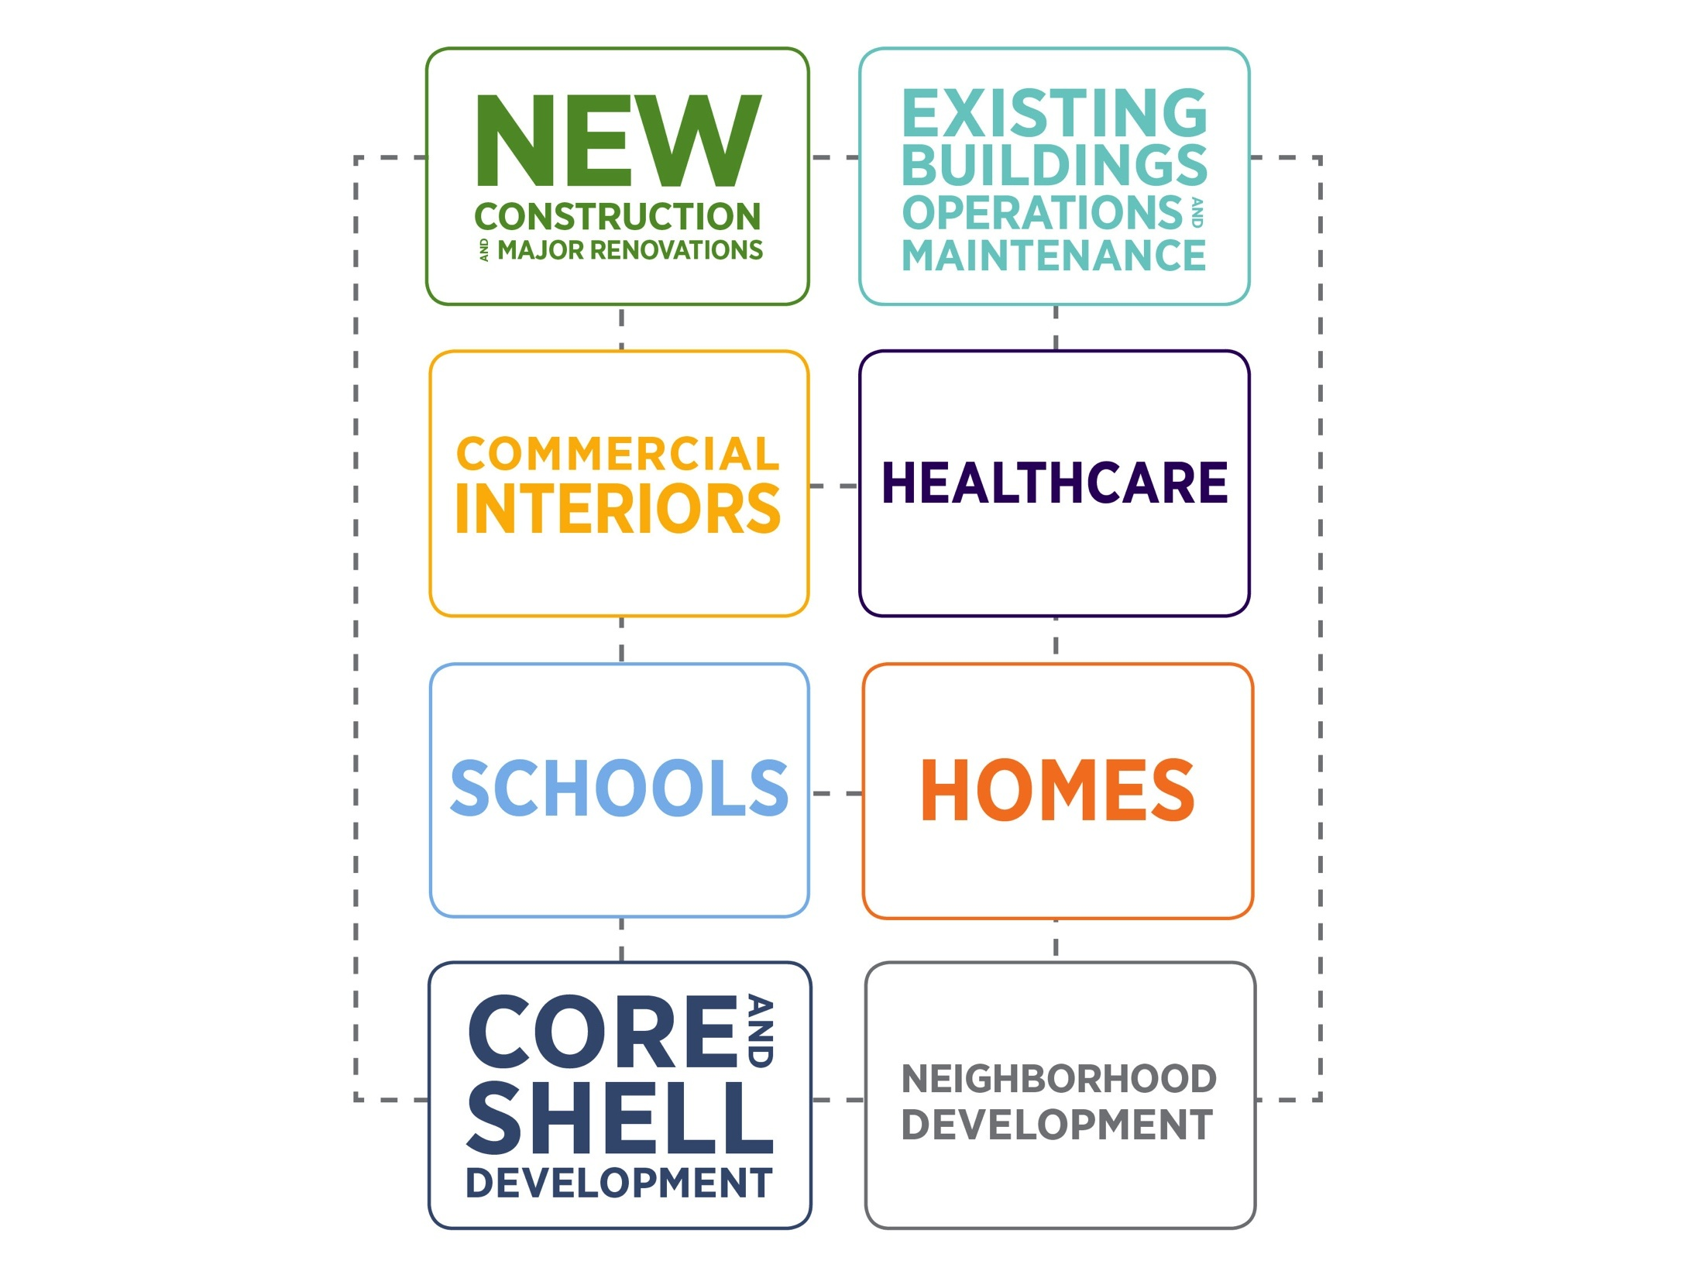
Notes:
Started with New Construction, as more people got interested in LEED there were other types of projects. Now 20 years later we’ve aligned things and made connections amongst all of the rating systems. Since the rating systems were developed at different times, not all the requirements between them aligned.
With v4, the rating systems are better aligned when the requirements and thresholds could be the same for a credit. Used studies and data to determine the requirements for a credit and to see if a specific project type meant there needed to be some differences.
The benefit to project teams is that understanding and working on one project type can make it easier to apply LEED to a different project type. You don’t need to learn a whole new rating system since most of the credits are now similar across project types.

Slide 17
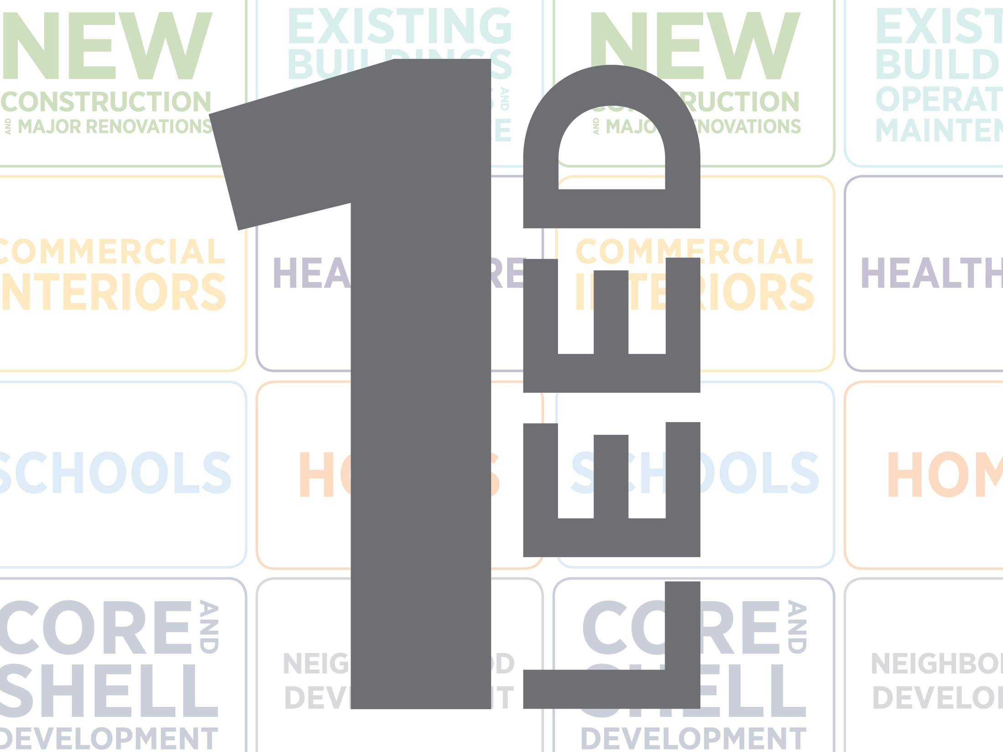
Notes:
Essentially all these are leading to one thing 1 LEED - its only different where it needs to be; you just need to learn 1 LEED. Once you know LEED for Design and Construction, you know it for Existing Buildings.

Slide 18
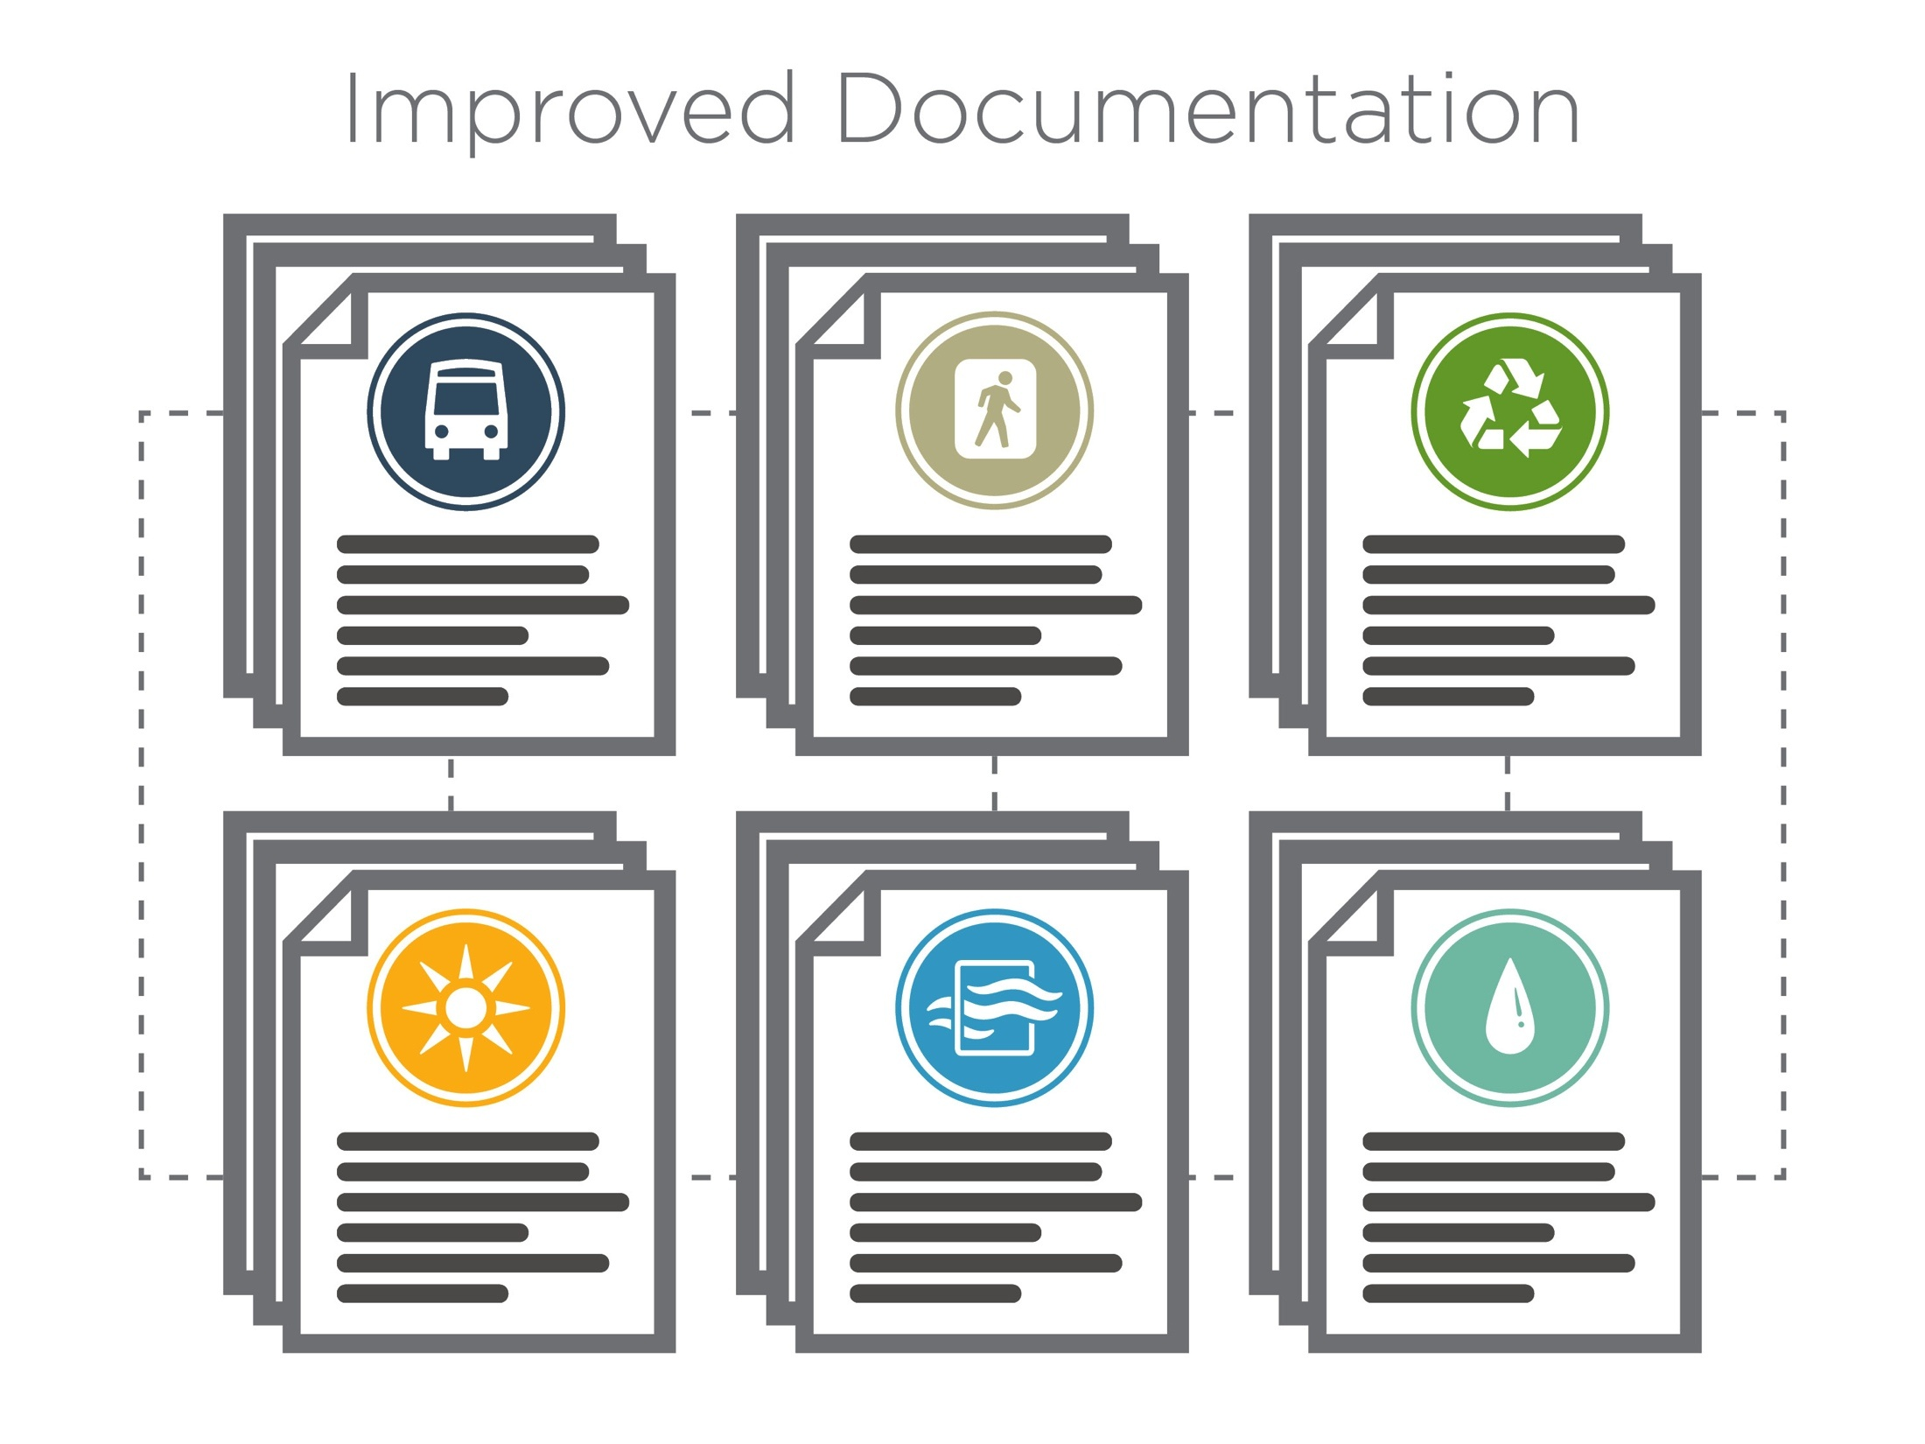
Notes:
Improved Documentation is the thing about LEED v4.
Since projects should spend their time achieving credits, rather than documenting them, USGBC focused a lot of their efforts on simplifying and streamlining the work for project teams.
- More accommodating of uniqueness on a project
- Specifically focus on how forms have been brought into alignment
From over 3000 forms for LEED 2009 (that includes all versions of the 2009 forms) to 121 total for all BD+C, ID+C, and EBOM rating systems in v4 – LEED has considerably reduced paper work.
LEED v4 is more than just credits and requirements. This version also took a deeper look at the tools and resources that support the program. They gathered feedback from the marketplace on what’s working and what’s not the so improvements could be made that help these tools operate as designed.

Slide 19
Intuitive
Transparent
Simple
Flexible
Industry-specific
Notes:
Here are some examples of improvements with respect to LEED documentation
Intuitive: quickly able to understand documentation requirements.
Transparent: Full understanding of why things are being asked for, how they’re calculated.
Simple: Critical information that is easy to provide.
Flexible: Information can be provided by any type of project and allows for different ways to meet intent. For example projects may submit information the same format they have already prepared so that there is no extra work for LEED Documentation
Industry-specific: Focus on information created during a typical design and operations process.

Slide 20
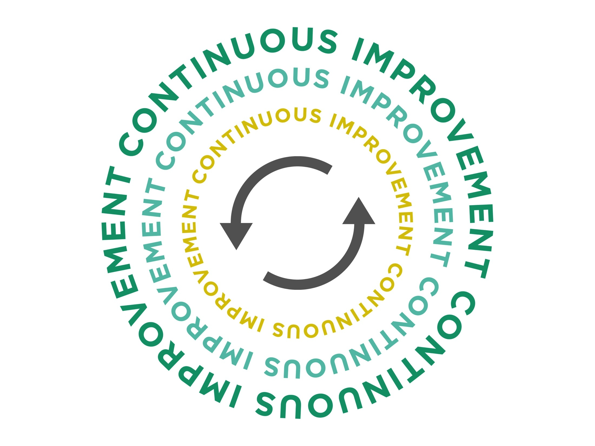
Notes:
It’s a continuous improvement…as LEED continues the mission of USGBC to transform the industry
To summarize:
We’ve shared the development process of LEED v4 to recognize not just how it came to be
By understanding LEED v4’s goals and the rationale behind the point allocations, teams can see how the rating system is designed to maximize outcomes.
We then moved on to explore the flexibility of the rating system. This included the global reach of LEED, the adaptations that reach 21 different project types, and the improved alignment.

Slide 21
Section Quiz
Review
Evolutionary Characteristics of LEED
Notes:
Alright folks…let’s get to a quick and short review
You will notice that we have added a few questions after each section. This is just a sample…you should take the section wise quizzes loaded on your on-demand account after revising the section content for each meeting or module. We have approximately 50+ questions with answer explanations. Even if you answer a question right – I would recommend you to look at the explanation which includes an analysis of other answer choices, other scenarios and tips.

Slide 22
?
Question:
Which of the following represent LEED’s system goals or the impact categories?
Climate Change
Human Health and Well-Being
Water Resources
Biodiversity
Material Resources
Greener Economy
Community
All of the above
Answer
Notes:
Question:
Which of the following represent LEED’s system goals or the impact categories? Or another way of asking this would be “A LEED Certified project would have a positive affect on which of the following?
Climate Change
Human Health and Well-Being
Water Resources
Biodiversity
Material Resources
Greener Economy
Community
Answer – all of the above. For the actual exam – you will be given other choices that look identical and prompt you to choose multiple correct answers like choose 2, or 3.
TIP: The Question would always say “Select 2, or 3” . For Single answer questions – it won't say anything.
Another TIP: One way to distinguish multiple answer choice questions from multiple questions is by checking whether answer choices are “radio-buttons” or “check-boxes”. Radio button would mean..only 1 answer. Check boxes would mean multiple answers. The computer program would not let the user select more answers than required. An error message would pop-up

Slide 23
?
Question:
What are the 3 association factors USGBC used to measure and scale LEED credit outcome?
Relative efficacy
Benefit Duration
Controllability of effect
Energy Efficiency
Health and Human Comfort
Answer
Notes:
What are the 3 association factors USGBC used to measure and scale LEED credit outcome to an impact category?
Correct answers – 1,2,3
These system goals as a basis, USGBC went through a process of evaluating credit outcomes and assigning them a point value accordingly.
USGBC used 3 association factors – Relative efficacy – Benefit Duration and Controllability of effect to measure and scale credit outcome to given impact categories that we looked at in the previous question.

Slide 24
?
Question:
How does LEED address Global Adaptability. Select (3)?
Integrated universal language
ACPs
LEED International Roundtable
More Reference Standards
Enhanced Performance
Answer
Notes:
How does LEED address Global Adaptability. Select (3)?
Correct answers – 1,2,3
Answers are Integrated universal language, ACPs or Alternate Compliance Paths and LEED International Roundtable. Let’s look at them in detail
Integrated universal language - LEED v4 provides global consistency for projects through integrated universal language. It is more globally aligned by including international standards and recognizing local solutions. It also includes IP and SI units for convenience.
Alternate Compliance Paths - It includes supporting tools and resources that address specific issues for projects outside the U.S. ACPs are addressed through the LEED reference guide and LEED Online.
LEED International Roundtable - LEED v4 is a baseline upon which more regionally specific solutions can be developed in collaboration with the LEED International Roundtable.

Slide 25
?
Question:
Which of the following are drivers behind 21 adaptations under LEED? Choose (3)?
To spur market transformation
To make LEED easier for new market types
To consider the unique needs and challenges of specific space types
Regulatory requirements
International Round Table
Answer
Notes:
More adaptations will help spur market transformation more effectively.
Correct answers – 1,3,4
LEED v4 expands upon previous work to address the specific and unique needs of particular space types. These needs might be driven by occupants a facility serves, regulatory requirements, or unique resource needs. By recognizing the unique needs of specific space types LEED removes barriers, moving us closer to market transformation.
Each of these market sectors have unique needs and adaptations to the rating systems allows LEED to appropriately address those needs.
The goal was not to make LEED easier for new market types but to take into consideration the unique needs and challenges

Slide 26
?
Question:
What are some examples of improved LEED Documentation? Select 3
Simple
Flexible
Industry-specific
Interactive
Global Adaptability
Answer
Notes:
What are some examples of improved LEED Documentation or In which of the following ways LEED Documentation has improved from previous versions? Choose 3
The correct answers are simple, flexible and industry specific. Other 2 choices are to trick you. LEED online forms are sometimes interactive but it’s been a feature in previous versions too. Global adaptability is a feature of LEED v4 itself not an improvement to LEED v4 documentation.
Let’s look at the answers –
There are 5 improvement to LEED Documentation under V4:
Intuitive: quickly able to understand documentation requirements.
Transparent: Full understanding of why things are being asked for, how they’re calculated.
Simple: Critical information that is easy to provide.
Flexible: Information can be provided by any type of project and allows for different ways to meet intent. For example projects may submit information the same format they have already prepared so that there is no extra work for LEED Documentation
Industry-specific.. Focus on information created during a typical design and operations process.

Slide 27
LEED Process
Evolutionary characteristics of LEED
LEED Certification Process, MPR and Prerequisites
Avenues to achieve LEED goals
Project boundary, LEED boundary and property boundary
Synergies
Notes:
Now that we are familiar with the evolutionary characteristics of LEED and LEED v4 in general – let’s look at the certification process, minimum program requirements, prerequisites and credits for projects to get final certification

Slide 28
Online Modules
LEED v4 Process: Certification Process
LEED Certification Process
Registration
Application
Preliminary review
Prelim review response
Final review
Accept or appeal
Appeal review
LEED Certification
Notes:
The Certification process begins with Project Registration. This is even before the pre-design meetings. Final Certification occurs after the project is built.

Slide 29
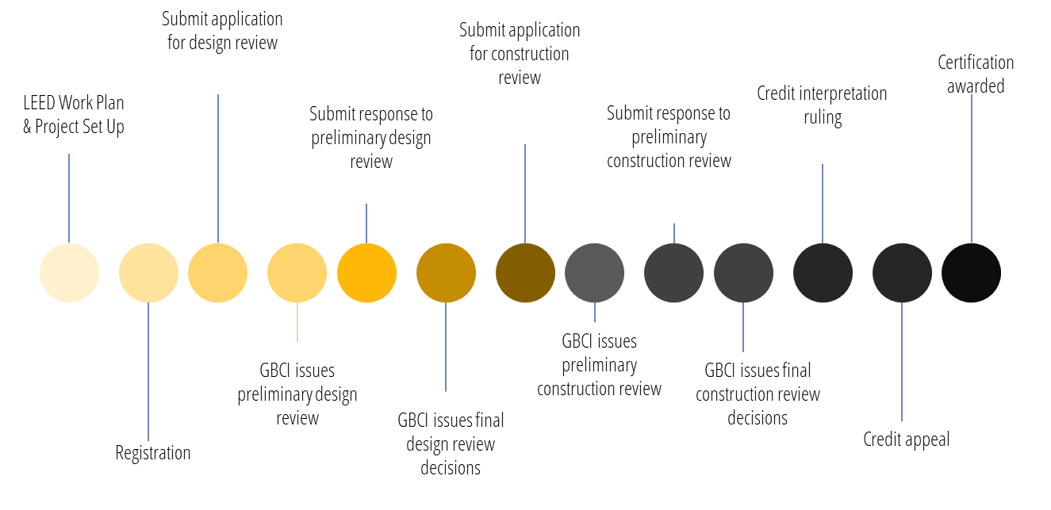
Online Modules
LEED v4 Process: Phases of Certification
Notes:
Once we understand the LEED process, we will be able to help our project in San Antonio get started with LEED. This is a more detailed process chart you see here.
The process begins when the owner selects the rating system and registers the project. The project is then designed to meet the requirements for all prerequisites and for the credits the team has chosen to pursue. After documentation has been submitted for certification, a project goes through preliminary and final reviews. The preliminary review provides technical advice on credits that require additional work for achievement, and the final review contains the project’s final score and certification level. The decision can be appealed if a team believes additional consideration is warranted.
This slide shows a detailed way to look at the phases of the certification process.

Slide 30
Credit Interpretation Requests/Rulings
(CIR)
Notes:
The next thing we need to understand in LEED certification process is CIR…Credit Interpretation Requests or Rulings.
Every project is different and sometimes it is difficult for a guide to create “on-fit-for-all” answer. CIR (requests)s are used to clarify a single question the project team may have and can be submitted any time after project registration.
Often the reference guide will not specifically address the issues at hand and more information is needed. To address these issues, GBCI has created the CIR process. The Project Credit Interpretation Ruling (Project CIR) process is designed to allow Project Teams to obtain technical guidance on how LEED requirements including Minimum Program Requirements (MPR), Prerequisites, and Credits pertain to their projects
If you have questions about a credit, or are unsure if your design option will count for a specific credit, you can submit a Credit Interpretation Request (CIR) to find out if your design strategy will count for credit points.

Slide 31
Online Modules
LEED v4 Process: LEED Interpretation
Precedent setting
LEED Interpretations are official answers to technical inquiries about implementing LEED on a project.
Published online
Subject to consensus based review
Notes:
Other than CIR there is LEED Interpretations which could get confused with CIR. LEED Interpretations are official answers to technical inquiries about implementing LEED on a project. They help multiple projects. They help project teams understand how their projects can meet LEED requirements and provide clarity on existing options.
They are Precedent-setting: LEED Interpretations are to be used by any project certifying under an applicable rating system. All project teams are required to adhere to all LEED Interpretations posted before their registration date. This also applies to other addenda. Adherence to rulings posted after a project registers is optional, but strongly encouraged.
They are Published online: LEED Interpretations will be published in a searchable database on usgbc.org.
They are Subject to consensus-based review: LEED Interpretations undergo review by USGBC member-selected volunteer LEED committees.
This could be part of guide
LEED Interpretations are not an avenue for making significant changes or new requirements to the LEED rating system. LEED Interpretations are also not the intended path for fixing errors in the LEED rating systems and reference guides. USGBC publishes corrections (also called addenda) to address those issues
Projects may use the searchable database found at http://www.usgbc.org/leed-interpretations to look for relevant LEED Interpretations. Alternatively, projects may access relevant LEED Interpretations directly from a specific credit in the Credit Library, under the Interpretations tab, for example - http://www.usgbc.org/node/1731178?view=interpretations

Slide 32
“LEED Interpretations are similar to Project CIRs but they are precedent setting as the results can be applied to all future LEED projects”
USGBC
Difference between a LEED Interpretation and a Project Credit Interpretation Ruling (CIR) ?
Notes:
What is the difference between a LEED Interpretation and a Project Credit Interpretation Ruling (CIR) ?
LEED Interpretations are similar to Project CIRs but they are precedent setting as the results can be applied to all future LEED projects.
This type of formal inquiry is relevant to many projects. These are examples of inquires that, after receiving a Project CIR, would also result in a LEED interpretation if the project team opted into the LEED-interpretations process.

Slide 33
?
Question:
Where do you register your project?
Answer
Notes:
Now that we are familiar with the LEED process, CIR and interpretations- Where do you register your project..?

Slide 34
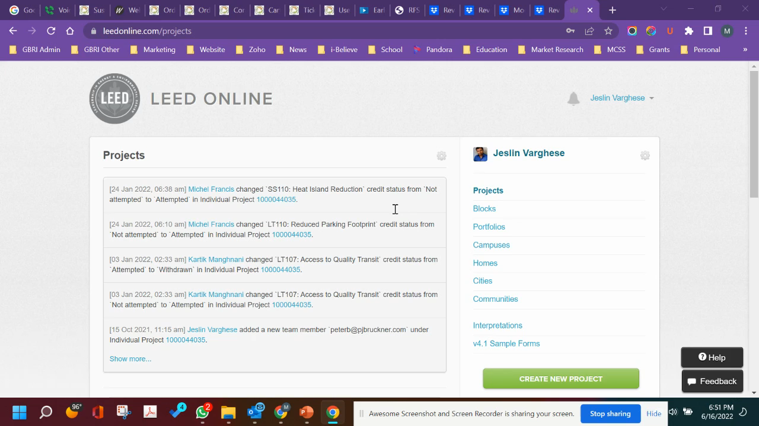
Online Modules
LEED v4 Process: LEED Online
Notes:
LEED online is the answer
LEED online is an online portal that LEED project use through out the project lifecycle. This is the place where projects register for LEED certification. In other words, LEED registration is the 1st step towards certification. Every registered LEED project will have access to LEED online. This is the place where you can invite project team members, assign them roles, submit the project for GBCI review, pay your fees, etc.
We will explore this later today.

Slide 35




Online Modules
LEED v4 Process: LEED Project Administrator
• Invite team members to LEED Online
• Assign team members to credits in LEED Online
• Submit the project application to GBCI for review
1
2
3
Notes:
The LEED project must choose a LEED Project Administrator to perform the
following tasks:
• Invite team members such as Designers, Engineers and Contractors to LEED Online
• Assign team members to credits in LEED Online. Contractors will be assigned construction credits or contractor responsible credits. Contractors will fill-up the required LEED online form, upload relevant documentation. The LEED Administrator will review the documentation and
• Submit the project application to GBCI for review
Usually, the LEED Administrator is a sustainability consultant, owner representative or a member of the design team.
Note that once you join a project via LEED online – you enjoy equal rights as the LEED project adminin under LEED v4

Slide 36
Online Modules
LEED v4 Process: Credits, Prerequisites, MPRs & CIRs
Project must satisfy three requirements for certification:
Minimum project requirement (MPR)
Pre-requisites
Minimum credit for desired certification level
Incase of any clarification about any credit:
Credit Interpretation Ruling (CIR)
For full details and up-to-date information on the MPRs of the rating systems visit:
http://www.usgbc.org/DisplayPage.aspx?CMSPageID=2102
Notes:
To sum up the last few slides, a project registered on LEED online MUST fulfill the:
-Minimum project requirement or MPRs
- Satisfy or meet All Pre-requisites in each category
-Earn the Minimum credit for desired certification level (certified, silver, gold, platinum etc.)
Incase of any clarification about any credit you should submit a Credit Interpretation Rulings (CIR).
So I hope everything is clear until now.

Slide 37
?
Q: Which
Rating system
Fits ours the
most?
Answer:
Notes:
Question – Which system fits our project the most.
Let’s see..

Slide 38
60/40 Rule
PERCENTAGE OF FLOOR AREA APPROPRIATE FOR
A PARTICULAR RATING SYSTEM
40%
SHOULD NOT USE
THAT RATING SYSTEM
40%-60%
PROJECT’S TEAM
CHOICE
60% SHOULD USE THAT RATING
SYSTEM
Notes:
Let’s look at a method to choose between rating systems
The following 40/60 rule provides guidance for making a decision when several rating systems appear to be appropriate for a project. To use this rule, first assign a rating system to each square foot or square meter of the building. Then, choose the most appropriate rating system based on the resulting percentages.
The entire gross floor area of a LEED project must be certified under a single rating system and is subject to all prerequisites and attempted credits in that rating system, regardless of mixed construction or space usage type.
Projects teams may contact LEED technical customer service in order to get assistance with existing LEED guidance or processes. For example – when a project team is not sure between two rating systems or when a project building that originally registered under one rating system wants to change rating system due to design change

Slide 39

Thank You!

Slide 40


Please don’t forget to review our course!

Slide 41
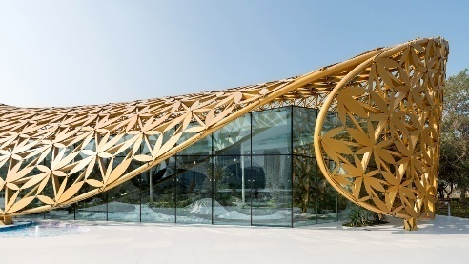

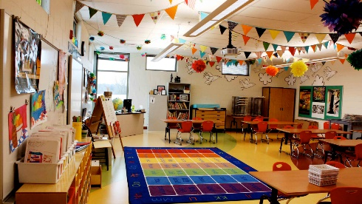



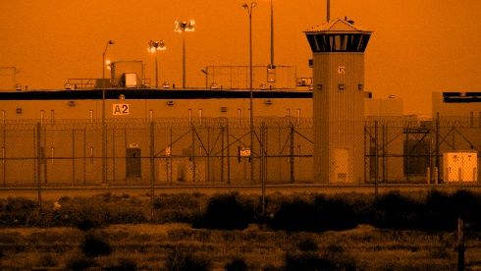
Explore More Courses From GBRIonline.org
Biophilic Design: A Truly Sustainable Design
From ABCs to STEM: Biophilic Design for Schools
Get Well Soon: Biophilic Design for Healthcare
Orange is the new Green: Biophilic Design for Prisons

Slide 42

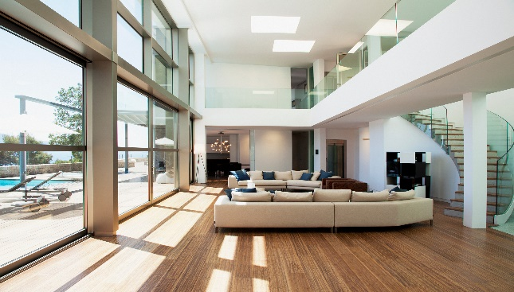

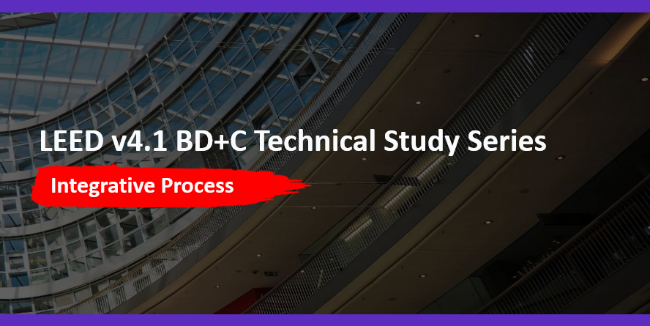
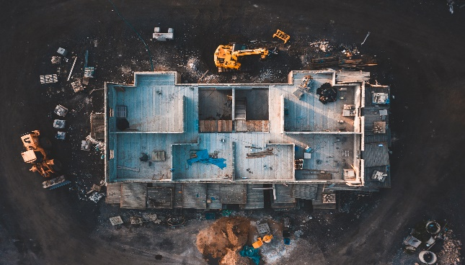
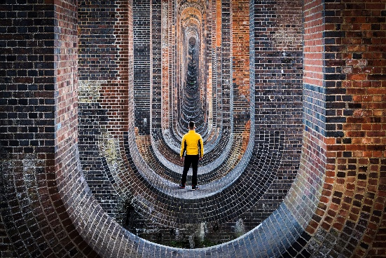

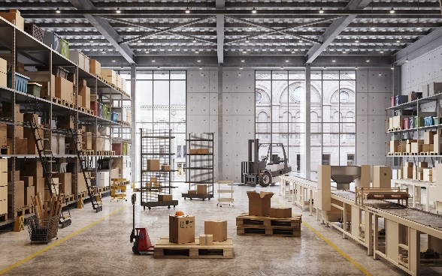
Explore More Courses From GBRIonline.org
The Art of Systems Thinking: Holistic Pathways to Sustainability & Social Impact
Designing with Purpose: Unleashing the Power of Integrative Processes in LEED v4.1
Life-Cycle Impact Reduction: Through the Eyes of LEED BD+C v4.1
Building Green from the Inside Out: EPDs, Raw Material Sourcing, and Material Ingredients in LEED BD+C

Slide 43


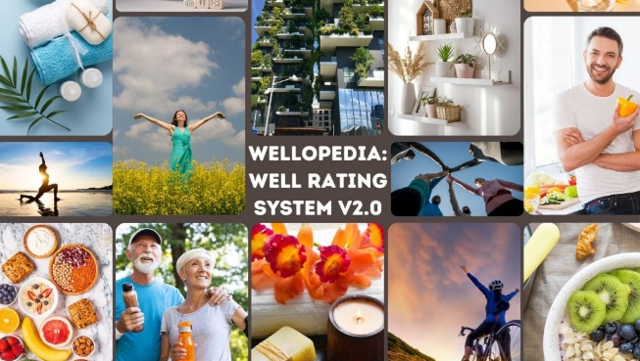

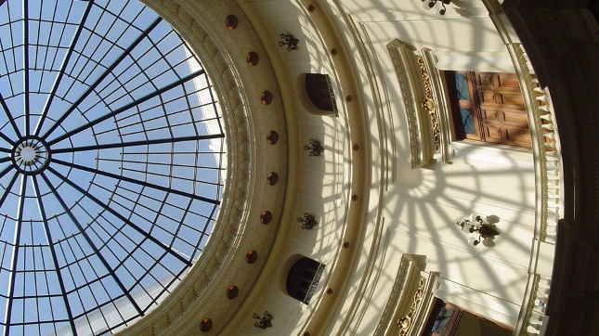
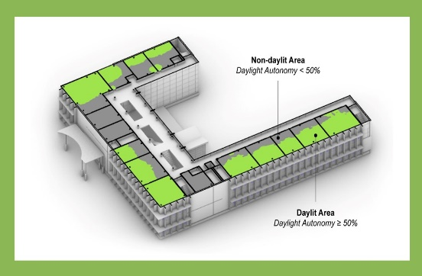
Explore More Courses From GBRIonline.org
I am doing WELL v2. Are You?
WELLopedia v2: The ins and outs of the WELL Building Standard v2
Let There Be Light: An Illuminating Introduction to Daylighting
Daylighting in Green Building Rating Systems: A Focus on LEED and WELL

Slide 44

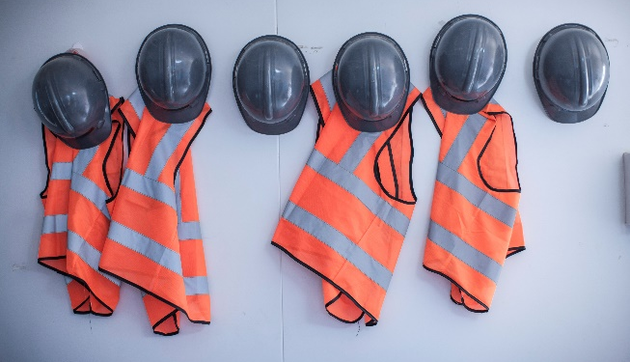




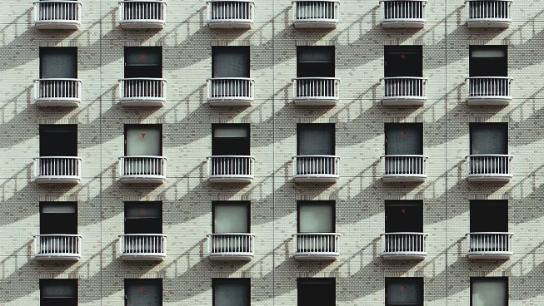

Explore More Courses From GBRIonline.org
Contractor's Corner: Mastering LEED BD+C Waste Management under v4.1
Beyond the Building: Conquering Outdoor Water Conservation within LEED v4.1
Aquatic Alchemy: Unraveling LEED v4.1 Indoor Water Use Reduction & Strategies
Drips to Drops: Strategies and Mastery of LEED v4.1 Process Water Use Credit

Slide 45



Explore More Courses From GBRIonline.org
Biophilic Design: A Truly Sustainable Design
From ABCs to STEM: Biophilic Design for Schools
Get Well Soon: Biophilic Design for Healthcare
Nature’s Marvels: Innovation in Natural Building Design

Slide 46

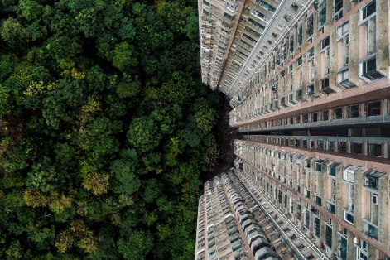
Explore More Courses From GBRIonline.org
Climate Justice – A Multigenerational Global Civil Rights Issue
Climate Change and ESG Workshops
LEED Exam Prep for Green Associates, BD+C and O+M
In-Person Exam Prep in NYC
Nature’s Marvels: Innovation in Natural Building Design
Accelerating Building Decarbonization
WELL AP Exam Prep Quizzes and Mock Exams
WELL AP Exam Prep Study Guide Package

Slide 47

Test Your Green Building IQ on the Kahoot Platform
We've created an interactive, engaging, and informative quiz on Kahoot ON Green Buildings, Climate Change and Decarbonization! This is a fun and fantastic opportunity to test your knowledge, learn something new, and see how you measure up against your peers from around the globe. (Link in the description)
See you on the leaderboard!"

Slide 48
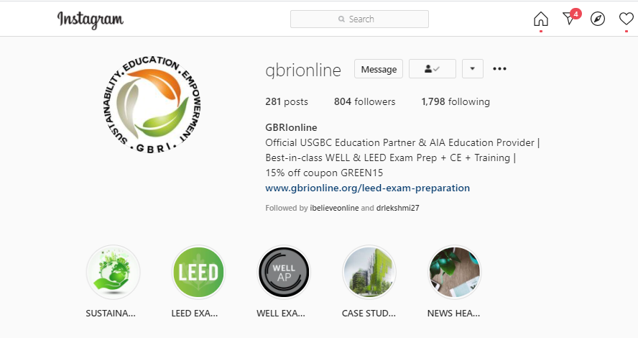
https://www.instagram.com/gbrionline/

Slide 49

Climate Change Song - Bella Ciao - GBRI International Version Collage

